Slide 1
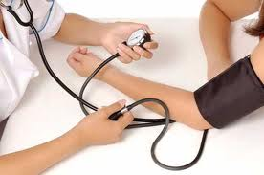
OPPORTUNITIES FOR HIGHER-LEVEL SCHOLARSHIP AND SERVICE IN SERVICE-LEARNING
Sandra Hill &
Paula Griswold
ULM

Slide 2
Presentation Objectives
Describe pedagogical designs for community-based writing and health-related S-L projects
Discuss goals and outcomes for scholarship and service
Examine the potential for higher scholarly inquiry and application in S-L work

Slide 3
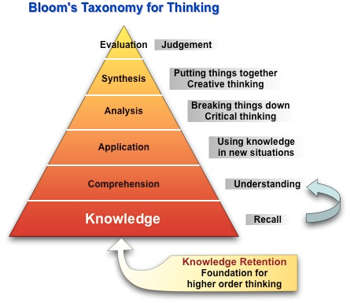

Slide 4
Higher Level Thinking Skills of S-L
Application: | Extract and transfer this knowledge
Analysis: | Categorize, characterize, compare and contrast
Synthesis: | Collating and creating
Evaluation: | Prioritization, relevancy and judgment

Slide 5
Our Goals in S-L Projects
Analysis of civic and community problems
Application of higher-level skill sets to real-world situations (made complex by virtue of their being real)
Professional document production & communication
Critical reflection & evaluation of community problems and civic responsibility
Participation with community (synthesize skills & action)
Opportunity for another source of learning from community

Slide 6
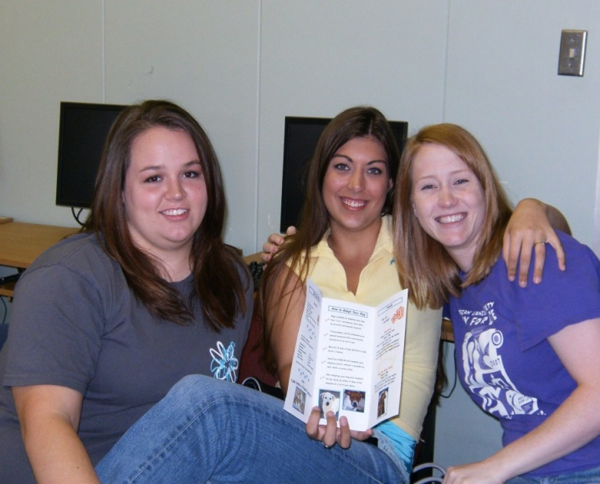
S-L Benefits Service-learning is ….
a predictor of increased leadership skills
a signifier of personal efficacy, of “greater
self-knowledge, spiritual growth, and finding
reward in helping others”
a predictor of feeling connected to the
community, peers and teachers
Eyler, J. & Giles, D. (1999). Where’s the Service in Service-Learning? San Francisco: Jossey-Bass, pp. 55-56

Slide 7
S-L students say that…
they learn more and are more motivated in service-learning classes than in regular classes
they remember and can use the material they learn in the community context
the work is powerful because it is situated in personal relationships and in doing something that makes a difference in people’s lives.
Eyler, J. & Giles, D. (1999). Where’s the Service in Service-Learning? San Francisco: Jossey-Bass, pp. 55-56

Slide 8
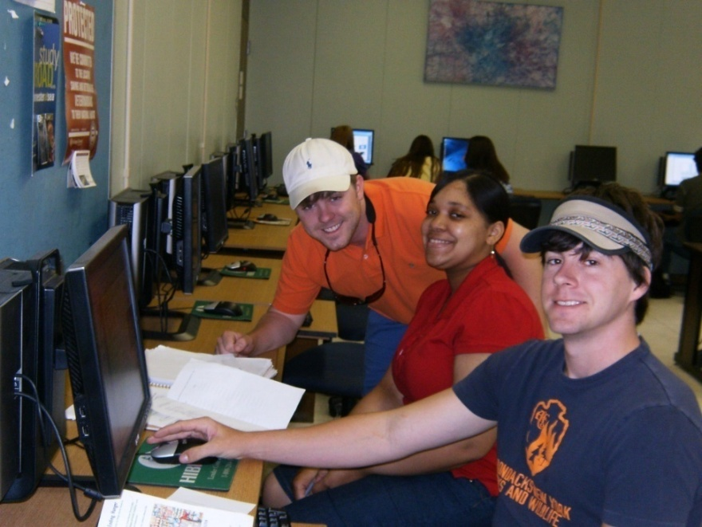
In Professional Writing …
application of academic principles of technical writing
to non-academic situations
management of real-world
projects across time
confrontation of real-world
problems
connections to professionals in the
Community
Bowden, M. and Scott, J.B. (2003). Service-Learning in Technical and Professional Communication. The Allyn and Bacon Series in Technical Communication. NewYork: Longman, pp. 13-17.

Slide 9
In Health Studies …
service-learning is a predictor of increased tolerance
students reported a positive view of the people they worked with
students felt that the people they worked with were “like me”
Eyler, J. & Giles, D. (1999). Where’s the Service in Service-Learning? San Francisco: Jossey-Bass, p.54

Slide 10
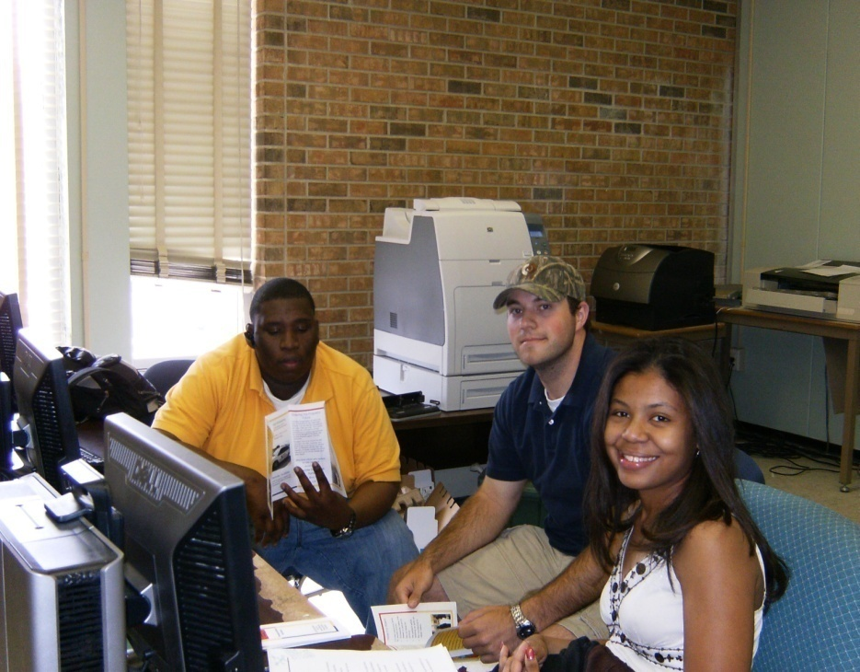
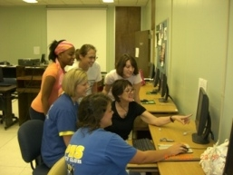
Professional Writing Projects

Slide 11
Project Goals
Participate in the civic life of the community
understand the needs of others different from oneself
Practice professional writing and communication skills in a real-world setting
Work on a team to produce an effective writing and design product

Slide 12
Sample Projects
PowerPoint – Humane Society – solicit adoptions
PowerPoint – Our House (safe house) – informative presentation
Brochure – BBBS – information & donations for Mentoring Children of Promise Program
Surveys – Ouachita Public Library – user satisfaction surveys

Slide 13
Project Requirements & Skills Applied
***60% of the course grade***
9 assignments:
an email query memo to a non-profit agency of their choice (Application)
an interview and summary of that interview (Analysis & Evaluation)
a team-written planning proposal (Synthesis & Collation)
the team-constructed professional document needed by the agency (Synthesis & Creation)
a progress report (Evaluation)
3 written reflections (Evaluation)

Slide 14
Student Outcomes
Practice in professional communication, oral (interview, project planning and implementation) and written
Experience of the complexities of communication by practicing communication skills within the context of an agency’s real world of work issues and problems (i.e. financial budgets, worker personality conflicts, conflicting instructions for the project work, delayed feedback,etc)
Team writing and team communication and address of problems working in teams

Slide 15
Student Outcomes Cont’d
Multi-tasking various assignments of the course (balancing the service-learning project with other course assignments)
Connection to potential employers
Professional conduct
Discovery of non-profit needs in the community and ways to help
Participation in community activities for betterment of the community
Feeling of “giving back” to the community

Slide 16
Health Studies Projects

Slide 17
Project Goals
help students realize the role of compassion in healthcare and how volunteer community work can help them practice compassion
identify an organized service activity that meets a need in a community
gain a better understanding of course content
understand and deal with the complexity of the practice as well as theory of course content when experienced within a real-world setting
to enhance a greater sense of civic responsibility

Slide 18
Project – Victory Garden
Planted vegetable garden for Veterans Administration Home
Students researched roles, scope and mission of agency
Students volunteered for a minimum of 10 hours
Instructor and community partner designed activities
Projects were performed by student group (in other projects, individual participation)
Students kept service logs
Students wrote reflection papers at the end of the project

Slide 19
Project Requirements & Skills Applied
Work with patients with health issues (Application)
Plan the garden layout with help VA residents (Synthesis – collation and creating)
Work with VA residents to plant the garden at their VA Residence (Application -- working with health-related motor skills issues in context of real-world issues)
Practice skills of patient handling (Analysis --health-related disabilities; Evaluation of proper procedure)
Write reflection paper at end of project (Evaluation)

Slide 20
Students Preparing Garden Area

Slide 21
Student Outcomes
Recognition of need to continue to volunteer
Recommendation that every college student should do service-learning
Indication that helping others and giving back brought a feeling of pride
Feeling of accomplishment, fulfillment, and deeper appreciation for real-life learning

Slide 22
Student Outcomes Cont’d
Practice of higher-level skills of analysis and practice of course material made possible by a real-world context
Professional conduct
Enhancement of civic engagement and realization that they can influence a life and make a difference in their community
Experience working with populations of people different from themselves

Slide 23
Students Working Together Planting Garden

Slide 24
Community Outcomes
Documentation needs served at no cost
Relationship community and local university
Opportunities for local professionals to teach local students about the organization
Introduction to potential hires
Exposure of the organization’s work to more people, thus potential increase of volunteers and funding

Slide 25
Community Outcomes Cont’d
New and refreshing ideas from students
Positive image of young men and women in their community
Technology skills of the students
Opportunity to build a relationship with the university
Willingness of students to help out in the community

Slide 26
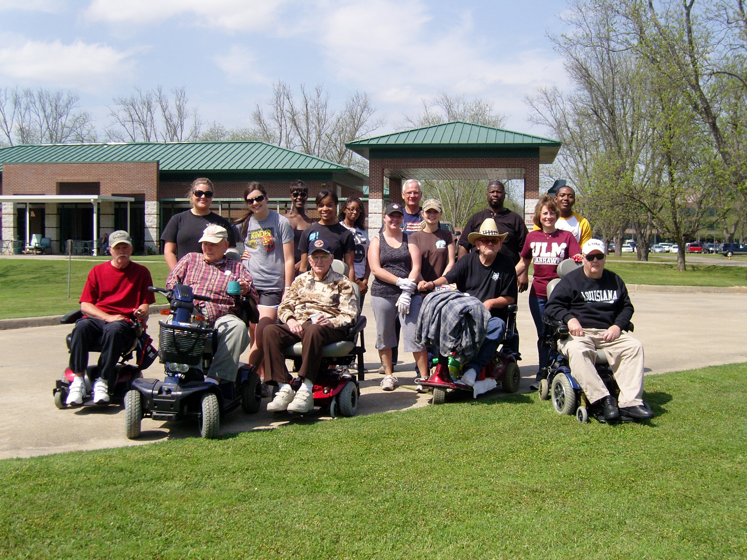

Slide 27
Looking Ahead
Partnering with local agencies/organizations for grants
Involving graduate students in service-learning
“Fishing with the Veterans” --future Veterans Home projects
Producing health-related brochure for placement in community health clinics
Collaborating, professional writing & health studies, on the design and editing of brochures

Slide 28
Sources
Bowden, M. and Scott, J.B. (2003). Service-Learning in Technical and Professional Communication. The Allyn and Bacon Series in Technical Communication. NewYork: Longman.
Colby, A., Ehrlich, T., Beaumont, E., & Stephens, J. (2003). Educating Citizens:Preparing America’s Undergraduates For lives of Moral and Civic Responsibility. San Francisco: Jossey-Bass.
Eyler, J. & Giles, D. (1999). Where’s the Service in Service-Learning? San Francisco: Jossey-Bass.
Higher order thinking. Retrieved April 10, 2012 from http://www.cant-think.com/HigherOrderThinkingSkills.html

