Slide 1
Service-Learning Projects Are a Great Fit for Marketing Courses
Dr. William T. Neese
Nicholls State University

Slide 2
What is Service-Learning and Why is it Important?
The development of students who value being productive members of their communities by donating time to help others with a need but without the expertise or resources necessary to accomplish the task on their own is an important goal of higher education.

Slide 3
Defining Service-Learning
“One of the greatest challenges in the study of service-learning is the absence of a common, universally accepted definition of the term.” (Furco 2003, p. 13)
“All service-learning activities, regardless of their overall design and programmatic goals, involve a complex interaction of students, service activities, curricular content, and learning outcomes… Indeed, no two service-learning activities are alike.” (Furco 2003, p. 13)

Slide 4
Defining Service-Learning
According to Bringle and Hatcher (2009, p.38), service-learning is defined as:
“A course or competency-based, credit-bearing [emphasis added] educational experience in which students (a) participate in an organized service activity that meets identified community needs, and (b) reflect on the service activity in such a way as to gain further understanding of course content, a broader appreciation of the discipline, and an enhanced sense of personal values and civic responsibility.”

Slide 5
Defining Service-Learning
However, several definitions of service-learning do not necessarily require the activity to be course-based for credit:
“Service-learning programs emphasize the accomplishment of tasks which meet human needs in combination with conscious educational growth… They combine needed tasks in the community with intentional learning goals and with conscious reflection and critical analysis.” (Kendall 1990, p.20)

Slide 6
Defining Service-Learning
In a speech delivered at the 1994 Conference of the National Society for Experiential Education in Grand Rapids, Michigan, Kinsley stated:
“So here is a definition: Community Service Learning is an educational process (that word again) that involves students in service experiences with two firm anchors: First their service experience is directly related to academic subject matter; and second, it involves them in making positive contributions to individuals and community institutions.” (Kinsley 1994, p.41)

Slide 7
Defining Service-Learning
Finally, Jacoby (1996, p.5) defines service-learning as:
“A form of experiential education in which students engage in activities that address human and community needs together with structured opportunities intentionally designed to promote student learning and development; service-learning combines service objectives with learning objectives with the intent that the activity change both the recipient and the provider of the service.”

Slide 8
Exhibit One: Factors Necessary for Service-Learning to Occur
Faculty and Student Skill and Motivation
College and University Involvement
Real-Life Community Needs

Slide 9
Service-Learning Channels
There are several channels available to deliver a service-learning project either on- or off-campus:
Course credit specifically designed to fit that particular topic for the entire class, typically a group project.
Independent studies with individualized instruction for one or a few students.
“Non-credit” activity through student organizations such as your campus student chapter of the American Marketing Association (AMA).

Slide 10
Service-Learning Channels
For example, AMA student clubs are evaluated on their community service by judges at the annual International Collegiate Chapters Conference each spring.
Competing student AMA chapters submit a chapter plan describing specific community service projects planned.
The actual results for that chapter are presented to AMA for judging in a chapter report due before the conference.
Must be marketing-related to achieve maximum points.

Slide 11
Service-Learning for Course Credit
This presentation is about integrating service-learning in a course for credit through a marketing research project.
Several authors provide frameworks for incorporating service-learning projects into course requirements (e.g., Brower 2011; Cook 2008; Dixon 2011; Flannery and Pragman 2010; Larson and Drexle 2010; Pless, Maak and Stahl 2011).
One good example is found in Brower (2011), who outlines a flowchart of course development and the delivery process in Figure 1 on page 67.

Slide 12
Service-Learning for Course Credit
It is somewhat difficult to create one comprehensive model for all service-learning projects due to its multidimensional nature.
Service-learning projects that integrate students into communities in other countries will require extensive travel planning, whereas local projects will not as much.
Human subjects research requires Institutional Review Board (IRB) approval, but secondary research, helping low income citizens complete tax forms, or teaching at-risk children basic financial principles does not.

Slide 13
Marketing Defined
“Marketing is the activity, set of institutions, and processes for creating, communicating, delivering, and exchanging offerings that have value for customers, clients, partners, and society at large.” (American Marketing Association 2007):
This views marketing as a broader activity providing long term value to a host of constituency groups rather than narrowly as an exchange of money (short-term) only for the benefit of the shareholder or organization.

Slide 14
Exhibit Two: The Marketing-Mix (4-Ps)
Customer
Product
Price
Promotion
Place

Slide 15
Marketing and Service-Learning
Marketing is a discipline that is particularly well-suited to address community needs through service-learning activity.
Many of the topics commonly discussed in marketing classes (e.g., marketing research, competitive market analysis, or target marketing) relate to needs in the business and nonprofit communities.
However, it is doubtful that larger corporations with in-house marketing research departments need students to conduct business analysis studies.

Slide 16
Marketing and Service-Learning
Nonprofit organizations are mostly managed by people with technical backgrounds in social work, psychology, or nursing, yet they find themselves confronted with a need to be more marketing-oriented in today’s competitive fundraising environment.
Small business owners may have solid marketing knowledge, but may also need data that does not exist at the local level or is too expensive for them to afford.
Many of these organizations have very limited resources, and that’s where service-learning can be extremely useful.

Slide 17
Service-Learning Marketing Research
The process of determining information needs for a variety of marketing decisions, designing a set of activities necessary to gather that information, collecting the data, analyzing it, and reporting the results is marketing research. Marketing research is used to:
Make better marketing decisions.
Identify and correct problems with the marketing-mix.
Better understand customers and competitors.
Determine the value of what the organization offers.

Slide 18
Exhibit Three:
The Marketing Research Process
Define the Research Problem
Plan the Research Design
Determine the Sampling Procedure
Gather the Data
Analyze the Data
Report the Results

Slide 19
Exhibit Four: Using Service-Learning Marketing Research (SLMR) Projects in Class for Credit
(1) Identify the Service-Learning Project
(2) Incorporate Requirements in Course Syllabus
(3) Obtain Human Subjects IRB Approval
(4) Assign Groups
(6) Monitor and Make Adjustments
(7) Evaluate Student Outcomes
(8) Report Results to Community Organization
(9) Publicize Project Internally and Externally
(5) Implement the Project

Slide 20
Step 1: Identify the Service-Learning Project
On-campus service-learning projects can include surveying alumni for the Dean of the College of Business and the Director of the University Foundation;
Evaluating on-campus service providers to identify areas of customer dissatisfaction and service failures (e.g., campus food services);
Surveying customers to determine what their perceptions of the current offerings are and ways to improve that service (e.g., student recreation facilities).

Slide 21
Step 1: Identify the Service-Learning Project
Off-campus projects include a survey of downtown merchants, employees, and customers as part of a Main Street grant initiative; determining demand for a Barnes & Nobles bookstore downtown instead of on-campus; and annual member surveys for a regional tourism promotion agency.
Area businesses and non-profits often initiate contact seeking student help either directly with faculty members or through an administrator they personally know.
A proactive approach is for faculty to become involved with community organizations by serving on Boards of Directors, or other participation in community activity.

Slide 22
Step 2: Include Requirements in Syllabus
Some SLMR projects are identified and planned well ahead of the academic period, and can be incorporated into the course syllabus before the semester begins.
However, worthy SLMR projects sometimes materialize after a semester has begun yet early enough to still be a viable class activity.
One way to handle this potentiality is to incorporate a generic group project in the syllabus with details to follow, making it clear at the beginning of class that a client-sponsored SLMR project is one possibility.

Slide 23
Step 3: Obtain Human Subjects IRB Approval
Class assignments that include surveying human subjects require approval by the university Institutional Review Board (IRB), which means the faculty member administering the SLMR project must submit required documents in a timely manner for the IRB process.
Subjects may want to ask questions to better understand the study’s purpose and value, so contact information for the instructor and the sponsoring organization must be provided on the survey cover sheet for every respondent.
Participants must be given the opportunity to withdraw from the survey at any time without penalty.

Slide 24
Step 3: Obtain Human Subjects IRB Approval
IRBs may view students as subjects in SLMR studies and require signed informed consent forms for each.
Students risk a bad grade for non-participation or a rude rejection by someone refusing participation.
The instructor can meet IRB standards by making students aware of project details prior to drop/add ending.
Alternative projects and whether the class is required or an elective might also be considered for IRB approval.

Slide 25
Step 3: Obtain Human Subjects IRB Approval
IRBs are strict concerning approval of studies involving biomedical procedures, personality profiles, and behavior modification programs often found in nursing, exercise science, or childhood education research.
The average SLMR survey causes no discomfort, harassment, physical damage or wounds, invasion of privacy, or threat to the dignity of subjects.
Full review by all members of the IRB is not necessary for most SLMR projects. Expedited reviews only require input from one, two or three IRB members.

Slide 26
Step 4: Assign Groups
Now that IRB approval has been obtained, will students be assigned to a group by the instructor or will they be allowed to pick their own team members?
How large will each group be?
How will underperforming group members be handled? One method that can be used is to enable a group to “fire” a member for just cause; an alternative is to require team members to evaluate each other at the end of the project.
What grading policies will be applied?

Slide 27
Step 5: Implement the SLMR Project
Clear expectations for implementation must be established up-front. Some clients have problems determining or explaining their research needs.
Clients inexperienced with college students might anticipate an unrealistic level of performance.
Clients may not share all information about their operations.
The instructor might have problems setting goals without knowledge of the inner workings of that organization.

Slide 28
Step 5: Implement the SLMR Project
Meeting with busy clients and collecting and analyzing data in a timely manner can present problems.
Lack of feedback due to the semester ending reduces benefits students receive from the SLMR experience, which is a main point for the activity to begin with.
SLMR instructions must be very specific in terms of required tasks and timeframe (see Syllabus Example).

Slide 29
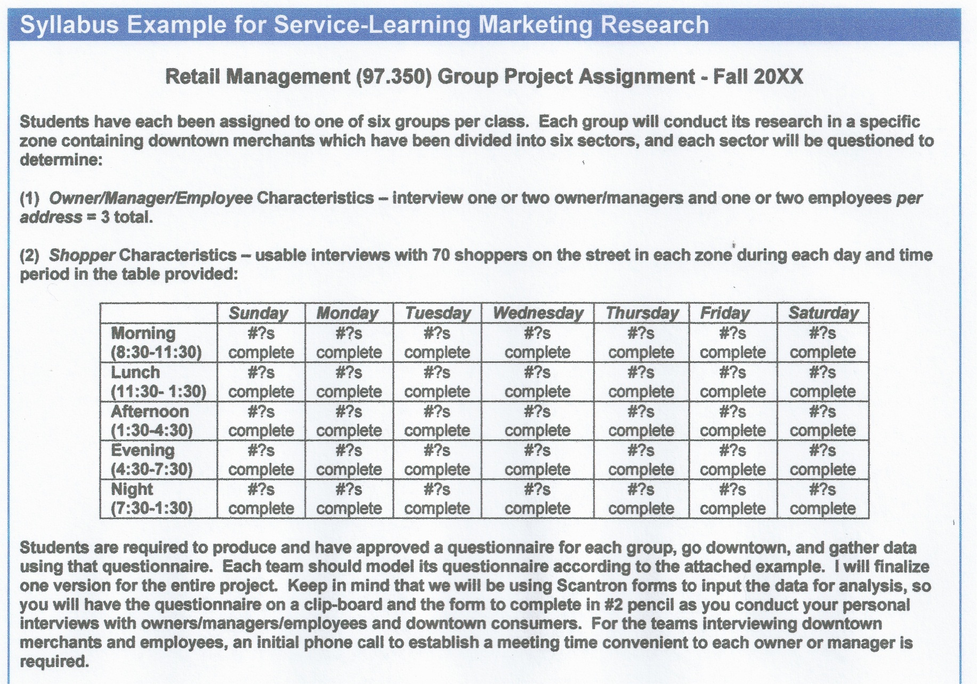

Slide 30
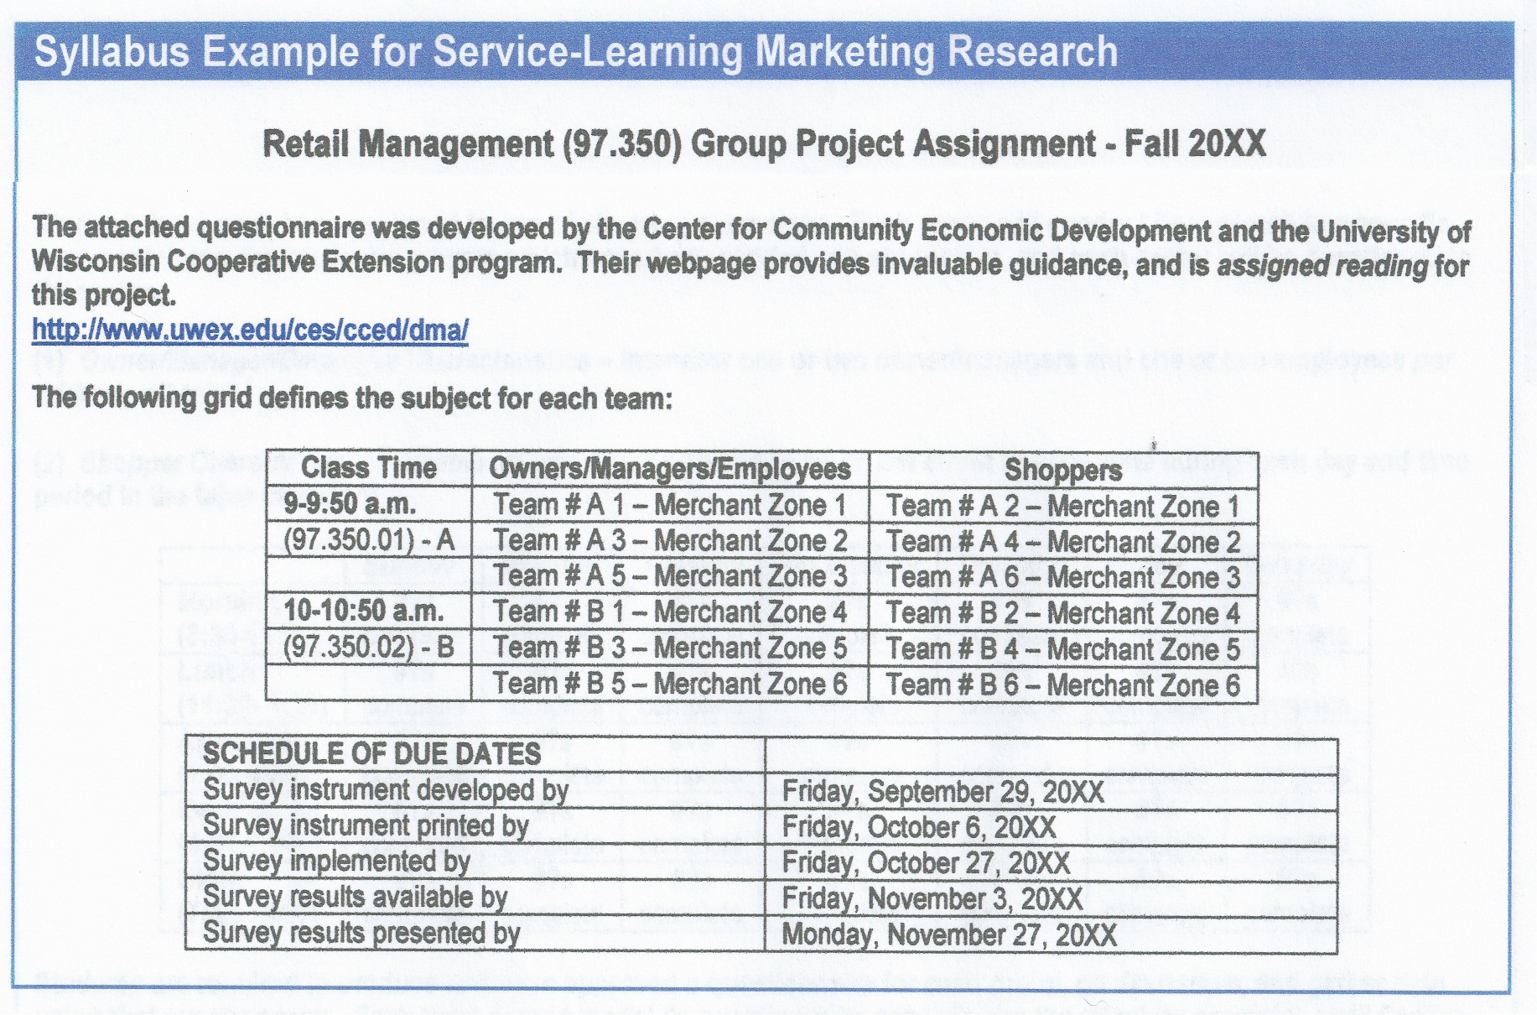

Slide 31
Step 6: Monitor and Make Adjustments
Mid-project adjustments may be necessary. For example:
Two senior Honors students were hand-picked to conduct an alumni survey for the University Foundation.
An SLMR description and detailed timeline for completion had been jointly developed by the faculty member, Foundation Executive Director, and both students as required for the official paperwork to approve the independent studies.

Slide 32
Step 6: Monitor and Make Adjustments
Unfortunately, the students did not begin the survey on time.
The Executive Director requested preliminary feedback and found out the questionnaire mail-out was three weeks past due.
The faculty advisor did not expect a need for tight control with these Honors seniors.
Closer monitoring would have prevented this problem.

Slide 33
Step 7: Evaluate Student Outcomes
Several methods for grading service-learning projects are discussed in the literature (e.g., written reflective narratives).
Exams are another viable grading method.
Part of the Main Street assignment previously illustrated included reading several articles related to the history and progress of Main Street programs across America, familiarity with the website used to develop the three questionnaires adapted for that survey, plus knowing the content of each questionnaire.
One examination was dedicated to this material.

Slide 34
Step 7: Evaluate Student Outcomes
Group performance had two dimensions: total group output and individual member output.
Each group was assigned a specific section of town and given a quota for completed questionnaires, and the grade for that group was based on what percentage of the quota was met.
Each questionnaire required a signature by the student administering it; individual evaluations were made by the instructor at the end of the project based on these signatures (see Sample Group and Individual Evaluation sheet).
Finally, team member evaluation forms were required from all students before their final grade was distributed.

Slide 35
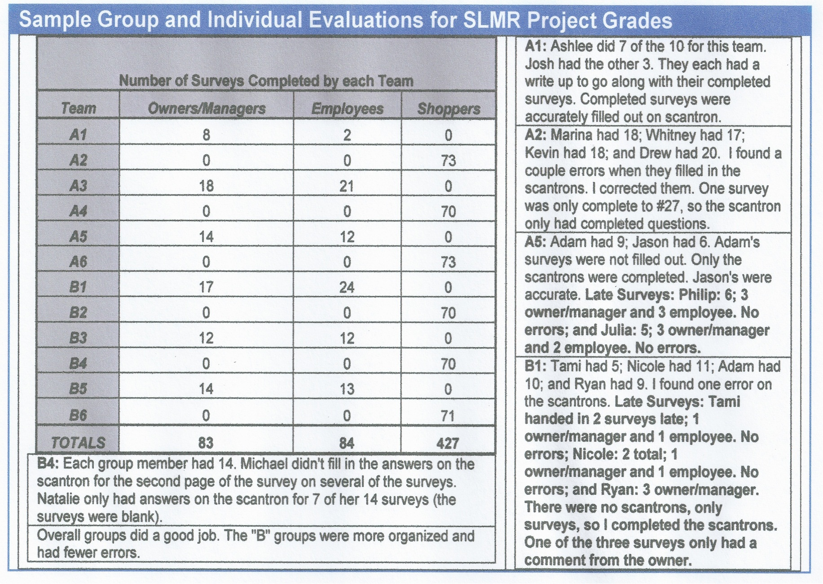

Slide 36
Step 8: Report Results to the “Client”
Results must be presented to the client in one of several ways:
The faculty member writes a report and gives it to the organization.
The faculty member reports the results to the Executive Director and Board of Directors.
Students present their results in a Power Point slide show.

Slide 37
Step 8: Report Results to the “Client”
A round-table discussion involves the faculty member, students, and key personnel from the client organization.
Video tapes of focus groups are given to the client.
Quantitative data is furnished to the client in electronic form.
The faculty member should stress the need for confidentiality to the student participants.

Slide 38
Step 9: Publicize the SLMR Project
Finally, publicize the SLMR work to various constituency groups (on and off campus) using the following methods:
The client writes a press release to the local newspaper.
The faculty member and/or client writes an article or editorial letter featuring details of the work.
The client thanks the faculty member and students in an internal newsletter regularly distributed to members of the organization (e.g., downtown retail members of the local Main Street nonprofit).

Slide 39
Step 9: Publicize the SLMR Project
The client discusses the work done by students in an interview on a local radio or TV show.
A summary of the work is featured in an appropriate section on the client’s or university’s website.
Students present their analysis during research week in a campus-wide poster session.
Students and instructor publish a paper together about the SLMR project.

Slide 40
Conclusion
According to Joseph et al. (2007), “students are, in fact, interested in community service, and attitudes toward course work that offers hands-on or real world applicability are generally positive (p.167).”
Mottner (2010) reports that students in her study ranked service-learning as most important for learning out of a portfolio of six pedagogical tools, including cases, guest lecturers, textbooks, exams, and other readings.
Well done SLMR projects are productive pedagogical tools that enhance student learning and help demonstrate the value of higher education to the community.

Slide 41
References
Bringle, R.G. & Hatcher, J.A. (2009). Innovative Practices in Service Learning and Curricular Engagement. In L. Sandmann, A. Jaeger & C. Thornton (Eds.), New Directions in Community Engagement, 37-46. San Francisco, CA: Jossey-Bass.
Brower, H.H. (2011). Sustainable Development through Service Learning: A Pedagogical Framework and Case Example in a Third World Context. Academy of Management Learning & Education, 10(1), 58-76.
Cook, S.J. (2008). Integrating Service Learning into an Advertising/Promotions Classroom. Allied Academies International Conference: Proceedings of the Academy of Marketing Studies (AMS), 13(2), 4-6.
Dixon, G. (2011). Service Learning and Integrated, Collaborative Project Management. Project Management Journal, 42(1), 42-58.
Flannery, B.L. & Pragman, C.H. (2010). Service-Learning and Integrated Course Redesign. Journal of Management Education, 34(1), 11-38.
Furco, A. (2003). Issues of Definition and Program Diversity in the Study of Service-Learning. In S.H. Billig & A.S. Waterman (Eds.), Studying Service-Learning: Innovations in Education Research Methodology, 13-34. L. Erlbaum Associates: eBook.
Jacoby, B. (1996). Service-Learning in Today’s Higher Education. In B. Jacoby (Ed.), Service-Learning in Higher Education, 3-15. San Francisco, CA: Jossey-Bass.
Joseph, M., Stone, G.W., Grantham, K.D. & Harmancioglu, N. (2007). A Preliminary Investigation Assessing Student Perceptions of Service Learning Outcomes, Social Responsibility, Critical Thinking, and Marketable Jobs Skills. Society for Marketing Advances Proceedings, 167-168.
Kendall, J.C. (1990). Combining Service and Learning: An Introduction. In J.C. Kendall and Associates (Eds.), Combining Service and Learning: A Resource Book for Community and Public Service, 1-33. Raleigh, NC: National Society for Internships and Experiential Education.
Kinsley, C.W. (1994). What Is Community Service Learning? Vital Speeches of the Day, 61(2), 40-43.
Larson, E. & Drexle, J.A., Jr. (2010). Project Management in Real Time: A Service-Learning Project. Journal of Management Education, 34(4), 551-573.
Mottner, S. (2010). Service-Learning in a Nonprofit Marketing Course. Journal of Nonprofit & Public Sector Marketing, 22(3), 231-245.
Pless, N.M., Maak, T. & Stahl, G.K. (2011). Developing Responsible Global Leaders through International Service-Learning Programs: The Ulysses Experience. Academy of Management Learning & Education, 10(2), 237-260.

Slide 42
Thanks for attending!

