Slide 1
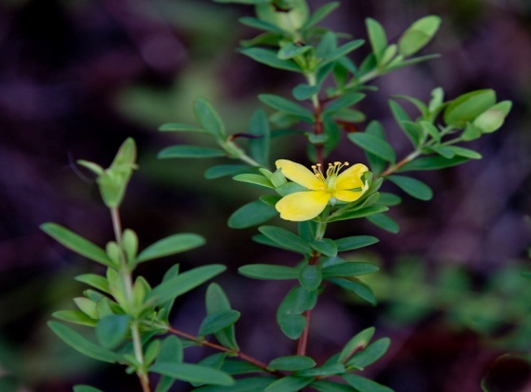
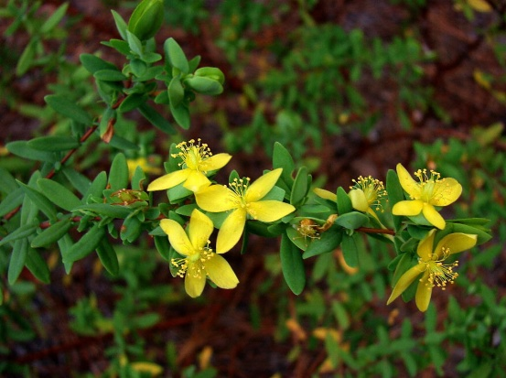
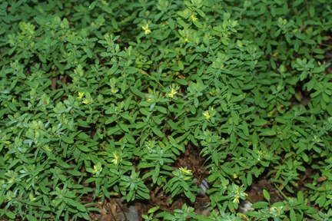
New Antioxidant Prenylated Benzophenone Derivative from Native Louisiana Species of Hypericum hypericoides Shreedu Pradhan, Anjela Manandhar, Cecilia Richmond, Dr. Omar E. Christian McNeese State University Department of Chemistry

Slide 2
Overview
Introduction
Natural products
Hypericum hypericoides
Antioxidant activity
Experimental
Extraction and Isolation
Results and Discussion
Structure Elucidiation
MTT Assay
Future Work
Acknowledgement

Slide 3
Natural Products a Source of New Drugs
Natural products remain a viable source of inspiration for drug development worldwide.
Since 1940 ~ 75% of all anticancer drugs are natural products, or inspired by natural products.
Newman, D. J. Cragg, G. Natural Products As Sources of New Drugs over the 30 Years from 1981 to 2010. J. Nat. Prod. 2012, Article published on the web
Notes:
Natural products are any chemical compound produced my plants that have biological activity.
With the exception of vaccines and biologically derive metabolites the vast majority of new chemical entities used to treat cancer are natural products derived.

Slide 4
Hypericum hypericoides
Commonly known as St. Andrew’s Cross.
Belongs to the family Clusiaceae that consists of more than 37 genera and over 1600 species.
Genus consist of about 400 species.
Has antioxidant properties.
Exhibits antileukemia, anti-HIV, and anti-cancerous activities.

Slide 5
Oxidation and Cancer
There is a recognized link between oxidative damage and cancer.
Free radical/reactive oxygen species (ROS) are generally responsible for this damage.
Antioxidants can intercept these free radicals/ROS preventing cellular damage.
Notes:
In our body, oxidation is the loss of electron from molecules when they are attacked by free radicals.
Free radicals are uncharged molecules with unpaired electrons in their valence shell. They are produced in our body during various metabolic processes.

Slide 6
Oxidation and Atherosclerosis
Oxidized low density lipoproteins (LDL) products have been implicated as playing an important role in atherosclerosis.
Antioxidants have been proven to inhibit several key intermediates in this process including the lipooxygenase family of enzymes.
b
a
Vessel cross-sections showing (a) early, (b) middle, and (c) late atherosclerotic plaque development.
c
Blockage of the coronary arteries
is the most common cause of
heart attacks. (photos from Human Physiology by Rhoades and Pflanzer 1996.)

Slide 7
Rationale
Isolation and determination of antioxidant potential of the prenylated benzophenones of native Louisiana Hypericum hypericoides.
Hypericum hypericoides

Slide 8
Prenylated Benzophenone Derivatives from the Jamaican Collection of Hypericum hypericoides
R = H epi-Clusianone
R = OH 18-Hydroxy-7-epi-clusianone
R = H Clusianone
R = OH 18-Hydroxyclusianone
R = H Hyperibone K
R = OH 18-Hydroxyhyperibone K
Christian, O. E.; McLean, S.; Reynolds, W. F.; Jacobs, H. Nat. Prod. Comm. 2008, 3, 1781 – 1786

Slide 9
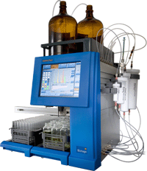
Experimental
Plants collected from Sam Houston Jones State Park, Lake Charles, Louisiana.
Plant material separated in to roots and aerial parts, then sun dried and ground.
Powdered plant material sequentially extracted with hexane, ethyl acetate and methanol
Purification of ethyl acetate extract based
on preliminary TLC and LCMS.

Slide 10
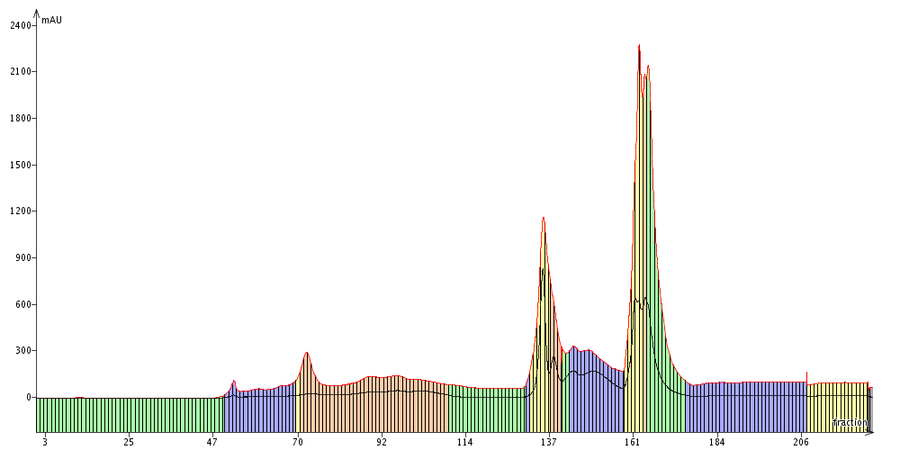
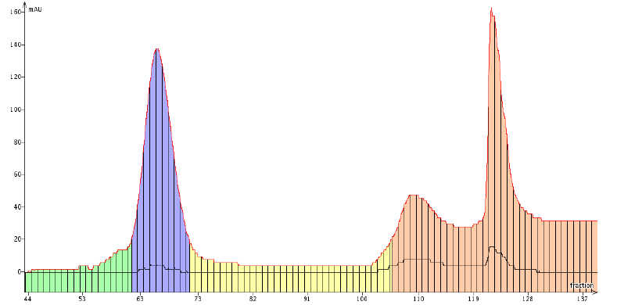
Isolation Scheme
HHAFE crude 6g
B1
B2
B3
B4
B5
B6
B7
B8
B9
B10
B11
B12
B13
238.0 mg
69-76
B4
B4B1
B4B2
B4B3
B4B4
B4B5
B4B6
B4B7
B4B8
B4B9
B4B10
143.8mg
62-70

Slide 11
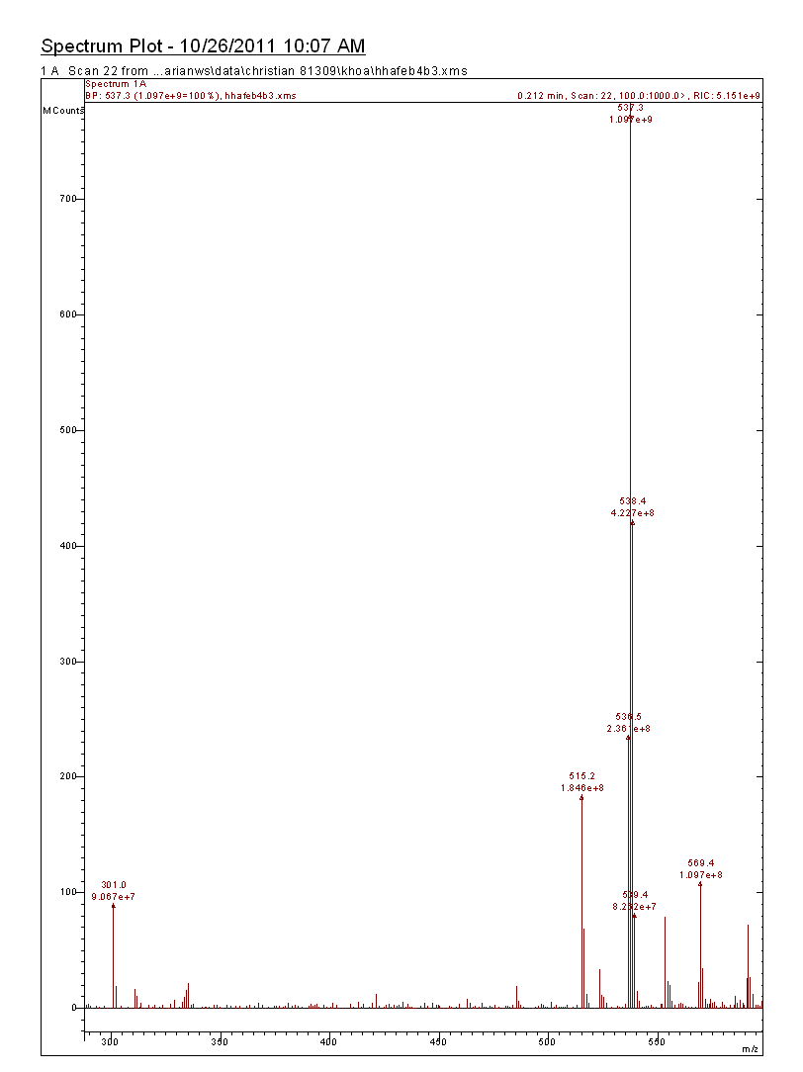
LCMS analysis of HHAFEB4B3 Molecular mass of the new metabolite: 514.2 amu
M+Na = 537.3 amu
M+H=515.2 amu

Slide 12
Results and Discussion
Proton and carbon NMR data suggested that the compound has a general bicyclononane structure observed in other prenylated benzophenones.^{1,2,3}
General bicyclononane structure
The carbon at position C-7 (42.3 ppm) suggests that the R group (prenyl) is equatorial, similar to clusianone.¹
1. Christian, O. E.; McLean, S.; Reynolds, W. F.; Jacobs, H. Nat. Prod. Comm. 2008, 3, 1781 – 1786
2. Henry, G. E.; Raithore, S.; Zang, Y.; Jayaprakasam, B.; Nair, M. G.; Heber, D.; Seeram, N. P. J. Nat. Prod. 2006, 69, 1645 – 1648. (b) Wu, C.-C.; Yen, M.-H.; Yang, S.-C.; Lin, C.-N. J. Nat. Prod. 2008, 71, 1027 – 1031.
3. Ky, K.; Pradhan, S.; Richmond, C.; Christian, O. E. Antioxidant activity of H. hypericoides extracts. ACS 69th Regional Conf. Austin TX Nov 2011.

Slide 13
Results and Discussion
The proton and carbon NMR data suggests that the structure of the compound has a chromene ring similar to that of Plukenetione F and G.
Carbon values in ppm
Chromene ring
Plukenetione F and G isolated from Clusia Plukenetii.
Notes:
Interestingly, C-5 has the largest deviation suggesting that the 2-methylpentenyl residue is at this position!

Slide 14
Results and Discussion
The new metabolite C₃₄H₄₀O₄ differs from the known plukenetione F and G by 14 amu (CH₂).
One of the prenyl group is 2-methyl-2-pentenyl instead of the general
2-methyl-2-butenyl.

Slide 15
MTT Assay
3-(4,5-dimethylthiazole-2-yl)-2,5-diphenyltetrazolium bromide colorimetric assay
Colorimetric assay used previously for measuring the activity of mitochondrial enzymes present in healthy cells.¹
MTT method has been reported in the evaluation of the antioxidant potential of plant extract.
Liu, Y. and Nair, M. G. J. Nat. Prod. 2010, 73, 1193–1195
Notes:
With your permission I will refer to it as MTT!!!

Slide 16
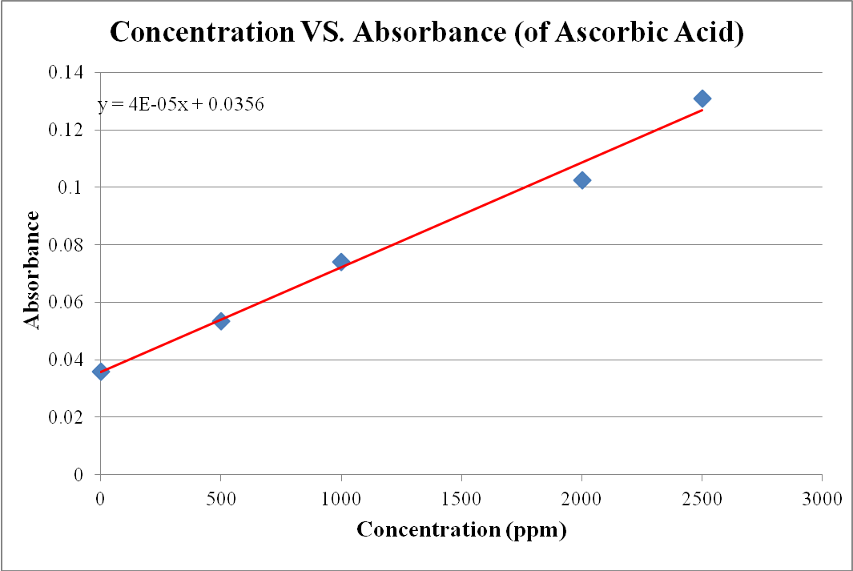
Results from MTT Assay
Aerial (
Aerial (MeOH)
New metabolite
Notes:
The new metabolite displayed antioxidant activity equivalent to an ascorbic acid concentration of ~1500 ppm.
Interestingly, in a separate study the methanolic extract displayed significantly higher activity (~ equivalent to a ascorbic acid concentration of ~ 2400ppm) this suggests that it might be due to either more potent prenylated benzophenones or a different class of metabolites responsible for the activity.

Slide 17
FUTURE WORK
Work on the aerial methanolic extract of
H. hypericoides.
Detailed inspection of the 2D NMR data to determine connectivity between main bicyclononane core and isopentenyl group.
Isolate the other pure compounds (identified by LCMS) from crude ethyl acetate extract of aerial parts of Hypericum hypericoides and determine their antioxidant potential.

Slide 18
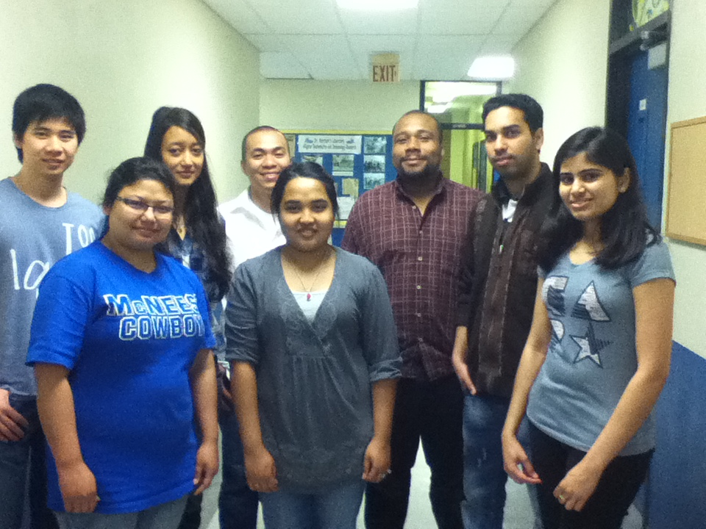
Acknowledgement
Louisiana Environmental Research Center (LERC)
Chenier Plain Sustainability Initiative Collaboration
LA BoR SURE
SASOL
Dr. Ray M. Neyland
Dr. Mark E. Merchant
Natural Products and Drug Discovery Group

Slide 19
QUESTIONS?

