Slide 1
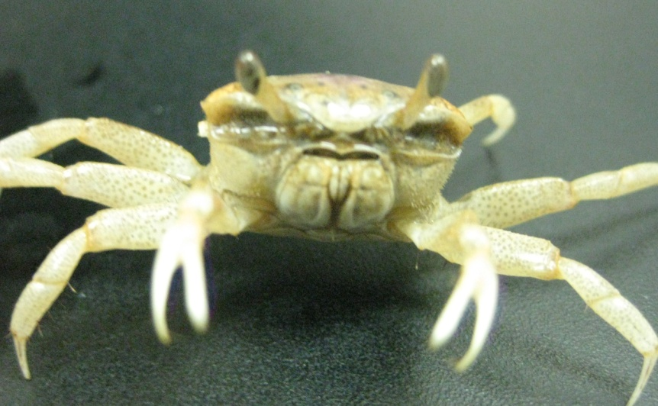
Is EROD activity affected by the molting cycle in the fiddler crab, Uca pugilator?
By: Kate Hotard
Nicholls State University
Department of Biological Sciences

Slide 2
What is EROD activity?
Ethoxyresorufin O-deethylase (EROD) activity:
Measures activity of cytochrome P450 1A (CYP 1A) enzymes in vertebrates
CYP 1A enzymes are Phase I metabolic enzymes.
Important for detoxification of organic pollutants
EROD activity can measure detoxification efforts in organisms making it a good biomarker for aquatic pollution.
Notes:
phase I enzymes catalyze hydroxylations, epoxidations, oxidations, deaminations, N-, O-, S- dealkylations and dehalogenations of various organic contaminants. In Phase II detoxification, enzymes such as glutathione S-transferase (GST) continue to alter the pollutants until the contaminants become polar and water-soluble metabolites (Hotard & Zou, 2007). These metabolites are then secreted from the body.

Slide 3
Crustacean Physiology
Crustaceans undergo periodic shedding of their exoskeleton known as molting.
If EROD activity were found to fluctuate with the molting cycle, then the indiscriminate use of fiddler crabs as a biomarker is questionable.
A-B stage
Postmolt
D34 Stage
C Stage
Premolt
Intermolt
D1 Stage
D0 Stage
Premolt
Premolt
Notes:
There are two questions that my research aimed to answer.
The first concerns crustacean physiology.
This makes much of crustacean physiology cyclical.

Slide 4
Crustacean Toxicology
EROD activity
Mitochondria Endoplasmic reticulum (Microsomal cell fraction)
Steroid metabolism Xenobiotic metabolism
If mitochondrial and/or microsomal EROD activity fluctuates, then whole tissue homogenate cannot be used for EROD assays.
Notes:
The second question I wanted to answer is whether crustacean toxicology plays a role in EROD activity.

Slide 5
Objectives
Determine if mitochondrial and/or microsomal EROD activity is affected by exogenous molting hormone.
The results of this study will determine if mitochondrial or microsomal EROD activity fluctuates during of the molting cycle.
Propose guidelines as to how accurately conduct crustacean EROD assays when determining levels of environmental pollution
Notes:
The logic for the first objective is that if EROD activity is impacted by molting physiology then should be affected by ecdysteroid treatment.

Slide 6
Methods
75 intermolt (C stage) fiddler crabs
Control
2 hormone treated groups
20-hydroxyecdsyone (20E) hormone stock solutions:
0.5 µg/µl
12.5 µg/µl
Hormone injection solutions were made with 1 part hormone stock solution to 9 parts Pantin’s crustacean solution.
0.05 µg/µl
1.25 µg/µl
Notes:
You may want to add a photo about how you inject.

Slide 7
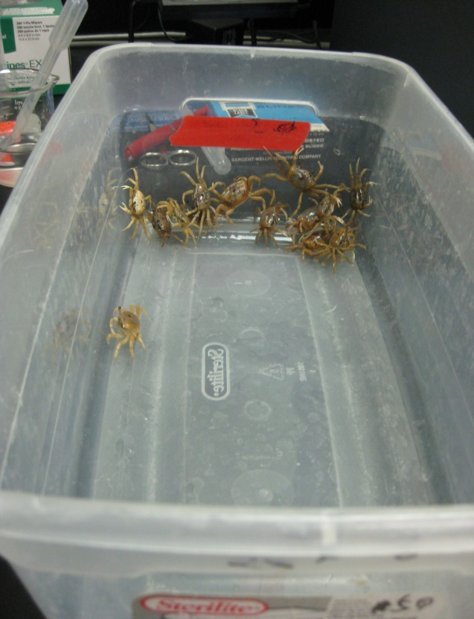
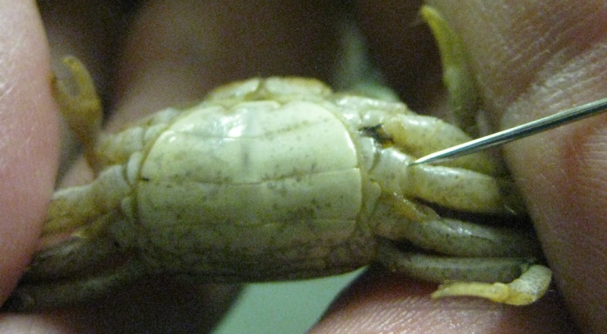
Methods
The hormone treatment groups injected:
Dose of 1 µg/g and 25 µg/g live mass
The control group injected:
Pantin’s crustacean saline containing 10% v/v ethanol
Amount to be inserted:
Weight of crab (g) x Dose (µg/g) = Amount of 20E(µg)
Amount of 20E(µg)/ Concentration of injection solution ((µg)/(µl)) = V (µl)
Notes:
The hormone treatment groups were injected with 20E at a dose of 1 µg/g and 25 µg/g live mass through the arthrodial membrane at the base of one walking leg.
You may explain how the injection volume was determined.
-weighed crab (g) X dose amount (ug/g)= m (ug)
-v (ul)= m (ug) / (m(ug)/v(ul))

Slide 8
Methods
On day 2, all surviving fiddler crabs were sacrificed.
The hepatopancreatic tissues were collected and snap-frozen with liquid nitrogen, and stored at -80°C.

Slide 9
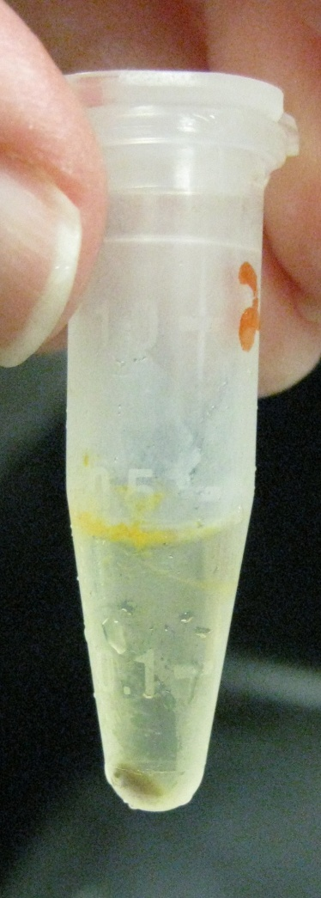
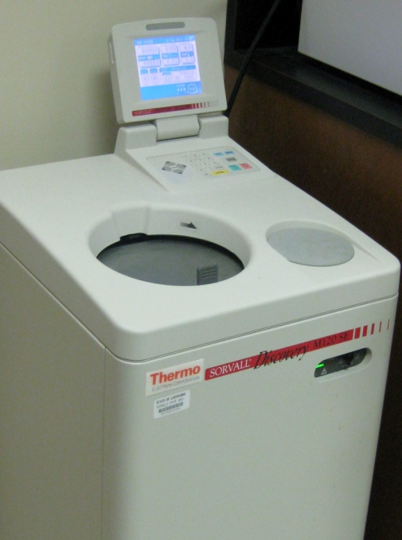
Methods
Tissues were homogenized.
Phosphate buffer saline
Proteinase inhibitor cocktail.
Samples were centrifuged at 9,000g for 10 min. at 4ºC.
Samples were then placed in an ultracentrifuge at 100,000g for 45 min. at 4ºC.
Supernatant contained non-microsomal cell fractions.
Pellet contained microsomal cell fraction (resuspended using 40µl PBS).
Notes:
It is not appropriate to call the supernatant mitochondrial fraction. Need to explain that enzymatic activity in the supernatant is due to mitochondrial EROD activity.
Supernatant’s EROD activity is attributed to mitochondrial EROD activity.
Pellet’s EROD activity attributed to microsomal EROD activity.

Slide 10
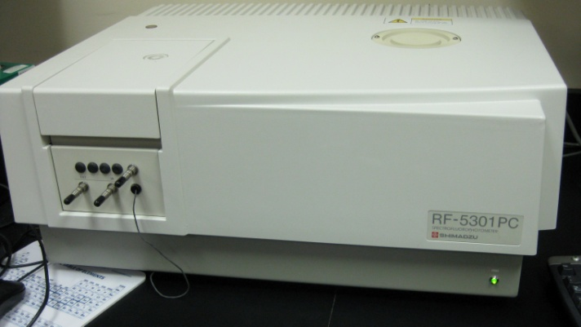
Methods
EROD assay:
1 mL pH 7.4 phosphate buffer saline, 20 µL of 1mM ethoxyresorufin, 5 µl of protein sample and 50 µl of NADPH (4 mg/mL) solution
Samples were incubated for 1 hour at 30°C.
100 µl of 0.1 mM of NaOH stopped reaction.
The reaction produced resorufin.
The amount of resorufin was measured at 583 nm (emission wavelength) on a spectroflurometer.
EROD
Ethoxyresorufin Resorufin
NADPH
Notes:
You may want to show the chemical reaction used for this assay.
Use EROD instead of CYP1A.

Slide 11
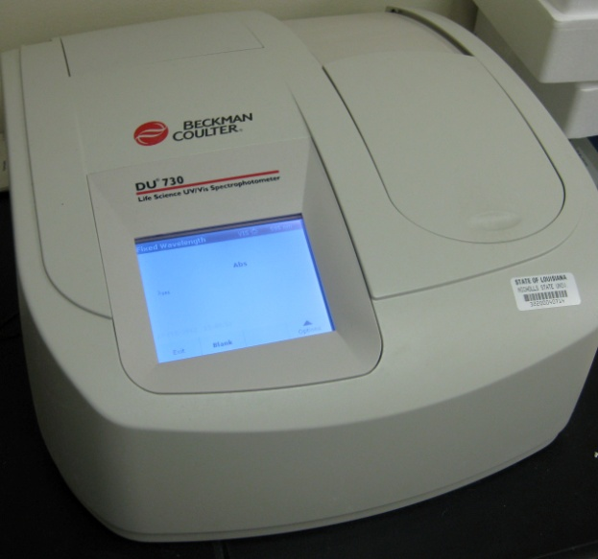
Methods
Protein Assay:
5 µl protein samples
800ml Bradford reagent
Absorbance was measured on a spectrophotometer.
Notes:
You may want to show your protein assay standard curve and how enzymatic activity was determined.

Slide 12
Results
Determine the value of y (amount of protein or resorufin for each sample) using the linear equation.
Notes:
Emphasize on the good correlation between concentration and absorbance.

Slide 13
Results
The enzymatic activity was calculated by determining:
pmol resorufin/ µg protein/ minutes of reaction
One-way analysis of variance (ANOVA) and Tukey’s test
The significance level was set at a P value less than 0.05.

Slide 14
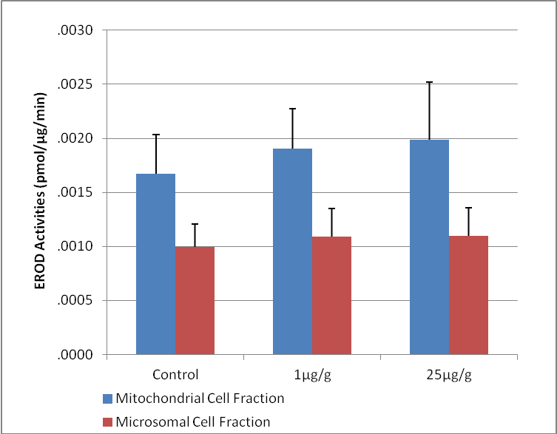
Results
The mitochondrial EROD activities were greater than the microsomal activities.
Mitochondrial EROD activity:
Significant difference between the control group and the 25µg/g group
Microsomal EROD activity:
No significance between the injection groups
*
Figure 1-1. Mitochondrial and microsomal EROD activity for exogenous molting hormone injection. Error bars show standard deviation. Asterisks (*) represents significant difference from control sample.
Notes:
Use asterick to show the significance.

Slide 15
Discussion
Mitochondrial EROD activity is induced by molting hormone.
Suggests that mitochondrial EROD activity is influenced of the molting physiology.
Expected result since mitochondrial EROD activity controls steroid metabolism
Microsomal EROD activity does not change as exogenous molting hormone is administered.
Suggests microsomal EROD is not under influence of molting physiology.

Slide 16
Conclusion
Mitochondrial EROD activity is affected by molting physiology.
Mitochondrial cell fraction must be separated from the microsomal cell fraction when performing EROD assays.
Only the microsomal cell fraction should be used when conducting EROD assay
Microsomal EROD activity is independent of molting physiology

Slide 17
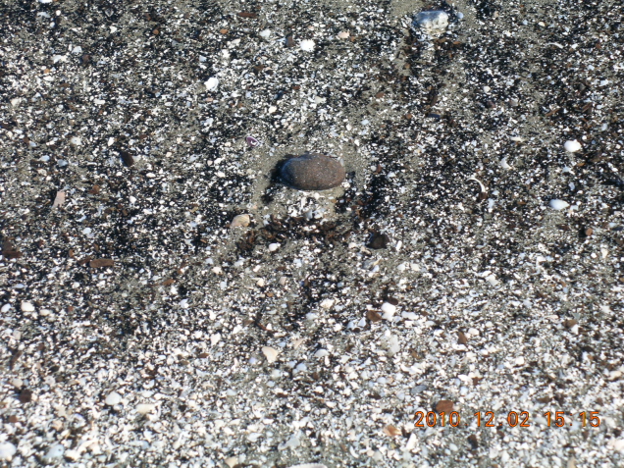
Applications
Crustaceans can now be used as a definitive biomarker for environmental pollution.
Important to local area
Determine the effects of the BP oil spill on the environment
Notes:
You may want to add pictures about oiled beaches, marshes, etc. Mention crustaceans inhabit these environments.

Slide 18
Future Study
Determine EROD activities of fiddler crabs of different molt stages (C, D0, D1, D3-4, A-B)
Determine if mitochondrial and/or microsomal EROD activities fluctuate
Compare results obtained from this study

Slide 19
Acknowledgements
I would also like to thank Dr. Enmin Zou for giving me the opportunity to conduct research under his guidance.
I would like to thank the Undergraduate Research Opportunity Program for choosing me as a recipient of the Louisiana Sea Grant.

Slide 20
Questions?

