Slide 1
An Assessment of the Incident Command System
Elizabeth Mrak
Al Landry

Slide 2
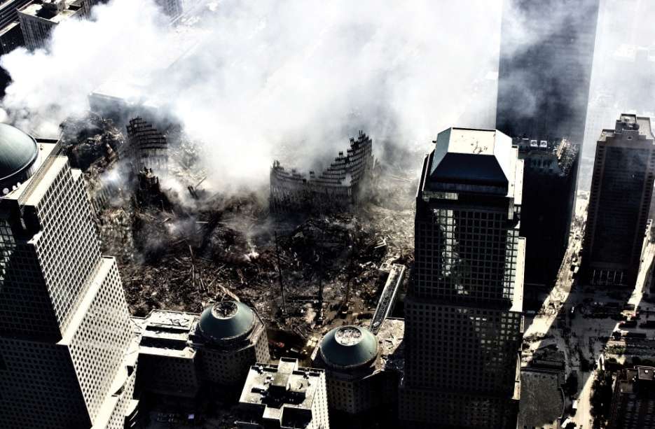
Homeland Security Mandate
One of many actions following 9/11
Homeland Security Presidential Directive 5 - (HSPD-5) – directed creation of a National Incident Management System (NIMS)
NIMS adopted the Incident Command System (ICS) as a fundamental component of the National Response Plan
Approximately one year later DHS mandated adoption of NIMS as a requirement to receive federal funding for disaster preparedness
Notes:
Hi, I’m Liz Mrak and Al and I are here to discuss our Assessment of the Incident Command System
Slide 1:
Following the World Trade Center terrorist attacks of 911, we learned that we were not prepared to handle a disaster of this magnitude.
As the president’s response he established and ordered Homeland Security protect us as a country and to manage any incident either natural or terrorist.
One of these directives was HSPD 5 which demanded development of the National Incident Management Systems or NIMS.
NIMS chose to adopt the Incident Command System as the fundamental or key component of the National Response Plan.
About a year later in response to the President’s direction DHS said in order to receive ANY federal funding for disaster preparedness a State MUST adopt NIMS.

Slide 3
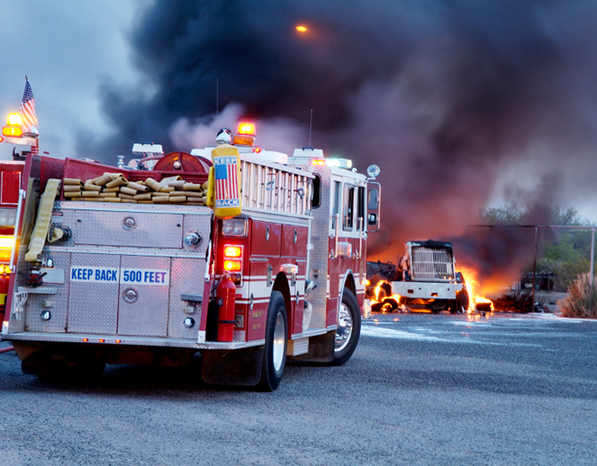
History of ICS
Originated in fire service in the 1970’s
Response to California wildfire experience
California firefighting organization (FIRESCOPE) credited with creation
Notes:
Slide 2:
So, what is the Incident Command System? Incident Command is a command system that includes a single agency or multi-agency response to an incident and the handling of that incident. This may be anything from a house fire to a plane crash. An ICS plan must be able to expand and contract as the incident dictates.
In 1970 in response to Southern CA difficult brushfire season. The fire agencies created what became known as FIRESCOPE and later Incident Command System. It took 10 years for this plan to be formally adopted by CA requiring all fire services to implement this new system.

Slide 4
History
Sought to correct 6 issues:
Confusion due to the number of agencies involved
Lack of a command structure
Lack of unifying concepts and systems
Lack of common terminology
Lack of common radio frequencies to facilitate communication
An overwhelming span of control
Notes:
Slide 3:
Some of the weaknesses identified following these brushfires were:
Confusion due to the number of agencies involved
Lack of a command structure
Lack of unifying concepts and systems
Lack of common terminology
Lack of common radio frequencies to facilitate communication
An overwhelming span of control

Slide 5
Basic Concepts of ICS
Modular organization
Unified command
Manageable span of control
Common terminology
Consolidated action plans
Comprehensive resource management
Integrated communications
Pre-designated incident facilities
Notes:
Slide 4:
Some basic concepts or solutions to the weakness identified were:
Modular organization – ability to expand and contract as the incident dictated.
Unified Command
Manageable span of control
Common terminology
Consolidated action plans
Comprehensive resource management
Integrated communications
Pre-designated incident facilities – pre-planning to identify command post, staging areas etc.

Slide 6
Command Structure / Organization
Command
Operations
Finance
Planning
Logistics
Notes:
Slide 5:
This chart is simple, it shows Command and the 4 areas of needed to control an incident: operations, planning, logistics and finance. Operation’s is the bear of these because it is where other agencies needed for the response fall. These agencies include Fire, Police, EMS, tow trucks, garbage trucks to move debris etc. Operations is where everyone MUST work together to get the job done.

Slide 7
Assessments of ICS…
“…incorporates the best practices developed and proven by thousands of responders and authorities across America.” (Anderson, Compton, & Mason, 2004)
“…quaintly antiquated and at odds with current trends.” (Moynihan D., 2008)
Notes:
So, our Assessment of ICS shows two extremes.
First, Anderson and his collegues say…
Second, Moynihan says…
So which is correct or is the true assessment somewhere in the middle.
Now Al will discuss some of the specific issues we identified with Incident Command as a National Response System.

Slide 8
“All Hazards” Management
“A Critical Evaluation of the Incident Command System and NIMS” Buck, D.A., Trainor, J.E., Aguirre, B.E. – Journal of Homeland Security and Emergency Management
Effectiveness of ICS assumes:
Demands coincide with the training of responders
A shared vision exists supported by training, practice and experience
Training at the local level
Leaders are trusted
Notes:
Buck and colleagues evaluated several different disaster responses in which ICS was used.
Many were classified as very successful – the common traits in those were the points listed.

Slide 9
“All Hazards” Management
The plan overlooks the social complexity of disaster
ICS was “a set of practices designed to facilitate inter-organizational coordination” , it’s now a “full-fledged bureaucracy”
Summary – “the deficiencies are not inherent in ICS but rather are related to inadequate implementation”
Notes:
However, in larger scale events ICS was less than successfully implemented and problems arose.
Note the summary – the problems are not inherent to ICS, but with the implementation.

Slide 10
Bureaucracy
“Organizing for Homeland Security after Katrina: Is Adaptive Management What’s Missing?” Wise, C. R. - Public Administration Review
“The NRP attempts to impose strict standards and structure to incidents that are diverse, complex and potentially very dynamic in nature”
DHS established 43 individual initiatives to fulfill federal disaster management responsibilities
DHS - lead agency over 37 federal departments
12 initiatives involve multiple federal agencies
GAO review of the system identified challenges in fulfilling the strategy across both mission areas and levels of government
Notes:
Provide overview of bureaucratic complexity in the Homeland Security structure

Slide 11
Bureaucracy
System test
Hurricane Pam exercise in 2004 found:
Issues identified across the board including
Problems with various government entity interactions
Failure to understand and apply principles of the NRP
Difficulty achieving unified command and control
Notes:
Bureaucratic complexity with implementation of the NRP was identified as a real issue in the Hurricane Pam exercise in 2004.
Explain briefly what the Pam exercise was.

Slide 12
Predicting Effectiveness
“Incident Command System as a Response Model Within Emergency Operations Centers during Hurricane Rita” Lutz, L.D., Lindell, M.K. – Journal of Contingencies and Crisis Management
Response Organization | Tasks Performed | Predicted Effectiveness
Existing | Normal | ↑↑
Expanding | Normal | ↑
Extending | Novel | ↓
Emergent | Novel | ↓↓
Notes:
Lutz and Lindel studied ICS as a part of the Hurricane Rita response.
They also found that ICS becomes less effective as the response organizations grows and new tasks (challenges) are placed on responders.
Define terminology of response organizations.

Slide 13
Predicting Effectiveness
“Organizations with normal civilian structures such as public works and social services cannot operate effectively under such a structure”
“Neglects volunteers and emergent organizations”
Training -“transfer of training to the job must be based on a an effectively designed program of practice”
“There needs to be further study of ICS application in emergencies other than structural and wild land fires, as well as development of new ICS training materials for emergency relevant agencies…”
Notes:
Their summary findings:
Doesn’t work well outside of the typical public safety hierarchy
Neglects volunteers
Training was not effective

Slide 14
Management Theory
“Combining Structural Forms in the Search for Policy Tools: Incident Command Systems in the U.S. Crisis Management” Moynihan, D.P. – Governance
“The Network Governance of Crisis Response: Case Studies of Incident Command Systems” Moynihan, D.P. – Journal of Public Administration Research and Theory
“What Makes Hierarchical Networks Succeed? Evidence from Hurricane Katrina” Moynihan, D.P.
Notes:
Moynihan’s studies of management intergration

Slide 15
Management Theory
Hierarchies
Fundamental organizational structure of ICS
Supports a rapid consistent response
In large responses effectiveness is based on trust
Trust is generated by previous experience
Networks
Not specifically addressed in ICS structure but will be necessary
Allow utilization of a wider variety of experts
Adversely affected by task size and scope
Undermine the “chain of command” concept due to interactivity
Notes:
Large responses will require both classic hierarchies (public safety) and networking with other agencies.
Describe fundamentals of each.

Slide 16
Management Theory
Extends beyond a philosophical argument
Exotic Newcastle Disease (END) – difficulty adjusting response when infected birds identified outside of commercial producers
Hurricane Katrina – “Whereas the NRP was developed to allow local coordination and control with supplemental assistance provided by higher levels of government, no one was prepared for the total dysfunction experienced between municipal, state and federal entities.” - Senate Review of Katrina Response
Notes:
END response and Katrina are two examples of the challenges when dissimilar organizations are forced to network under the ICS hierarchy.

Slide 17
Research
“The Incident Command System: A 25-Year Evaluation by California Practitioners” Cole, D. – National Fire Academy
16 item survey of over 200 ICS users (fire services) in 2000
10 point scale (1 = maximum weakness, 10 = maximum strength)
All 16 items received a mean score of greater than 5
Notes:
There is quite a bit of research on ICS effectiveness and limitations.
This one was selected for two reasons:
It was an evaluation of the system by practitioners
It occurred before implementation of the NRP so it was available to DHS
Provide overview of the studies components

Slide 18
Research
Lowest scoring (Tier 3)
Resource mobilization effectiveness - the efficient use of available resources
Effectiveness of integrating non-fire government agencies
Consistency of implementation among various agencies
Effectiveness of integrating non-government organizations (e.g. relief agencies, businesses, citizens)
Agreement among agencies about who has authority to modify the ICS “rules of the game”
Notes:
Demonstrates that the lowest ranked elements of Cole’s study show the same concerns identified today.

Slide 19
What Have We Learned?
Include all emergency relevant agencies
Training on the local level strengthens sense of belonging (i.e. trust)
Improve interactivity with practice, drills, etc.
Notes:
Summary of what we’ve learned.
ICS is not going to go away. Realistically, there isn’t a better plan out there that we know of. That means we need to improve the issue of implementation and training to be more inclusive and meaningful.
Ultimately, these are the fundamental components that need to be addressed to improve NIMS and ICS as an All Hazards response system.

Slide 20
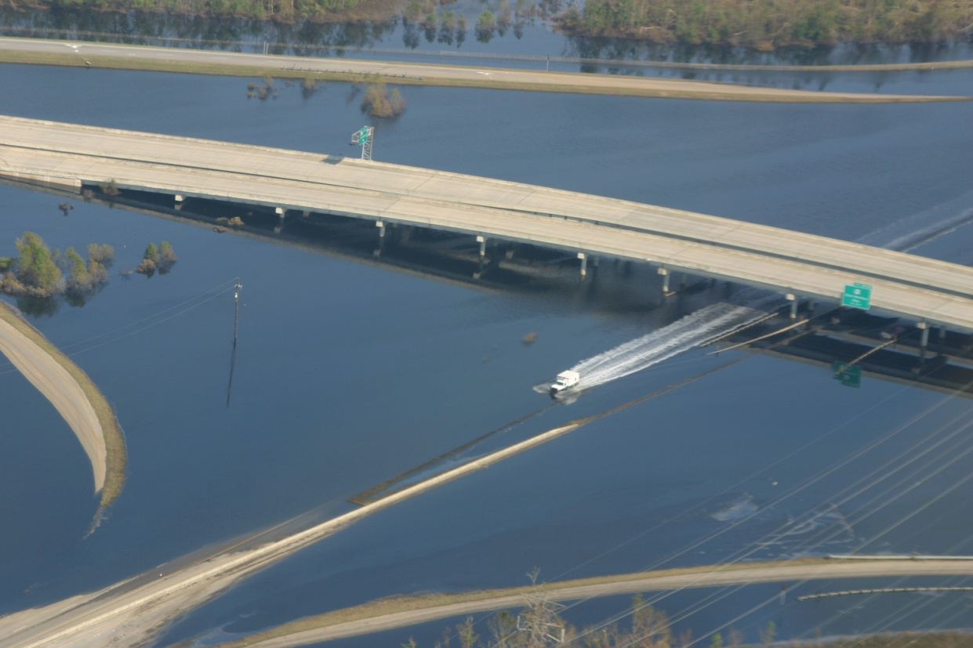
Louisiana Experiences
Hurricane Katrina
Hurricane Rita
Hurricane Ike
Hurricane Gustav
BP Oil Spill
Notes:
Louisiana is an excellent testing ground for piloting our recommendation.
List of recent events either in, or significant to the state.

Slide 21
Strategy
Local buy-in – GOHSEP
Identify stakeholders ( ALL respondent agencies)
Survey needs and compile data
Draft plan to address issues with training utilizing the state’s resources
NSU – UPSA faculty and students???
Notes:
Simple overview of recommendations for improvement
Must have buy-in from the state agency charged with emergency preparedness – they have authority
Review the past responses and identify all the players (public safety, municipal, volunteer, private, etc.)
Survey those agencies on their needs and compile data to construct a framework for the improvement plan
Leverage the expertise within the state in drafting the plan
Institution of higher learning provides access to experts in research, survey construction, data management, instructional design, etc.
Why not NSU???

Slide 22
Questions?

