Slide 1
Torrefaction of Pine, Willow, and Arundo to Improve Fuel Characteristics
Philip Aucoin
Department of Mechanical Engineering
University of Louisiana at Lafayette
November 12, 2011

Slide 2
Why Should We Pursue Alternative Fuel Sources?
The CO2 emissions from fossil fuels are harmful to the environment . These green house gases are polluting our air, and are a direct cause of global warming.
Alternative energy can be harnessed from within our own country, lower our dependence on oil from foreign countries.
According to International Energy Outlook, energy consumption is going to increase 53% by 2035
The United States is encouraging the use of alternative energy by introducing several policies, mandates, subsidies, etc.
Solar, wind, geothermal, nuclear, and biomass fuel are all sources of energy currently being pursued.

Slide 3
Renewable Portfolio Standards
www.dsireusa.org / May 2010
WA: 15% x 2020*
VT: (1) RE meets any increase in retail sales x 2012; (2) 20% RE & CHP x 2017
ME: 30% x 2000
New RE: 10% x 2017
MT: 15% x 2015
MN: 25% x 2025
(Xcel: 30% x 2020)
NH: 23.8% x 2025
OR: 25% x 2025 (large utilities)*
5% - 10% x 2025 (smaller utilities)
ND: 10% x 2015
MI: 10% + 1,100 MW x 2015*
MA: 22.1% x 2020 New RE: 15% x 2020 (+1% annually thereafter)
SD: 10% x 2015
WI: Varies by utility; 10% x 2015 statewide
NY: 29% x 2015
RI: 16% x 2020
NV: 25% x 2025*
IA: 105 MW
CT: 23% x 2020
OH: 25% x 2025†
PA: ~18% x 2021†
CO: 30% by 2020 (IOUs)
10% by 2020 (co-ops & large munis)*
WV: 25% x 2025*†
CA: 33% x 2020
IL: 25% x 2025
NJ: 22.5% x 2021
UT: 20% by 2025*
KS: 20% x 2020
VA: 15% x 2025*
MD: 20% x 2022
MO: 15% x 2021
DE: 20% x 2020*
AZ: 15% x 2025
NC: 12.5% x 2021 (IOUs)
10% x 2018 (co-ops & munis)
DC
DC: 20% x 2020
NM: 20% x 2020 (IOUs)
10% x 2020 (co-ops)
TX: 5,880 MW x 2015
HI: 40% x 2030
State renewable portfolio standard
29 states + DC have an RPS
(6 states have goals)
*
Minimum solar or customer-sited requirement
State renewable portfolio goal
Extra credit for solar or customer-sited renewables
Solar water heating eligible
†
Includes non-renewable alternative resources

Slide 4
Renewable Standards in Louisiana
According to RPS electric utilities need to replace fossil fuels with alternative energy sources to some decided extent.
As can be seen, states across the country are creating renewable energy standards to either encourage or mandate their states to follow.
We must start pursuing this relatively cheap and reliable energy resource now, so that we are not caught off guard when Louisiana decides to create its own renewable portfolio standard.

Slide 5
It’s a mild form of pyrolysis, heating biomass in the range of 200-320 C.
Biomass properties are changed to create a much better fuel quality for combustion and gasification applications.

Slide 6
The Benefits of Torrefaction
Torrefaction can lead to higher fuel density, which is more efficient and more economical.
Lower CO2 emissions produced from torrefied biomass as opposed to fossil fuels.
Torrefied biomass is has an increased grindability over biomass that is not torrefied.
Torrefied biomass is hydrophobic in nature
Torefaction allows for biomass to be used in existing coal fired power plants without forcing any major changes to the infrastructure already in place.

Slide 7
Coal vs. Torrefied Biomass Energy Difference
It takes about 500 kg of coal to produce 1 MWh of energy.
It takes about 590.909 kg of torrefied wood to produce 1 MWh of energy.
This is about enough energy power 1000 homes.
In Louisiana alone, there are over 11,000 tonnes of biomass resources that are already available each year (in the form of crop residue, mill residue, forest trimmings, etc.).
An estimated 22% of homes in the state could be powered by our currently available biomass resources.

Slide 8
Lab Scale Torrefaction Studies
We evaluated different biomass species (including Pine, Willow, and Arundo).
We evaluated the effect of temperature, residence time, and biomass size on the torrefied product.
For each test, we determined:
Solid Yield (SY = [mass of torrefied biomass/mass of feed]_{daf})
Energy Yield (EY = SY[HHV of torrefied biomass/HHV of feed]_{daf})
Grindability Characteristics
Hydrophobic Nature
Solid yield, energy yield, and energy content for different biomass species were correlated.

Slide 9
Properties of Biomass Tested
 | Lignin, % | Hemicellulose, % | Cellulose, % | Extractives, % | HHV, Btu/lb (Determined)
Pine | 30 | 25 | 42 | 3 | 8762
Willow | 24 | 23 | 44 | 3 | 8221
Arundo | 21 | 30 | 31 | 6.7 | 7330

Slide 10
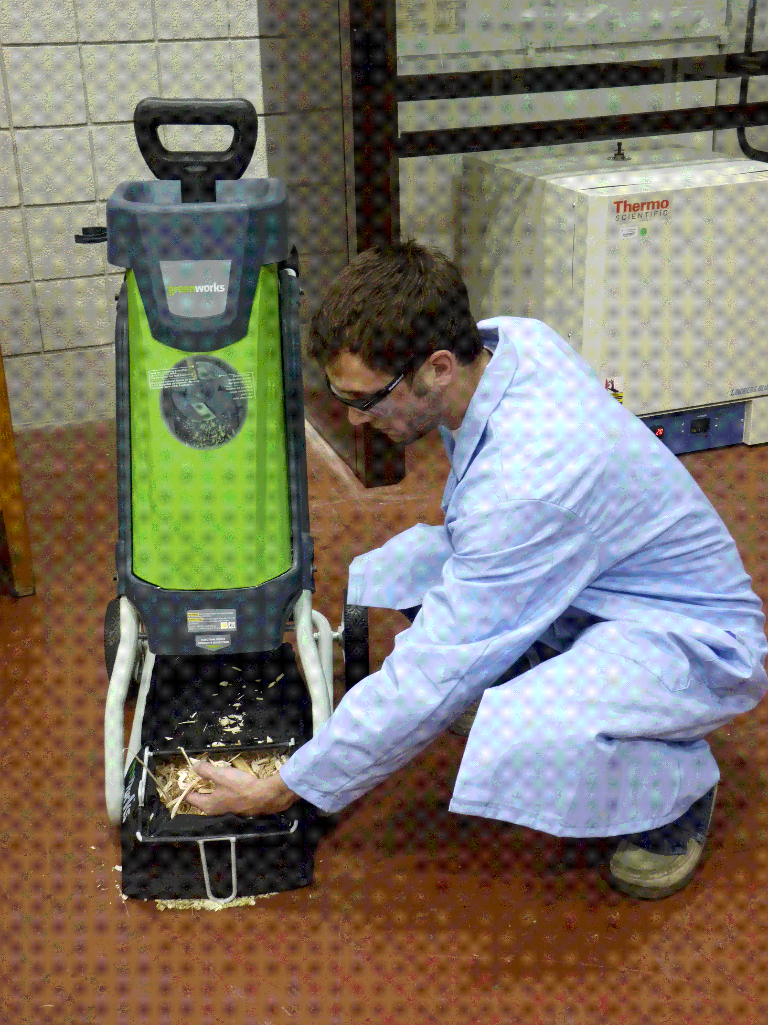
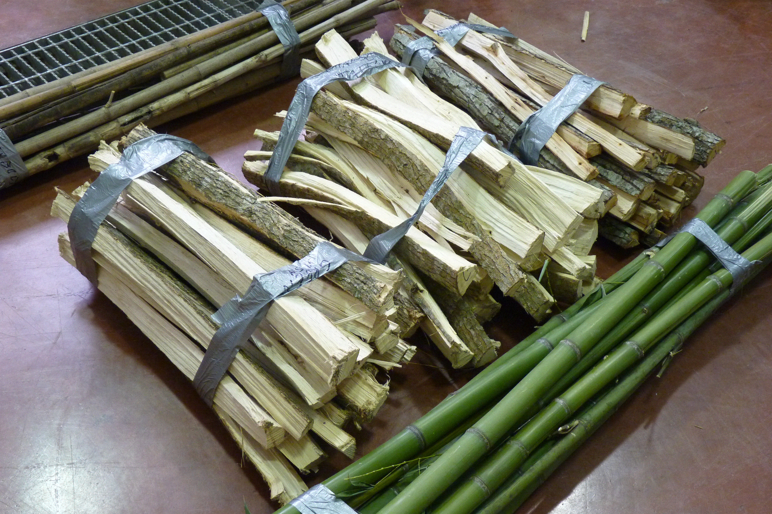
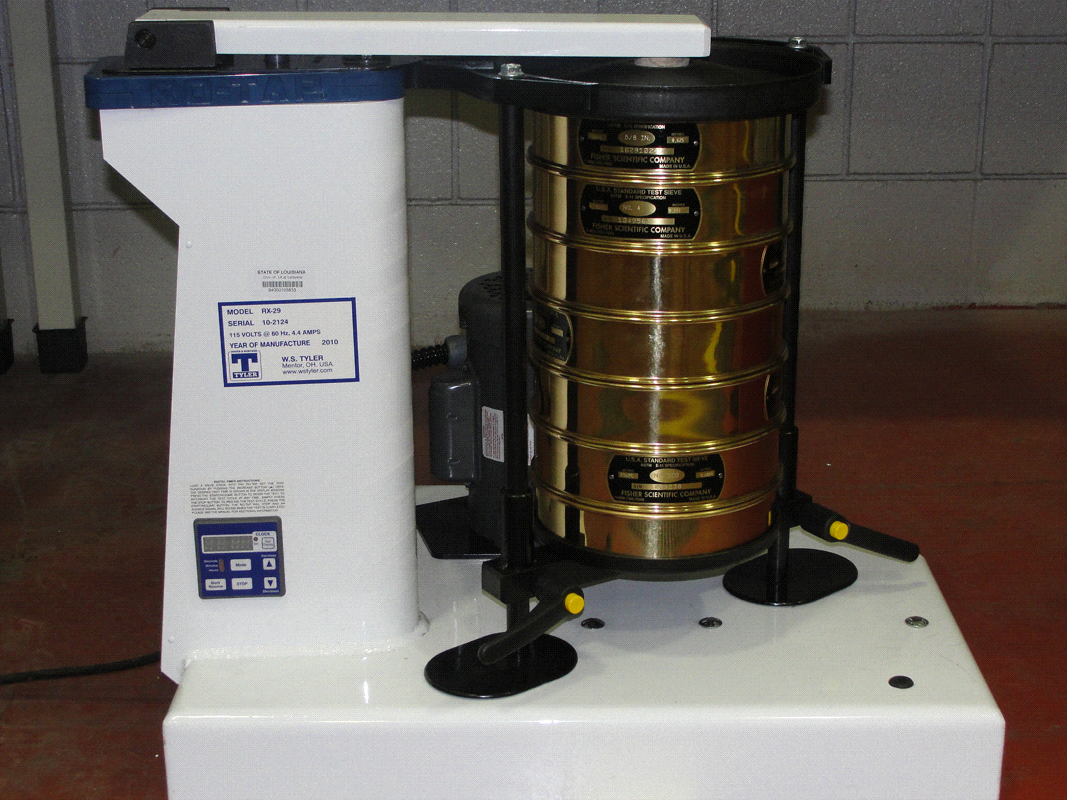
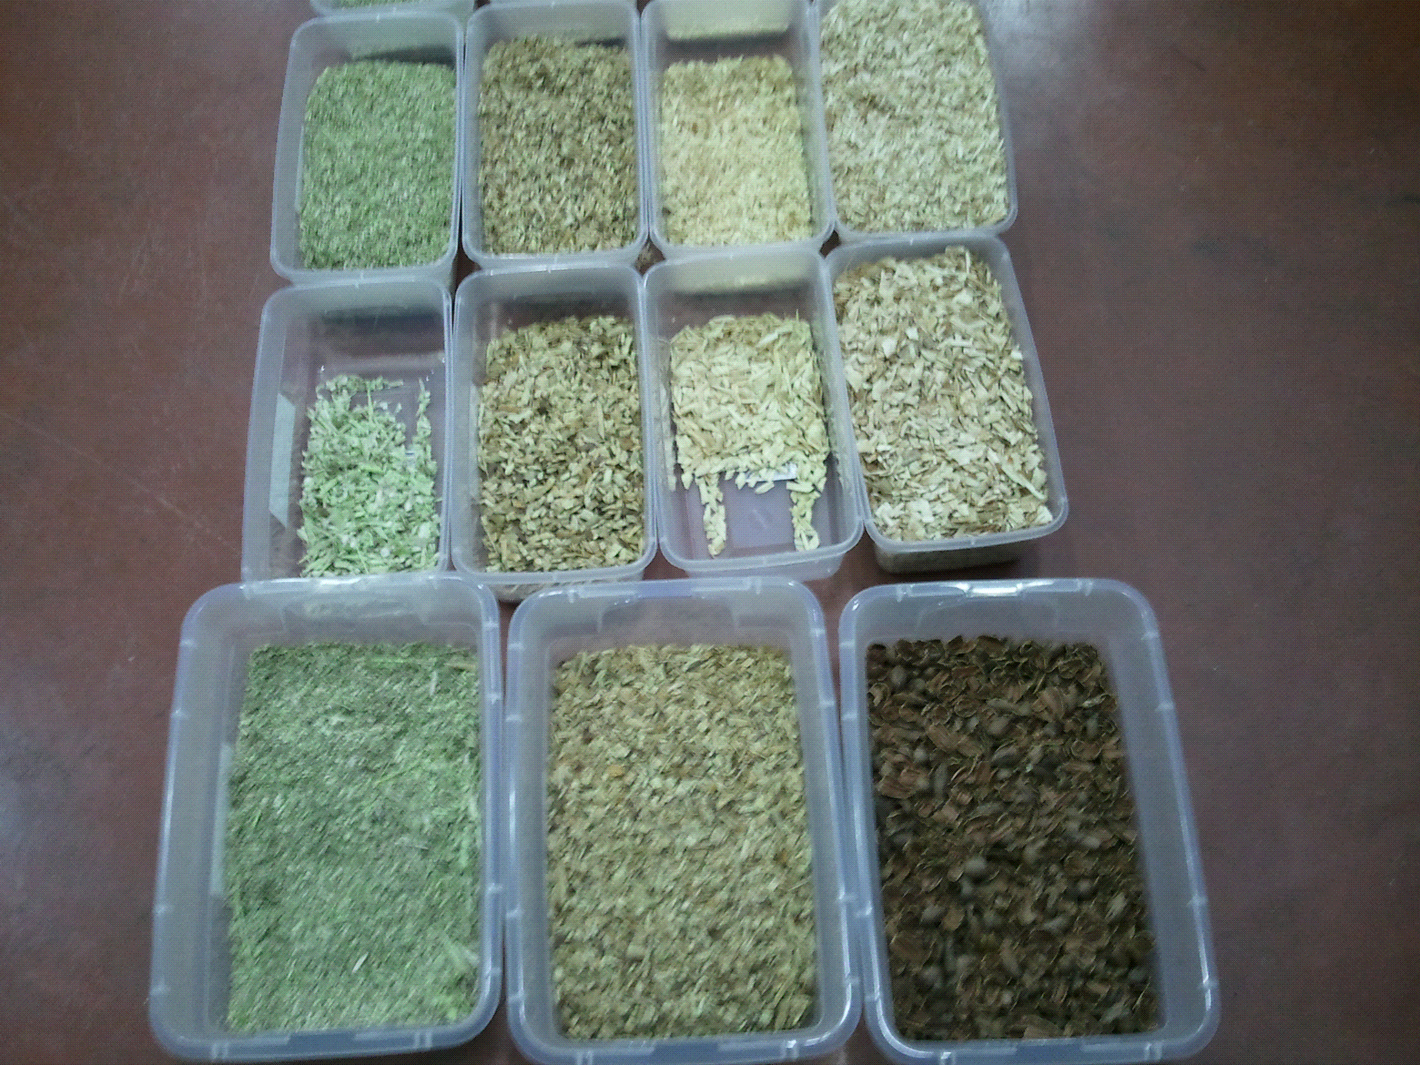
Sample Preparation
Untreated Biomass
Sieve Shaker
Chipper
Moisture Analysis
BTU Analysis
Torrefaction Studies

Slide 11
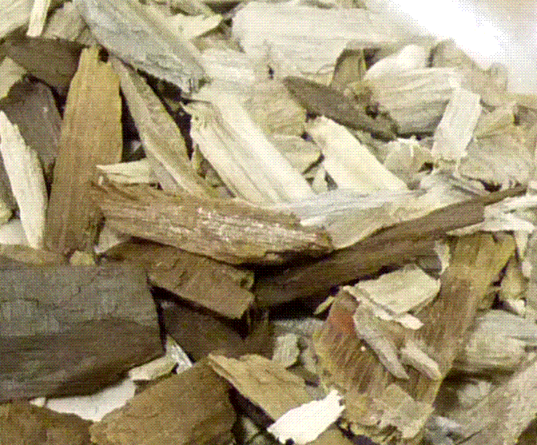
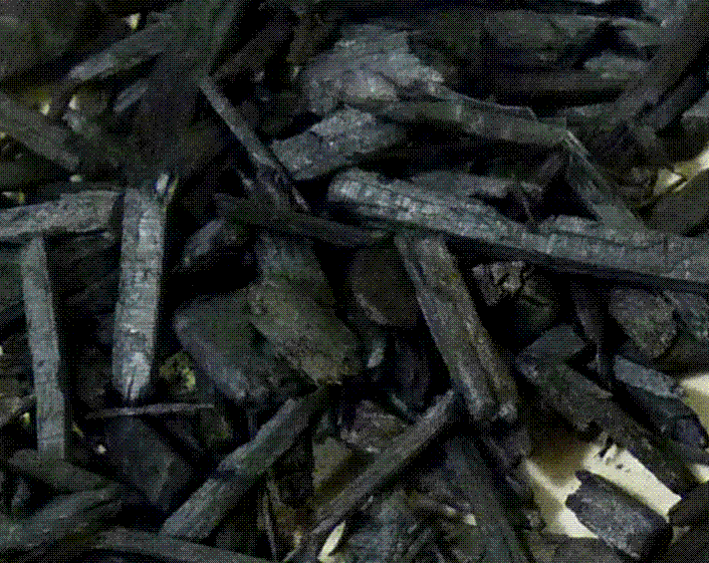
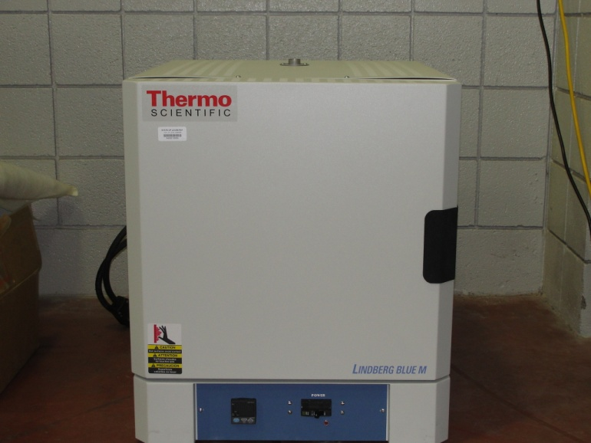
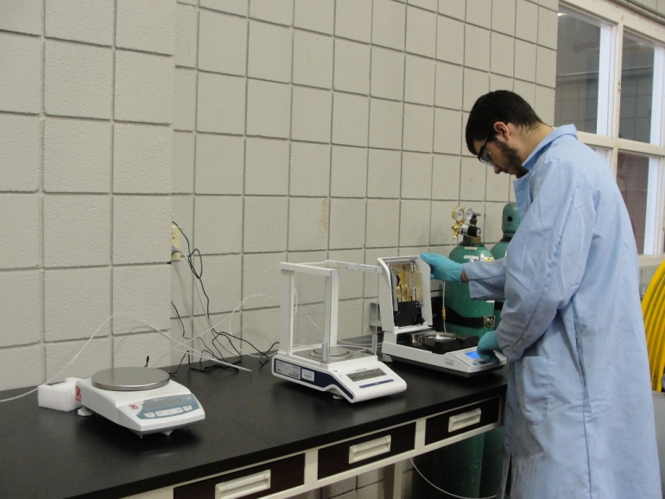
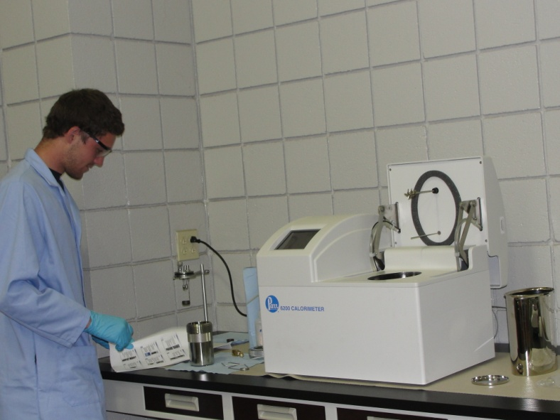
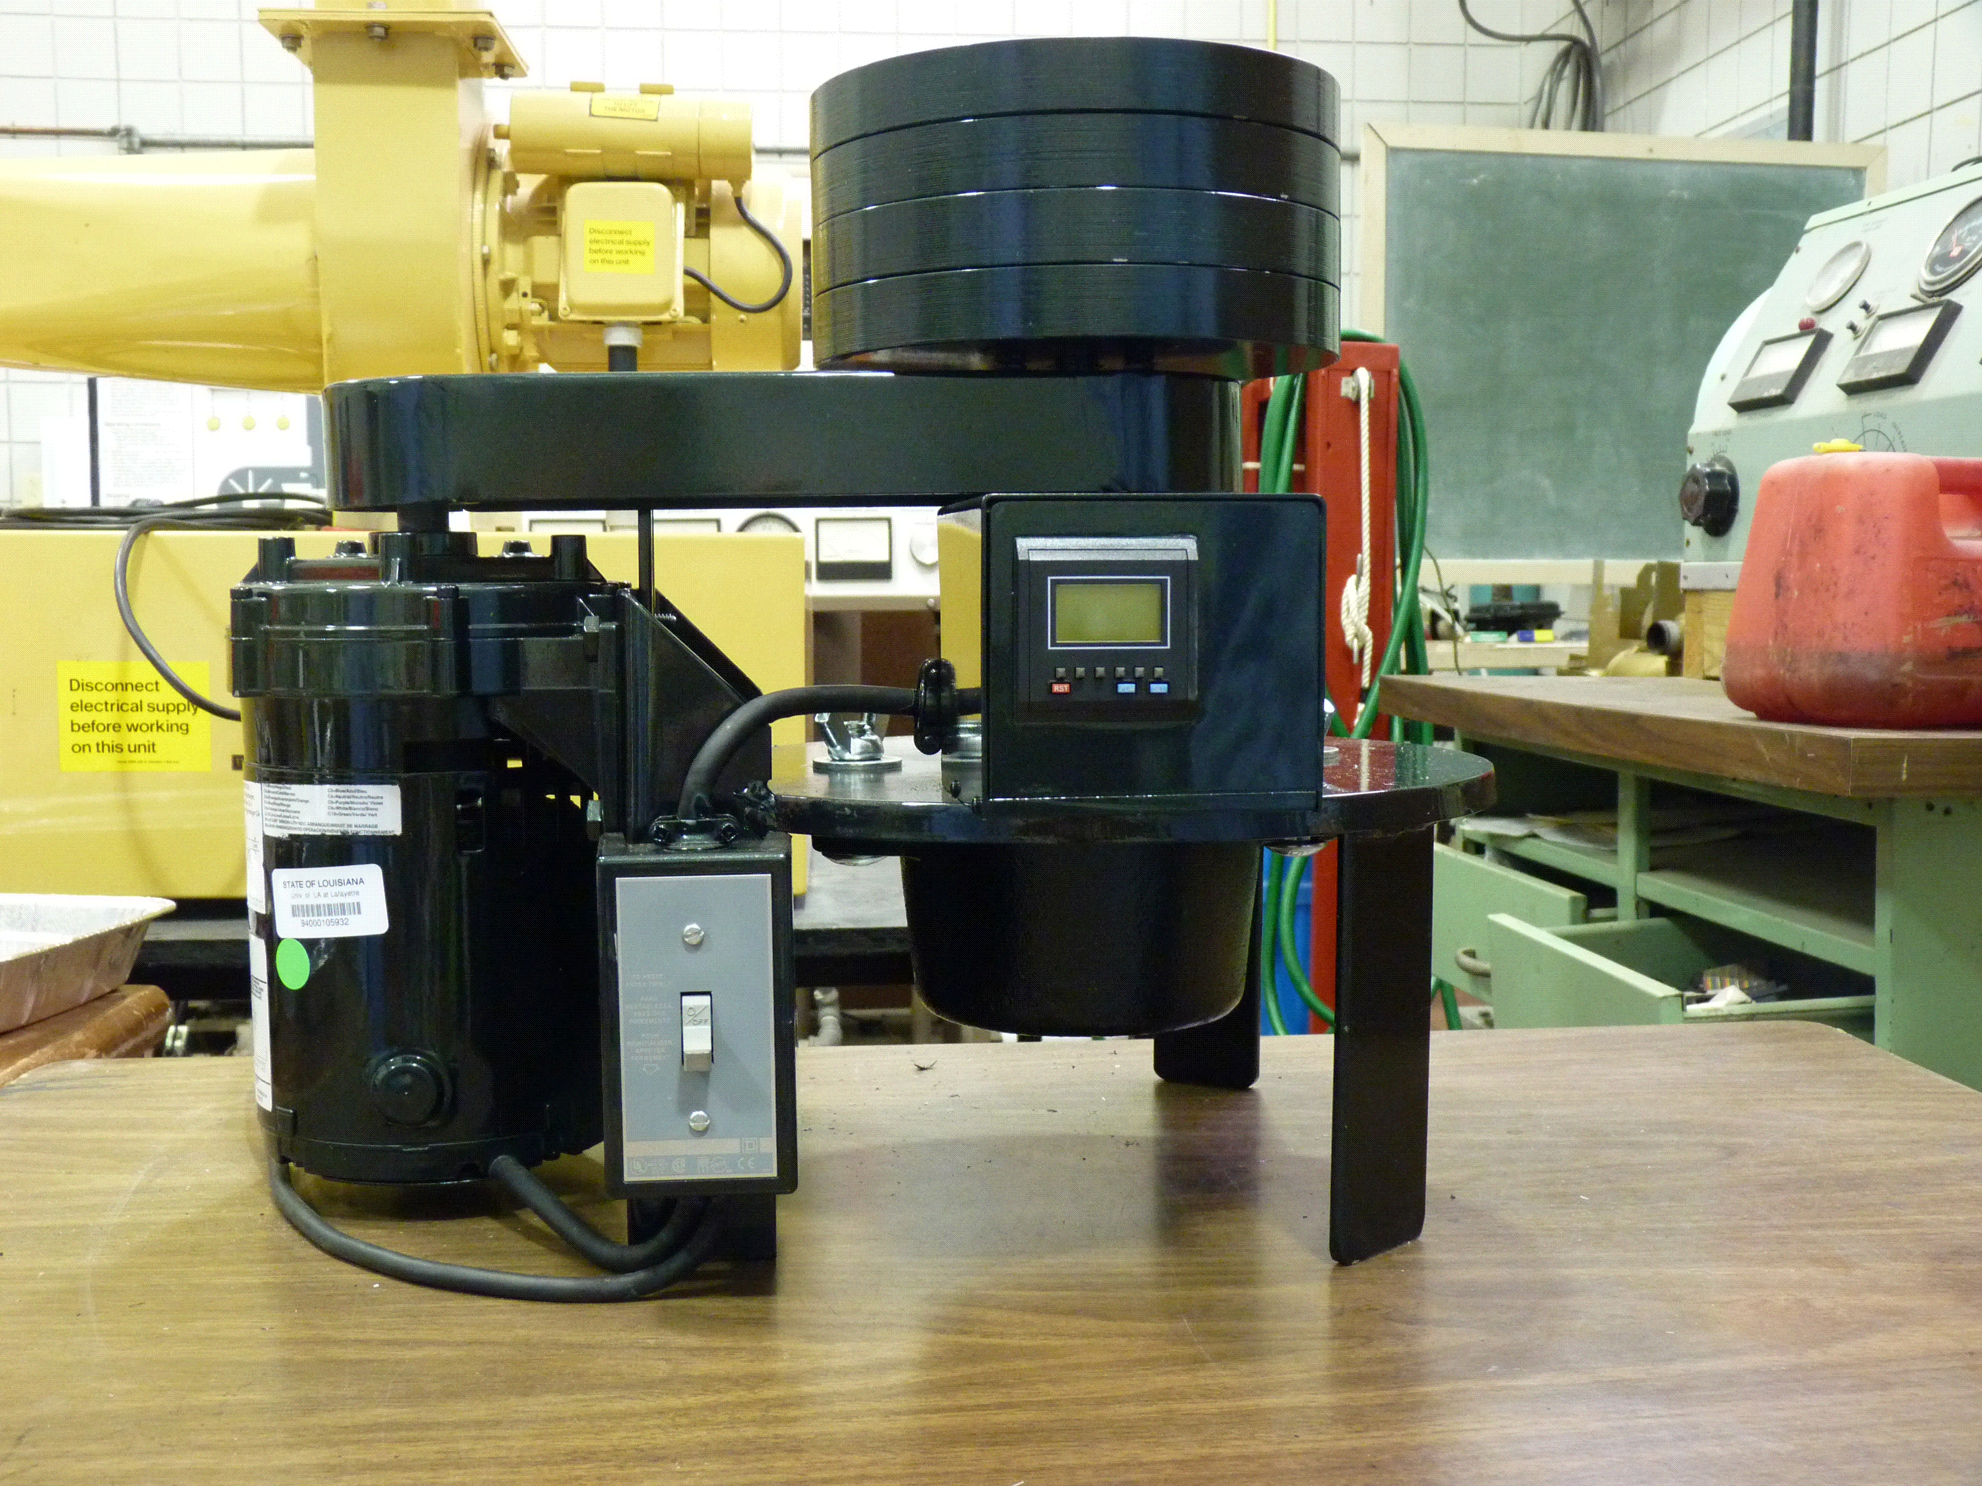
Experimental Procedure
Untreated Biomass
Torrefied Biomass
Torrefaction Reactor
Gravimetric &Moisture
Heating Value
Hardgrove Grindability

Slide 12
Effect of Temperature on Solid Yield, and Energy Yield for Pine (HHV – 8762, RT-30 mins., Particle Size- #8 mesh)
HHV,
Btu/lb

Slide 13
Effect of Temperature on Solid Yield, and Energy Yield for Willow (BTU – 8221 RT-30 mins., Particle Size- #8 mesh)

Slide 14
Effect of Temperature on Solid Yield, and Energy Yield for Arundo (BTU – 7330 RT-30 mins., Particle Size- #8 mesh)
HHV, Btu/lb

Slide 15
Variation of Solid Yield, and Energy Yield with Biomass Type at 270ºC.(RT-30 mins., Particle Size- #8 mesh)
HHV, Btu/lb
HHVdry basis of Pine – 8762, Willow – 8221, Arundo – 7330

Slide 16
Effect of Residence Time on Solid Yield and Energy Yield for Arundo. (Temp.- 250ºC., Particle Size- #8 mesh)

Slide 17
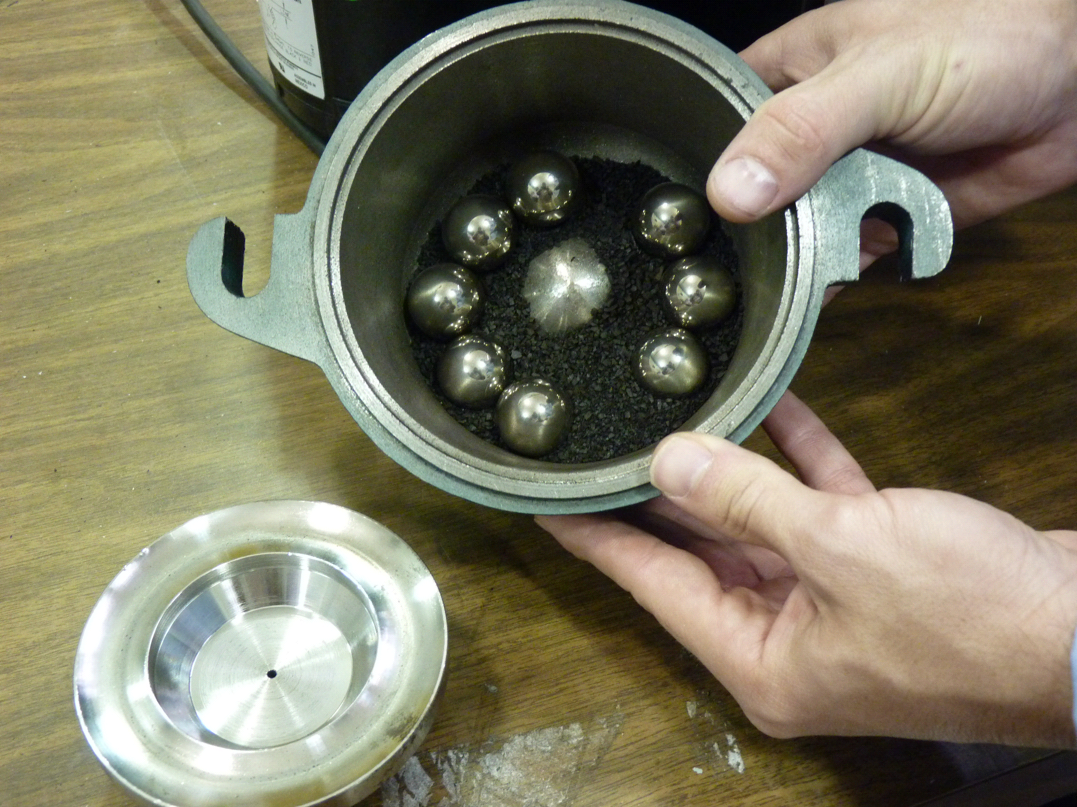
Hardgrove Grindability Index Calibration
Grindability Index of Coal by ASTM D409 – 46, Modified ASTM D409 -51

Slide 18
Grindability Index of Torrefied Biomass at Different Temperatures (RT- 30 min., Particle Size- #8 mesh)
HGI Coal - 46

Slide 19
Conclusions
Solid Yield decreased with an increase in temperature for all the biomass types tested, which leads to an increase in the HHV. This can be attributed to hemicellulose decomposition, which begins around 250º C.
The Solid-Energy Yield percentage difference of our samples was in the order of (from highest to lowest): Arundo, Willow, Pine—at all the temperatures tested. This is due to the variation in the lignocellulosic composition of these biomass types.
The grindability characteristics of the samples also greatly increased with an increase in torrefaction temperature.

Slide 20
Conclusions
The minimum desired HHV of torrefied biomass was achieved at temperatures greater than 260ºC for all of the types tested.
Moisture content was always within the specified limits of <4%.
The optimal residence time for all the samples tested was determined to be 30 min.
Torrefaction improves fuel, grindability, and hydrophobic characteristics of biomass, and raises the HHV. This makes torrified biomass attractive to use with coal in current power plants as a reliable way to reduce our dependence on fossil fuels.

Slide 21
Acknowledgements
Prashanth R. Buchireddy (Mentor)
Dr. John L. Guillory Ph.D., P.E.
Dr. Mark E. Zappi Ph.D., P.E.,
Ben Russo, CLECO LLC
Adam Sellers
Jake Sieber
Milbrandt, A., A Geographic Perspective on the Current Biomass Resource Availability in the United States. 2005, National Renewable Energy Laboratories: Golden, Colarado
Jackson, S.L., Mayfield, C. Louisiana Biomass and Bioenergy Overview. 2007; http://sungrant.tennessee.edu/NR/rdonlyres/9FB3F212-B6A1-4DE1-BE6C-F21713DB4ED3/0/louisiana.pdf.

