Slide 1
A Novel Mechanism for Regulating Glycolysis and Glutaminolysis During the Cell Cycle
Saul Carcamo
University College of London
Professor Sir Salvador Moncada

Slide 2
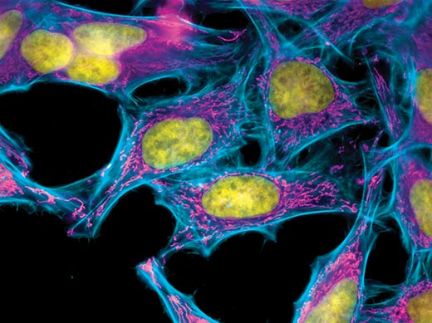
Production of Energy

Slide 3
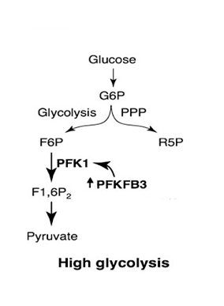
Cells are able to upregulate glycolysis due to the activity
of glycolysis-promoting enzyme PFKFB3

Slide 4
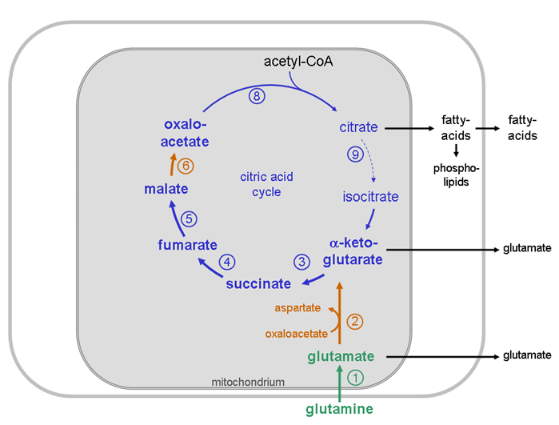
Cells are able to upregulate glutaminolysis due to the activity
of the promoting enzyme GLS1
Gls1

Slide 5
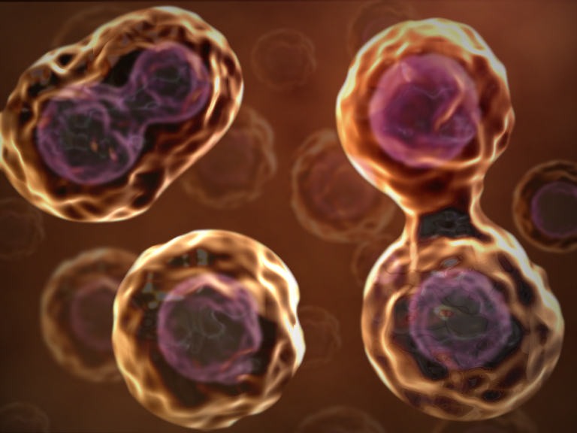
Cell Division

Slide 6
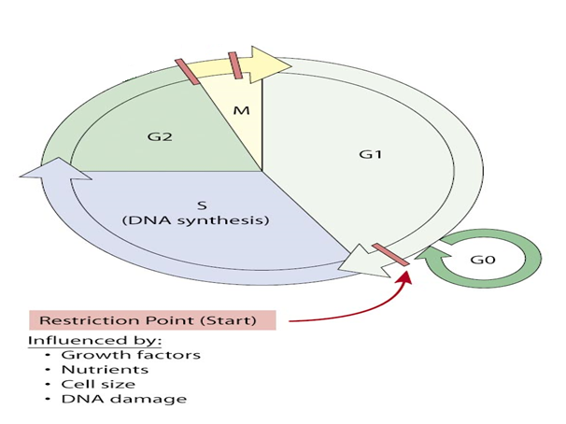
Cell cycle.

Slide 7
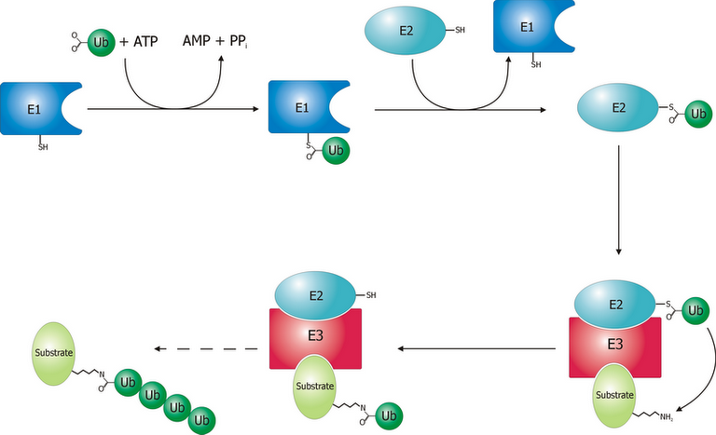
Ubiquination

Slide 8
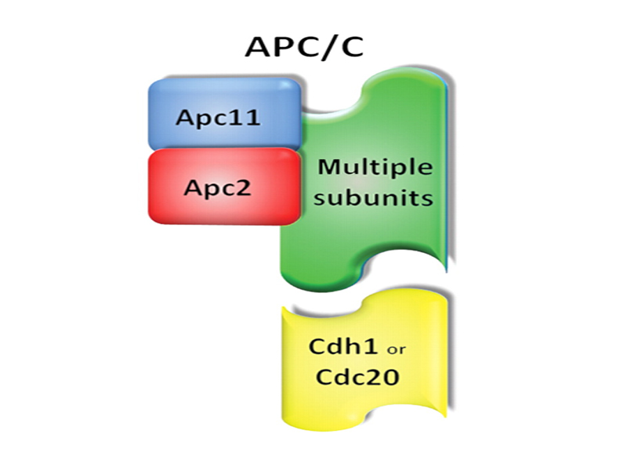
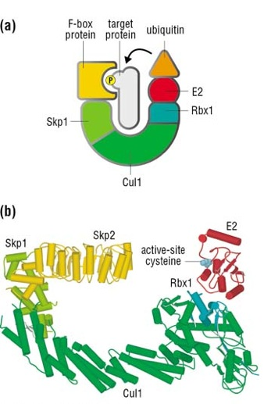
The APC/C and SFC play an essential role in mitosis through the degradation of cell cycle proteins.

Slide 9
Methods
Cell Synchronization

Slide 10
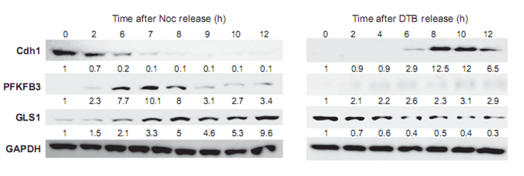
APC/C-Cdh1 and SFC: linking glycolysis and glutaminolysis to cell proliferation

Slide 11
APC/C-Cdh1 and SFC: linking glycolysis and glutaminolysis to cell proliferation

Slide 12
Conclusion and Impact
The accelerated utilization of glucose and glutamine is regulated by PFKFB3 and GLS1 respectively
This metabolic programming contributes to the rapid production of biosynthetic precursors, such as nucleotides, carbohydrates, amino acids, and fatty acids, which are required for cell proliferation
Given their timely and selective targeting of substrates, APC/CCdh1 and SCF coordinate global metabolism networks with the cell cycle.
It will be interesting to determine whether nonmalignant cells also use these mechanisms to regulate energy production and macromolecular precursor biosynthesis.
Further investigation will provide important information about the contribution of metabolic pathways to cell growth and malignancy, as well as the speciﬁc metabolic features used by tumor cells.

