Slide 1
“Take a Walk in my Shoes”: A Qualitative Analysis of Participant Impressions
Binita Adhikari

Slide 2
Background
More than 13% that is over 40 million of U.S. populations are over the age of 65 (U.S. Census Bureau, 2010).
The populations of older adults will increase approximately 20% by the year 2030 (FIFARS, 2004).
Individuals older than 65 represent 35% of hospital stays, 73% of all ambulatory adult primary care visits, 34% of all prescriptions, and 90% of nursing home residency (IOM, 2008).
63% of newly licensed nurses report that older adults comprise a majority of their patient loads.
Notes:
Before I explain you about the project I want to give you some background. Let me all ask you a question. How many of us have father mother, grandfather, grandmother, or any relatives over the age of 65? Yea, people of these age group are the major part of each our lives. It has been estimated that by the year 2030 their population is going to double from 40 million to over 70 million. We also know that these individuals are the major consumers of health care services. They represent 35%...... Likewise, nurses have reported that older adults comprise majority of their patient loads.

Slide 3
Contd. Background
According to the IOM (2008), negative attitudes regarding older adults persist in our society and in the medical community .
These negative stereotypical attitudes also serve as barriers to forming effective, therapeutic relationships with older adults (Krout & McKernan, 2007).
National Institute of Nursing Research (2006) is emphasizing research towards developing interventions to improve the quality of caregiving.
Notes:
We are all aware that there are many stereotypes associated with older adults in our society and sadly, also in the medical community. These negative attitudes create a barrier in forming effective, therapeutic relationship with older adults. This especially very important in the medical field because we are the ones to take care of them in their most vulnerable times of their life. If we have pre-conceived notions about them then we won’t be able to build repor with them with might affect their healing as they might be unlikely to be compliant with the treatment.
So, to address this issue, the strategic plan that is set forth by NiNR is to emphasize research towards developing interventions to improve the quality of caregiving.

Slide 4
Contd. Background
Koren et al. (2008) concluded that well-designed curricula and clinical experiences regarding older adults are keys to promoting positive attitudes toward older adults.
Over the past 30 years, interactive games such as role-playing and board games have been used as ways in which to allow participants to experience the many normal age changes that occur and to endure common experiences in aging (Eymard et al., 2010).
Notes:
The studies have found that re-designing the curiculum and clinical experience related to older adults are the keys to promote positive attitudes towards older adults. From past 30 years, interactive games such as role—playing and board games have been used as way to allow participants to experience age related changes.They have been especially used in medical school.

Slide 5
Purpose
To incorporate nursing students in the interactive, educational program designed to in-service health care employees at local hospitals and nursing homes about our growing population, the elderly.
Notes:
Our program, Take a walk in my shoes, as the name suggests, is the interactive educational program that allows the participants to experience of things that older adults go through. This service learning project has been designed by the faculty for Senior level nursing level students. We, the senior level nursing students provide, in-service to the health care employees of local hospitals and nursing homes of our area, to teach them about different ailments that elderly population suffer from.

Slide 6
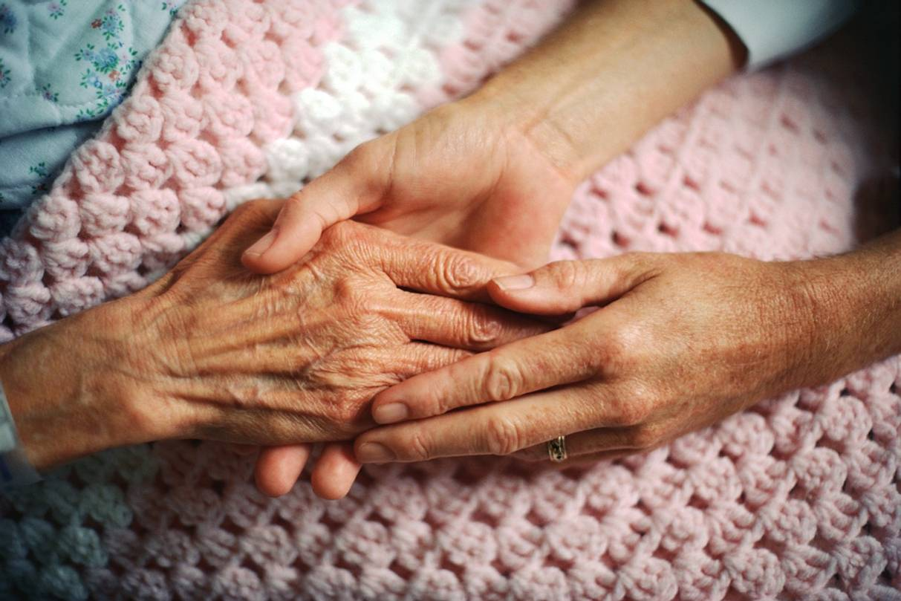
Goal
To educate and encourage the positive attitude of empathy in health care workers when interacting with the geriatric population.
Notes:
The main goal is to educate and encourage the positive attitudes to these group of people who are taking care of geriatric population.

Slide 7
Methods
Faculty recruited senior level baccalaureate nursing students.
A total of 115 senior level baccalaureate students have contributed to the program over the last 6 academic years. This semester, a total of 15 students is involved in the program.
Faculty oriented the students to the equipment.
Notes:
Now the question is how we do this? We teach them about various ailments associated with elderly populations through the use of simulation equipments. Faculty recruits 15 students and train them to use these equipments and we go the hospitals and provide them the in-service.

Slide 8
In-service Design
The health care workers visited four different stations designed to simulate “old age.”
Hearing/ Vision station
Wound Prevention station
Empathy Lung C.O.P.D station
Physical Limitation station
Viewed “See me” DVD
Notes:
The typical design of in-service is we have four stations: Hearing/ Vision station, Wound Prevention station, Empathy Lung C.O.P.D station
And Physical Limitation station
At the end we show them a short movie called “see me.”

Slide 9
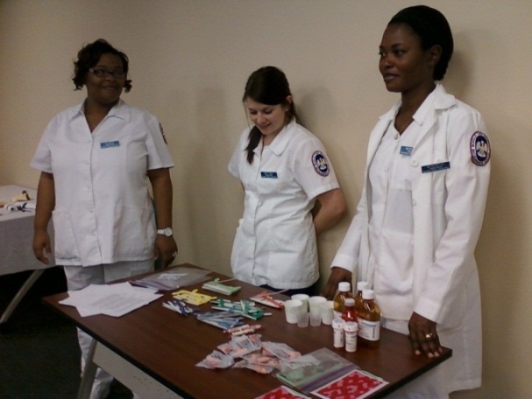
Hearing/Vision Station
cataracts
glaucoma
macular degeneration
retinopathy
hemianopsia
detached retina
Notes:
In the hearing and vision stations, participants are able to experience different vision challenges such as glaucoma, cataract, macular degeneration through the use of glasses like these. We make the participants to read the newspaper and the labels of medicine bottles with those glasses on. Also, we have ear plugs and we would make them to participate in conversation with the ear plugs on.

Slide 10
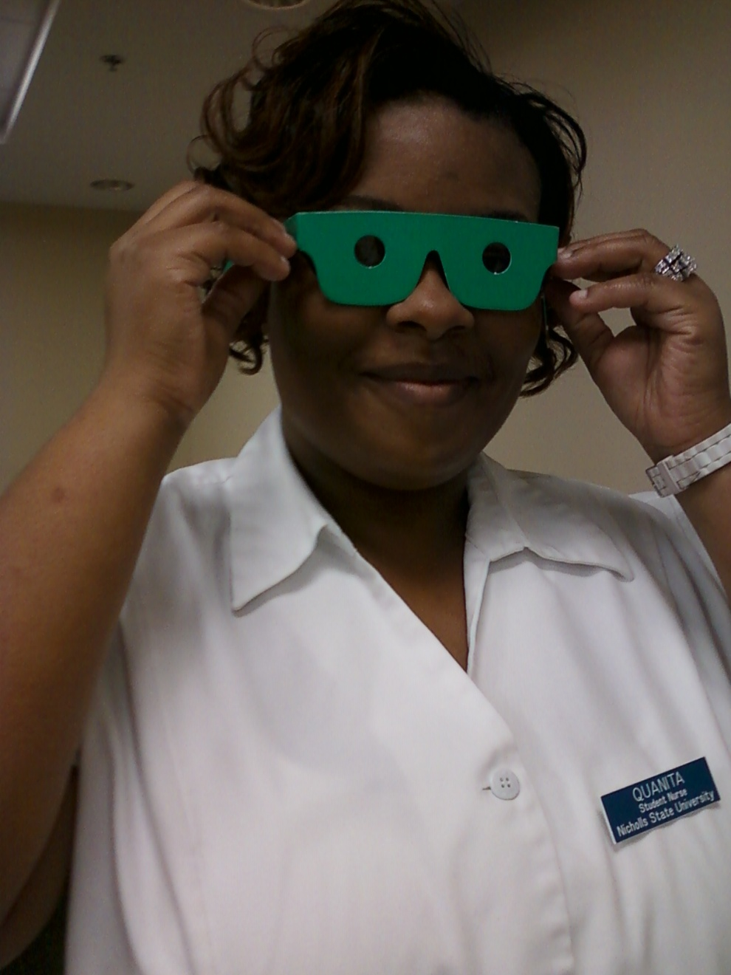
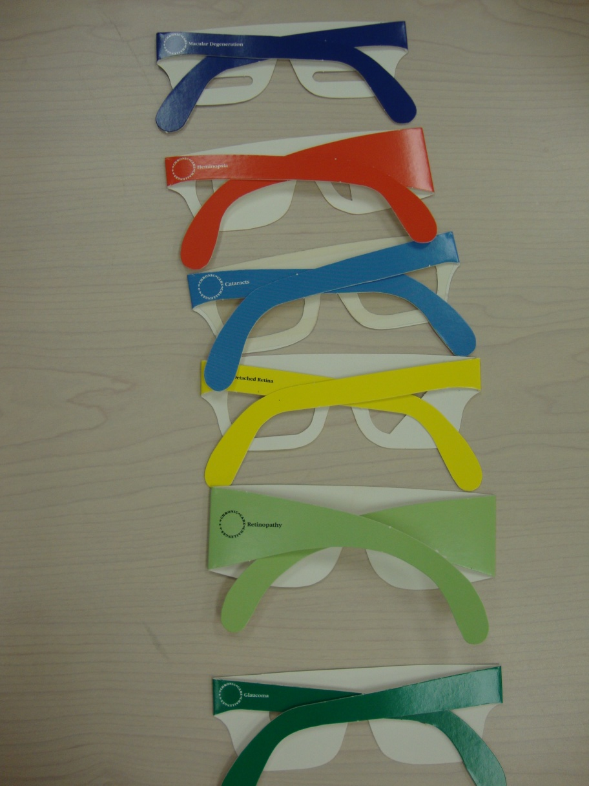
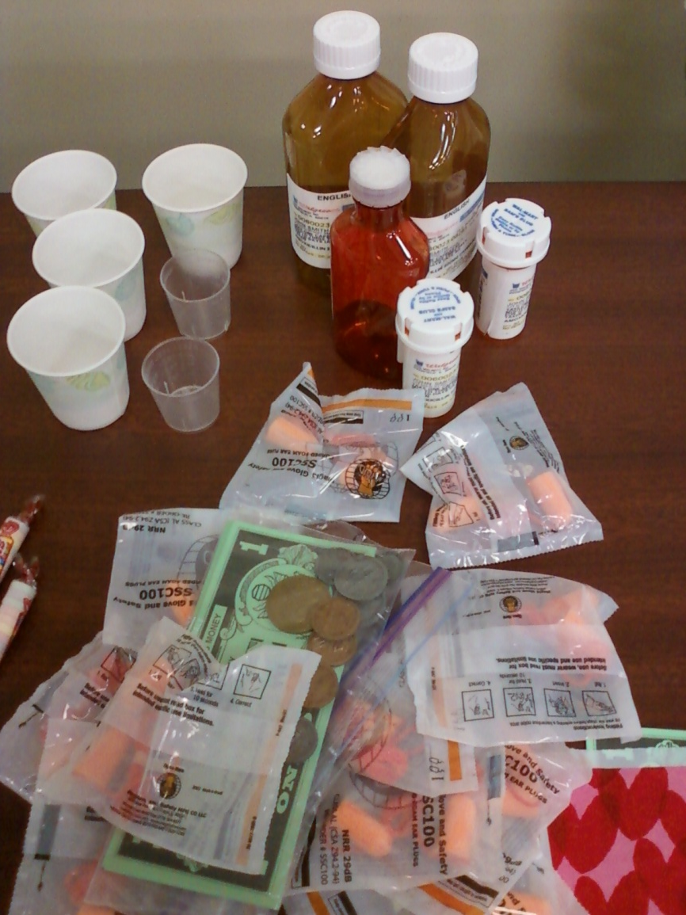

Slide 11
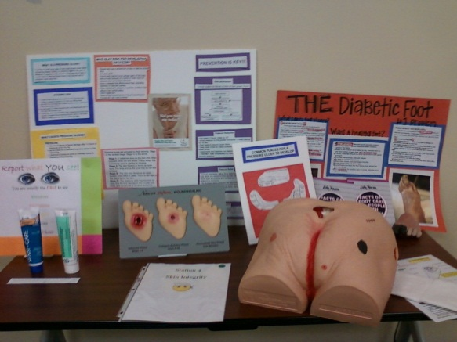
Wound Prevention Station
The Decubitus Wound Care Model
The Life/form Unhealthy Foot Model
The Life/form Wound Healing Display
Notes:
Another station is , wound prevention station. In this station, we show them the graphic images, and the real, life-size replica of decubitus wound care model, diabetic foot, and the different stages of wound healing. We also teach them how simple things like turning them every 2 hours or floating the foot with a pillow or putting a barrier cream over red spot can prevent pressure ulcer. I believe these information are mostly very important to the CNAs they are the ones who get to see any potential problem in their body while bathing them everyday. If we can train them to identify these early sign and symptoms, we could prevent it from getting worse.

Slide 12
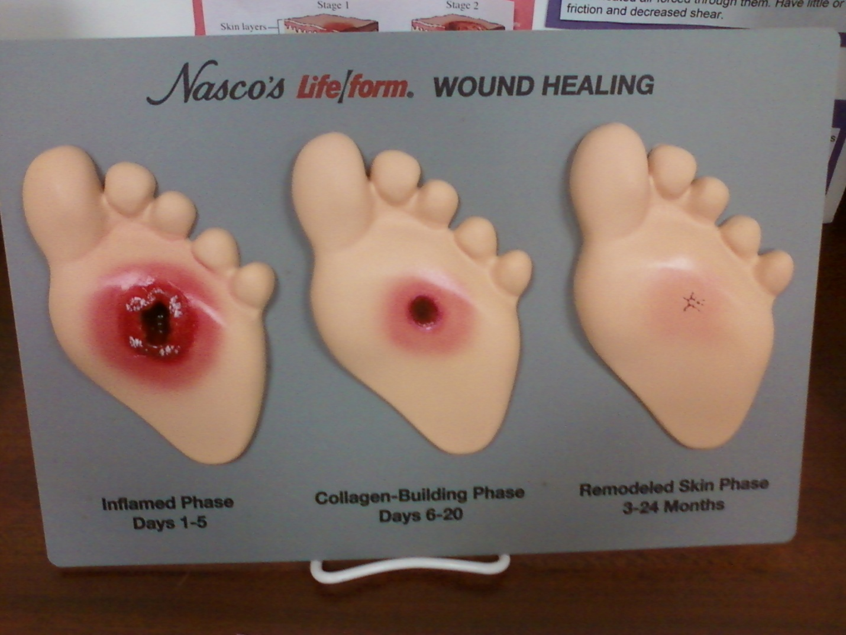
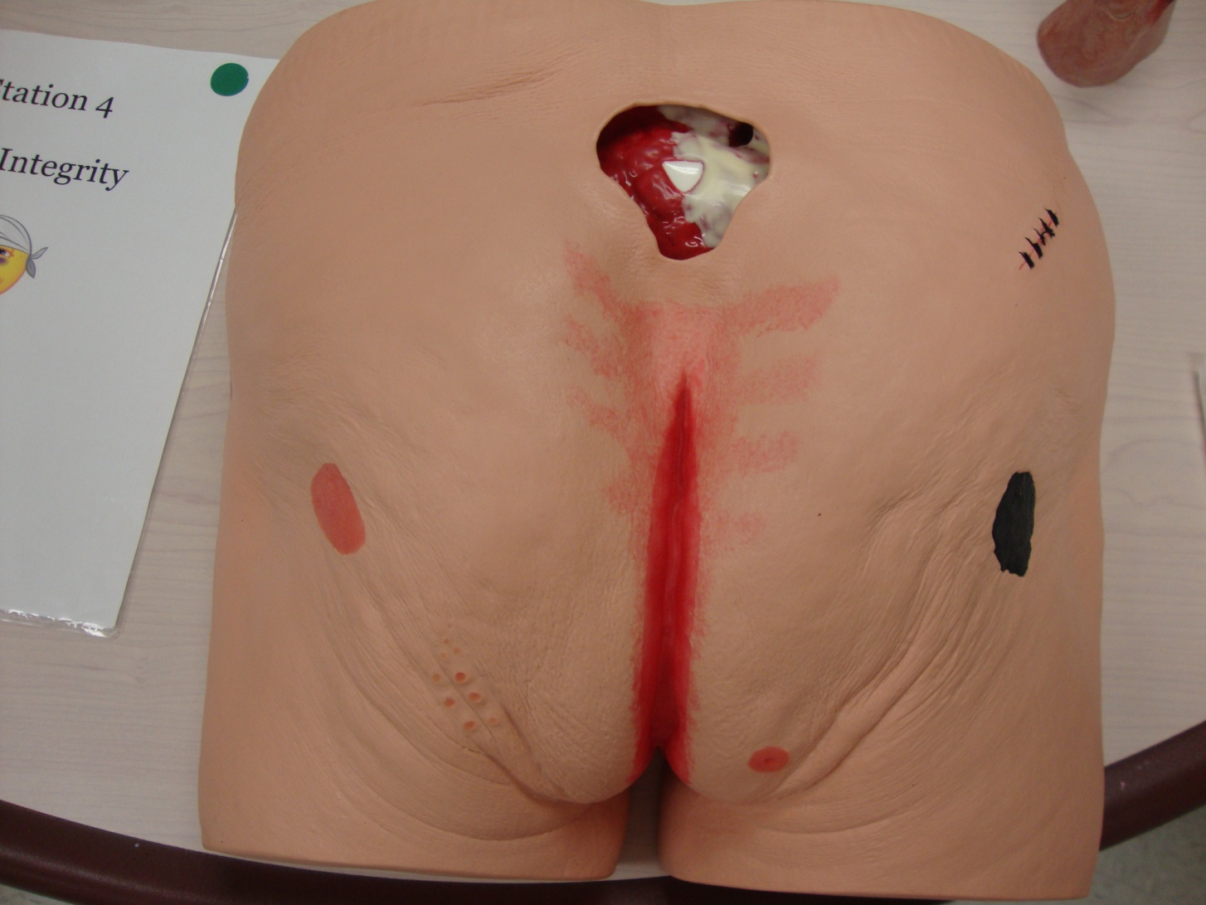
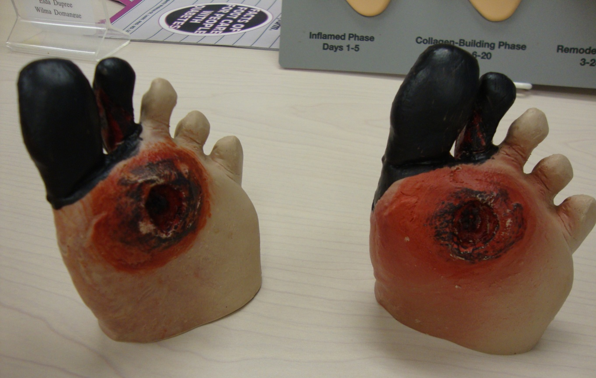

Slide 13
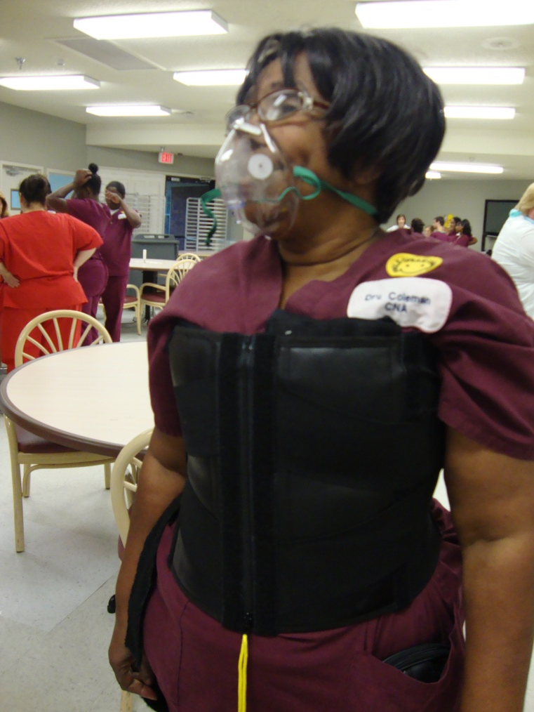
Empathy Lungs C.O.P.D Station
truss-like garment weighted and worn around the torso
customized airway mask
Notes:
The next station is Empathy Lungs C.O.P.D (chronic obstructive lung disease) station. In this station, we have this truss like garment that the participants can put it on. After you apply this garment around your upper body, it decreases the capacity of lung to expand which mimics the conditions such as C.O.P.D or asthma. We measure their lung capacity before putting on the garment and after putting on the garment. This activity really allows them to observe and experience how drastically their breathing is affected when we have conditions like COPD or asthma.

Slide 14
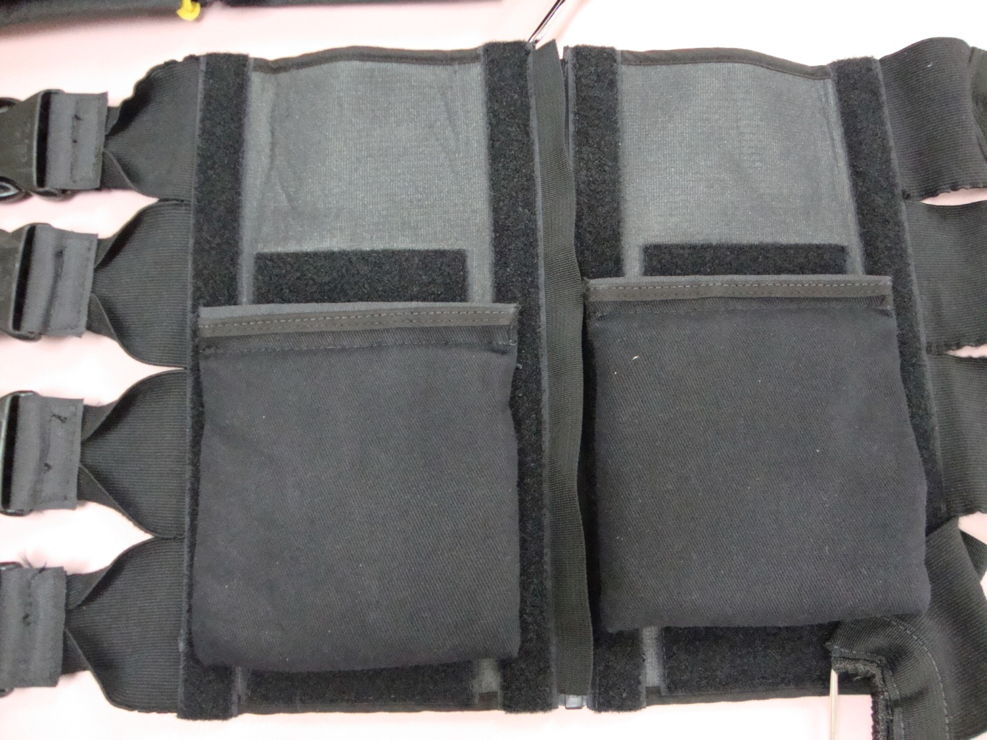
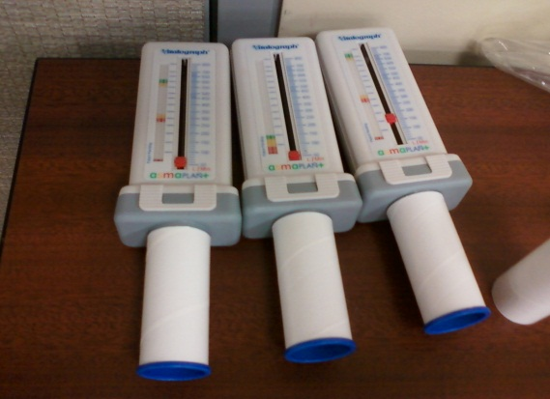

Slide 15
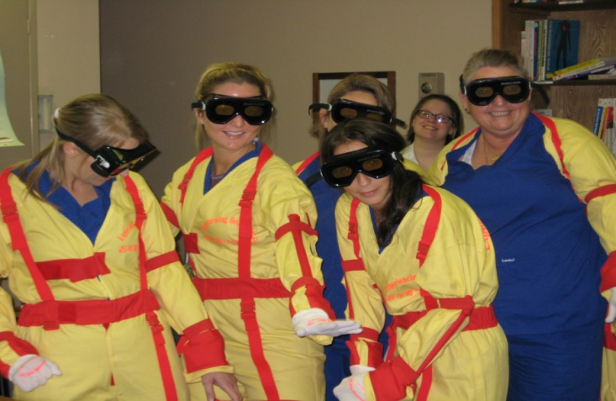
Physical Limitation Station
vision changes
limited movement
dull sense of touch
stiffening of joints
numbness
difficulty with raising arms and legs
Notes:
The last station is the physical limitation station. In this station we have these yellow suits which after you put it on allows you to experience various physical limitations experienced by the elderly people with arthritis or chronic back pain.

Slide 16
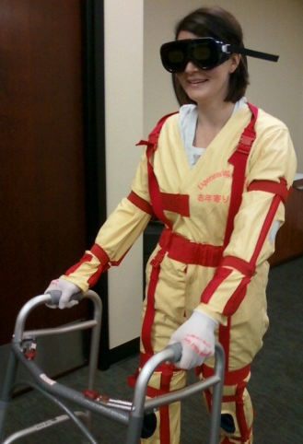
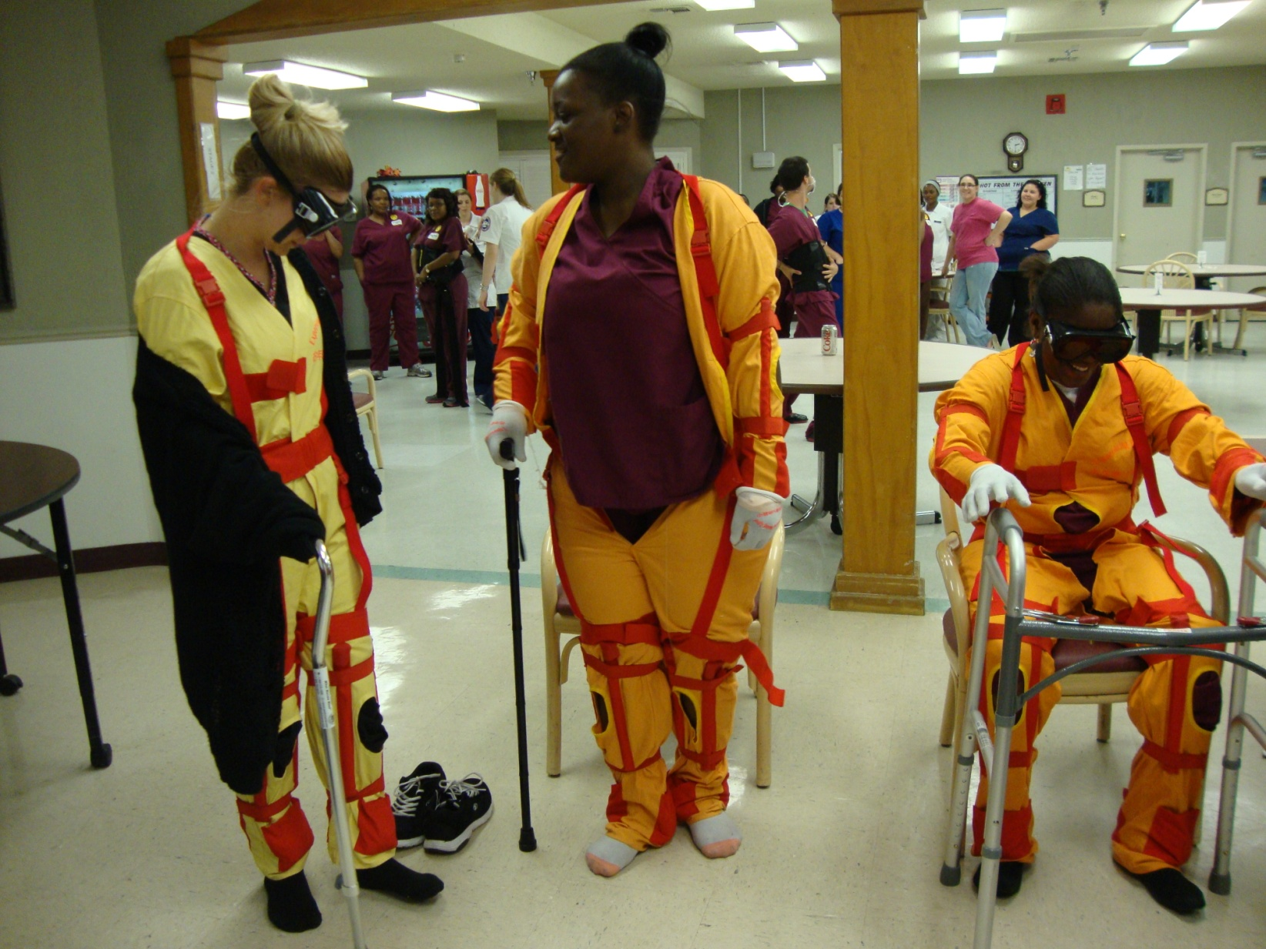
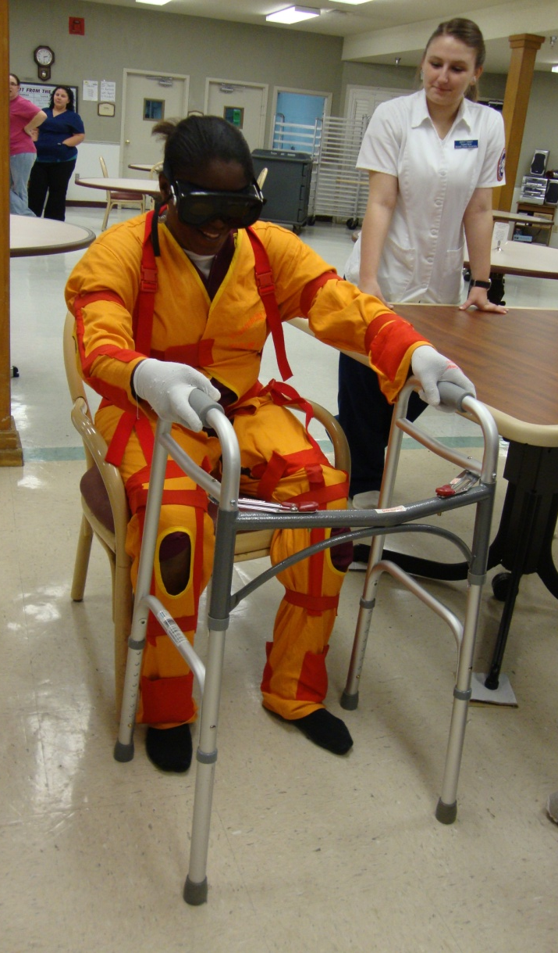
Notes:
After putting on the suit we usually make them to tie their shoe laces, or pick up something that is dropped on the floor. And the braces on these suits really makes it difficult to complete those simple task that we do in split of a second. Likewise the gloves mimicks the decreased sense of touch of the hands and the glasses decreases the peripheral vision.

Slide 17
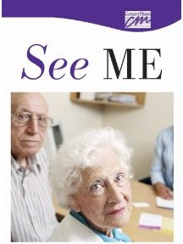
“See me”
It is a short movie by Sasha Oster, inspired by a poem written by an anonymous nursing home resident, depicting an older woman reflecting on her life while appealing to a nurse to look beyond her old age and truly “see” her as a valued individual (Eymard et al., 2010).
Notes:
At the end, we show them a short movie “ see me” which is a ….. By showing this video at the end of the in-service, it really allows the participants to reflect on all those difficulties that elderly people face on day to day basis and make them really think how they differently they should carry out their care activities.

Slide 18
Results
After analyzing the qualitative data from the student journals, 4 themes emerged within the data.
Nervous/ Anxious
Fun
Teacher/ Educating
Empathy
Notes:
For this qualitative study, we used student journals to study the results of the project. We analyzed their journals line by line and we were able to identify four major themes from them. They were :
Nervous/ Anxious
Fun
Teacher/ Educating
Empathy

Slide 19
Nervous/ Anxious
“I was a little nervous about teaching people who have been in the hospital longer than I have.”
“…am honored to be a part of. It gives me as a student, the opportunity to change lives and that speaks wonders. I did not know exactly what to expect, but I was sure ready to take on this responsibility.”
Notes:
The participants were anxious about teaching the group of people were already an expert in their field.

Slide 20
Fun
“We had fun laughing at each other try to perform simple tasks of daily living.”
“As the groups were in progress I noticed the CNAs who were earlier grumbling, now laughing and enjoying trying on the old age suit, empathy lungs and eye glasses.”
Notes:
Since it was a interactive in-service, participants had fun while they were trying those garments which is also evidenced by the pictures we saw earlier.

Slide 21
Teacher/ Educating
“It was a fun experience and at the same time a great teaching tool. I felt after such an experience, the nurses will now have a different mindset and also a positive attitude in the care of the older adults to best meet their individual needs.”
Notes:
The senior level nursing students were really able to utilize this project as the opportunity to perform the role of a teacher. They felt that this experience served as a great teaching tool by which they were able to bring the change on the mindset of people taking care of older adults.

Slide 22
Empathy
“One of the CNA said, “I can’t imagine not being able to flat iron my hair because I do that every day.” She had actually put on the limitation suit and could clearly understand how difficult it is to carry out basic functions like combing the hair.”
“… was very educational and eye-opening. I can’t help but feel remorseful for any time that I did not take the time to really offer my assistance to any older adult…”
Notes:
One of the most important theme that we were able to identify was empathy. The feeling of empathy was evident all over the students journals. The students commented how educational and eye-opening this experience was. She said that she couldn’t help but feel remorseful for anytime that she did not take time to really offer some assistance to any older adult. My another colleague wrote, one of the CNAs who participated in the in-service mentioned, I can’t imagine not being able to flat iron my hair because I do that every day. The CNA was able to realize the frustration that older adults feel for not being to groom themselves everyday. Likewise, another mentioned how she would never rush any elder patient through seemingly simple task because she now realized they are doing as fast as they can.

Slide 23
Discussion/ Conclusion
The in-service served to reinforce the feeling of empathy in the student nurses and the participants as evidenced by the excerpts from the student journals.
In the future, this project has the potential to be established as a leading program to allow health care workers to learn about the importance of empathy towards older adults.
Notes:
So, I believe that this service learning tool really has the ability to reinforce the feeling of empathy in the participating health care employees and the students nurses which is evidenced by the excerpts from the students journals. This project has the ability to deliver the message subtly but profoundly. Since the participants are able to get the hands-on experience it allows them to really think over or possibly change their usual care practices. And, I think that is what makes this project unique from other simulation projects. I think in the future, this project really has the ability to be established as the leading program to allow health care workers learn about the importance of empathy towards older adults.

Slide 24
Discussion/ Conclusion
The students:
were able to serve as teachers and leaders while teaching the participants about ailments associated with older adults.
had an opportunity to give back to the community by providing the in-services to local agencies.
were able to interact with healthcare providers already in the field in similar and conjoined disciplines.
were able to look within themselves as healthcare providers and reflect on their perceptions of aging and caring for the geriatric population.
Notes:
Likewise, the future leaders of health care world, the student nurses….

Slide 25
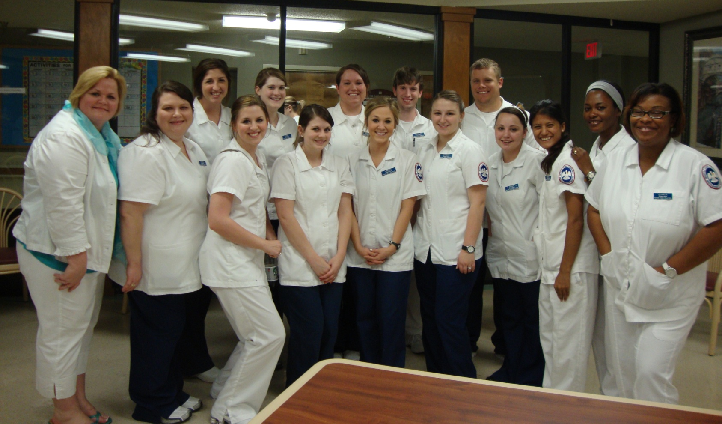
Thank you!!!
Notes:
Lastly, I would like all these wonderful people who helped me to prepare this project by providing their student journals. I want to thank my mentor, Dr.Amanda Eymard for providing me the opportunity to be involved this project.

Slide 26
References
Eymard, E.S., Crawford, B., & Keller, K.M. (2010). “Take a walk in my shoes”: Nursing students take a walk in older adults’ shoes to increase knowledge and empathy. National Gerontological Nursing Association 27(2), 137-141.
Institute of Medicine. (2008). Retooling for an aging America: Building the health care workforce. Retrieved from the National Academics Press website: http://www.nap.edu/catalog.php?record_id=12089
Koren, M.E., Hertz, J., Munroe, D., Rossetti, J., Robertson, J., Plonczynski, D.,…Ehrlich Jones, L. (2008). Assessing students’ learning needs and attitudes: Considerations for gerontology curriculum planning. Gerontology & Geriatrics Education, 28(4), 39-56. Doi:10.1080/02701960801963029
Krout, J.A., & McKernan, P. (2007). The impact of gerontology inclusion on 12th grade student perceptions of aging, older adults and working with elders. Gerontology & Geriatrics Education, 27(4), 23-40. Doi:10.1300/J021v27n04_02
National Institute of Nursing Research. (2006). Changing practice, changing lives: NINR strategic plan. Retrieved from http://www.ninr.nih.gov/NR/rdonlyres/9021E5EB-B2BA-47EA-B5DB- 1E4DB11B1289/4894/NINR_StrategicPlanWebsite.pdf
United States Census Bureau (2010). Age and sex composition. Retrieved March 5, 2012 from http://www.census.gov/prod/cen2010/briefs/c2010br-03.pdf

