Slide 1
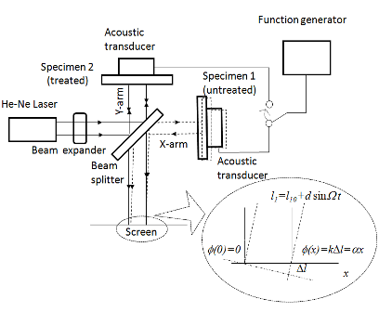
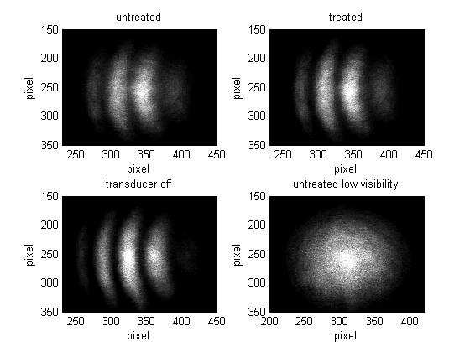
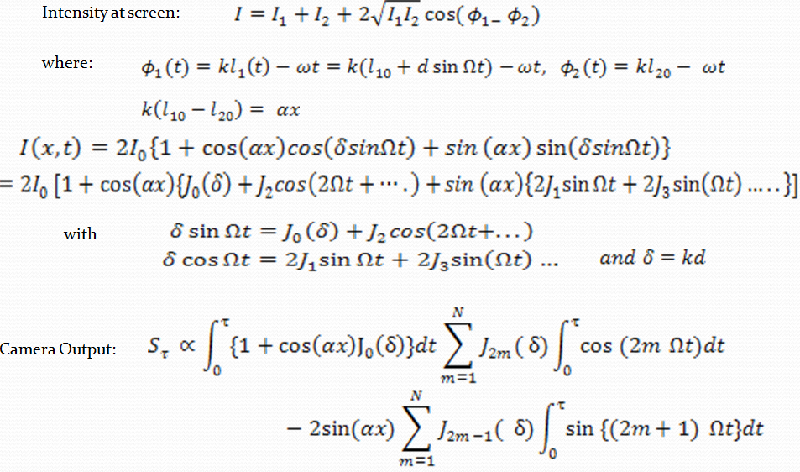
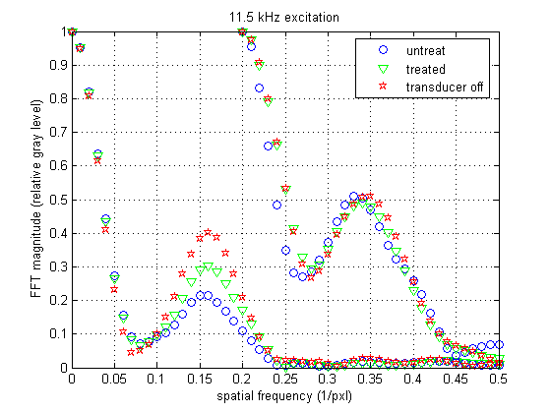

Characterization of Thin-Film Adhesion with Michelson Interferometer
Sushovit Adhikari, Sanichiro Yoshida
Department of Chemistry and Physics, Southeastern Louisiana University
Abstract
A Michelson Interferometer is used to evaluate the adhesion strength of thin-film systems. The specimens (gold-coated silicon wafers) are configured as the end mirrors, and are driven from rear with an acoustic transducer so that the specimens oscillate parallel to optical axis at moderate frequencies. The resulting film surface displacement is detected as a fringe shift of the interference intensity pattern behind the beam splitter with a digital imaging system. The difference in adhesion strength between two types of specimens is successfully visualized as the difference in the fringe contrast. Fourier analysis on the fringe pattern quantifies the fringe contrast.
Motivation behind the research
There are number of applications of nano-scale thin-film systems, ranging from semiconductor chips to artificial joints. One of the most important parameters that determine the quality of these systems is the strength of adhesion at the film-substrate interface. Available methods to evaluate film-substrate interface can be classified as a destructive methods and non destructive methods. But the methods available have many shortcomings. Some are expensive while others are time consuming. So there is a need for a method to overcome all these difficulties.
Hardware Arrangement and Theory
Displacement Using Bessel Function
Peak Ratio to 0 V input for 10 kHz
Qualitative Analysis
Intensity Profile
Peak Ratio to 0 V input for 10.42 kHz
180
11.5 kHz excitation
The thin-film specimen to be tested is configured as the end-mirror of a Michelson interferometer with coated side facing inward toward the beam splitter so that acoustic transducer attached to the substrate on the rear surface oscillates the specimen parallel to the optical path. The oscillation changes the optical path of the arm so that when the light reflected by the film surface is recombined with the light returning from the other end mirror the relative phase difference is modulated at the driving frequency of the transducer. When specimen is oscillated by the transducer, the fringes oscillate horizontally at the same frequency as the film surface's oscillation. The camera has a low frame rate, so this effect of oscillation is detected as blurriness of the fringe pattern.
160
untreated
O
plasma treat
2
140
transducer off
120
100
gray level
80
60
40
20
Bare silicon 0 V input Peak ratio for 10.6 kHz
0
200
250
300
350
400
450
horizontal pixel
Frequency Vs. FFT Peak Value
Fourier Transform of Thin Film Samples
Conclusion
Recent development confirmed previous results quantitatively. Bessel function was used to quantify oscillation amplitude.
Acknowledgement
Southeastern Louisiana University Star Grant

