Slide 1
The Safety Hazards of Lead Paint in the Natchitoches Historic District
Notes:
Begin with intro to you…
Name
School
Major
My senior projects community partner My senior presentation is sponsored by the Natchitoches Historic Districts so in this presentation I will give specific information relating to historic structures. The Natchitoches Historic District consist of historic homes, museums, bed and breakfasts, restaurant, libraries, and churches. Most of our cities in Louisiana have historic buildings that we cherish and value … as a result, this information applies to not only Natchitoches’ Historic Districts but to any historic buildings and structures in other areas. Today I would also like to give you some background information on lead paint and how it relates to the common everyday citizen and our communities.
This is not only pertains to the Historic Districs but to the everyday life of a citizen….

Slide 2
How many of you live in a house or work in a historic structure that was built before 1978?
Notes:
The reason why I am asking this question is because most House paint before 1978 were often painted with lead paint. Lead paint presents many hazards and risks to those living in homes that were built before 1978.

Slide 3
Notes:
Here you can see the likelihood of whether your house may contain lead based paint or not…. As you can see the houses between 1960-1977 have so so percentage houses between 1940-1959 has percentage and houses before 1940 has percentage are likely to have lead paint…..
These house might have lead paint in them but if the lead paint is not in bad shape it is probably not harmful…..

Slide 4
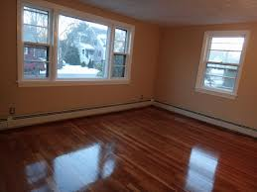
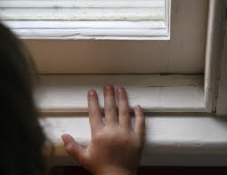
Where is lead found?
Notes:
Lead-based paint Is commonly found: was used extensively on wooden exteriors and interior trimwork, window sash, window frames, baseboards, wainscoting, doors, frames, and high gloss wall surfaces such as those found in kitchens and bathrooms. Almost all painted metals were primed with red lead or painted with leadbased paints. Even milk (casein) and water-based paints (distemper and calcimines) could contain some lead, usually in the form of hiding agents or pigments. Varnishes sometimes contained lead. Lead compounds were also used as driers in paint and window glazing putty.
Did you know that lead paint can be found in the soil around your home….
Eyelevel…
Mouth the window at there height..
Pull up on it and get dust from the window seals or baseboards which causes them to ingest the lead paint which can cause the symptoms……
As you can see Lead paint can affect everyone in your family but children are at the highest risk…. Lead has a sweat flavor which explains why children chew on lead painted surfaces….
Lead paint is a poison….

Slide 5
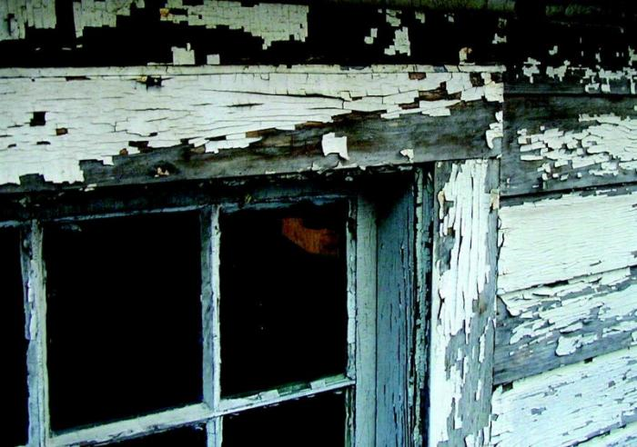
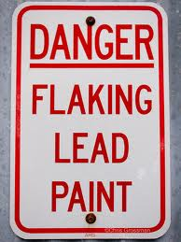
Why are we concerned?
Notes:
Have you ever seen a house or a historic building look like this…. Your house or families members house might not be flaking to this extent…. Any cracking peeling, and flaking creates a risk of lead hazard…..This is harmful to human beings in many ways….. This pictures shows or depicts the chipping and flaking of lead paint. Lead in the soil surrounding your home, caused by flaking lead paint on its exterior, since it is a risk to children playing outdoors and a prime spot to be track inside by shoes. In urban areas, even fully lead-safe houses can be re-contaminated within a year from lead or dirt outside the immediate property.
Deteriorating lead-based paint (peeling, chipping, chalking, cracking, damaged, or damp) is a hazard and needs immediate attention. •It may also be a hazard when found on surfaces that children can chew or that get a lot of wear-and-tear, such as: ◦Windows and window sills, ◦Doors and door frames, ◦Stairs, railings, banisters, and porches
There is a Lead blood test for children…..

Slide 6
Symptoms from Lead Poisoning
Symptoms include:
•Headaches
•Hearing problems
•Muscle and joint pain
•High blood pressure
•Trouble with digestion
•Reproductive problems
•Difficulties in pregnancy
•Loss of memory and concentration
Lead can enter the bloodstream by ingesting contaminated dust, eating paint chips, or breathing fumes or dust from sanding or torching.
Notes:
Here are some symptoms and how they can affect you as individual and your family…. So if you have some of these symptoms you should check into how old your house and maybe lead paint is causing your headaches or hearing problems….
How lead paint affects your children….
•Damage to the brain and nervous system
•Reduction in I.Q. levels
•Learning disorders
•Behavioral problems
•Slowed growth
Lead can enter the bloodstream by ingesting contaminated dust, eating paint chips, or breathing fumes or dust from sanding or torching.

Slide 7
How lead paint affects your children…
•Damage to the brain and nervous system
•Reduction in I.Q. levels
•Learning disorders
•Behavioral problems
•Slowed growth
Notes:
So if you see one or more of these problems in your child, there is a blood test for children that tests specifically for lead. Contact your child’s doctor or nearest health care center.

Slide 8
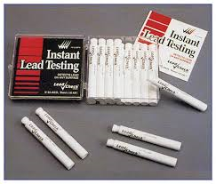
Prevention and Protection
Notes:
LeadCheck is easy to use: You just crush the ends of the LeadCheck swab like a Bright Glow Stick so the chemicals inside mix, and then you dab the end of the swab to the material you want to test. If the end of the swab turns pink or red, the surface contains lead.
If lead paint is not handled properly it can increase the danger….
A portable x-ray fluorescence (XRF) machine. u Lab tests of paint samples. u Surface dust tests. Home test kits for lead
One way to accurately determine the amount of lead present in older paint is by the instant lead tester
CT 26 HEPA VAC and RO125 Sander
So how are we protected from lead health hazards… Must follow EPA guildlines to remodel a home

Slide 9
Policies and Procedures
HEPA vacuums
HEPA filters to control the lead dust
HEPA respirators reduce exposure to
lead dust
Two Approaches for controlling
lead hazards:
- Interim Controls
- Hazard Abatement
Notes:
Interim controls: Short term solutions include thorough dust removal; thorough wash-down and clean-up of exposed surfaces; paint film stabilization and repainting; covering of lead-contaminated soil
Hazard Abatement: Long term involve permanent removal of hazardous paint through chemicals, heat guns or controlled sanding/ abrasive methods; permanent removal of deteriorated painted features through replacement; the removal or permanent covering of contaminated soil

Slide 10
RESTORATION
Notes:
This is a Before and After picture of large-scale historic rehabilitation project incorporated in a sensitive lead-hazard reduction measure that will not take none of the historical buildings character away.
Housing = Renovate and Remodel Historic Structures = Repair, Restore, and Preserve

Slide 11
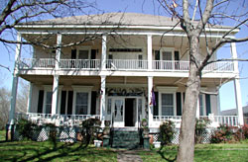
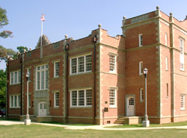
Lead is everywhere….
Notes:
What can you do to present Lead Poison because it is everywhere….. So you must be educated on it and be aware of the safety hazards and risk that it can present….

Slide 12
REFERENCE
Frantom , Mrs. Marcy . Personal interview. 28 Mar. 2013.
Book: Lead safety for renovation, repair, and painting: joint EPA - HUD curriculum: model certified renovator initial training course.. (2010). S.l.: EhsMaterials.com.
Book: The preservation of historic architecture: the U.S. government's official guidelines for preserving historic homes. (2004). Guilford, CT: Lyons Press.
Book: Park, S. C., & Hicks, D. C. (1995). Appropriate methods for reducing lead-paint hazards in historic housing. Washington, D.C.: U.S. Dept. of the Interior, National Park Service, Cultural Resources, Preservation Assistance.
"Dangers of Lead Paint in Your Home | Today's Homeowner." DIY Home Improvement | How to Videos and Articles | Danny Lipford. N.p., n.d. Web. 3 Apr. 2013. <http://www.todayshomeowner.com/dangers-of-lead-paint-in-your-home/>.

