Slide 1
Doing Local History of an African/American Church: Chackbay’s Little Zion
ACTIVE LEARNING: engaging the student in applied learning
Presented by:
Ms. Tina Granger, MSW, LMSW
Ms. Valorie Druilhet
NSU Government and Social Sciences Department

Slide 2
Traditional learning styles involved:
Lecture
Discussion and Review
Test

Slide 3
Service Learning
Partnering with community businesses
Building a link between student interest and job readiness
Real world experiences
SOCI 403 – averages 8 students per semester

Slide 4
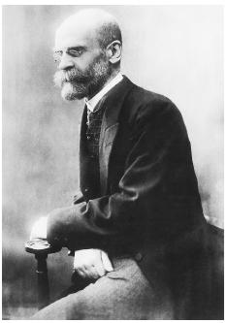
Emile Durkheim
“Religion is first and foremost a system of ideas by means of which individuals imagine the society of which they are members”

Slide 5
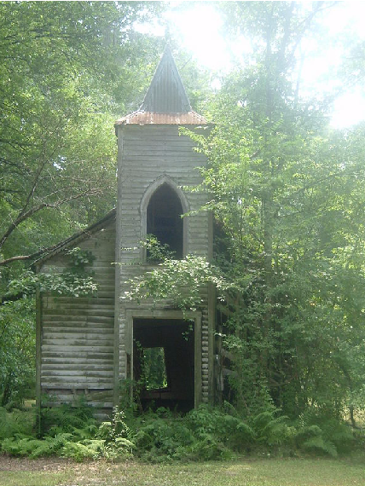
Independent Study
Little Zion – St. Luke Baptist Church
FA12 – 11 students participated
Genealogical research
Historical data analysis
African/American burial practices
Oral History Collection
Data Archiving

Slide 6
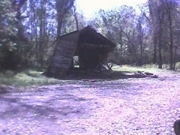
Frontal View of Collapsed Church Steeple
The winds of March and April , 2011 took their toll on the fragile structure of St. Luke’s Baptist Church.

Slide 7
Incorporation – April 24, 1891
Gaining identity beyond Chackbay.
The following names appear as members of Little Zion above the age of 21.
Anderson, Riley Mage, Lehazley
Anderson, Thomas Mage, Jashofean
Coleman, Candice Palmer, Millie
Eliza Conrad Parks, Abraham
Folse, Betsy Parks, Georga
Green, Edward Parks, Mary
Green, Joseph Parks, Rose
Folse, Julan Parks, Sarah
Hills, Jack Rhiley, Rachell
Jones, Horace Robinson, Susanna (Annie)
Lewis, Jones Robinson Willaim
Jackson, Santy Walker, David
Jones, Molto Willaims, Sealy
Jones, Odelia Willaims, Squire
Joseph, B. Garden
Lemon, Betsy

Slide 8
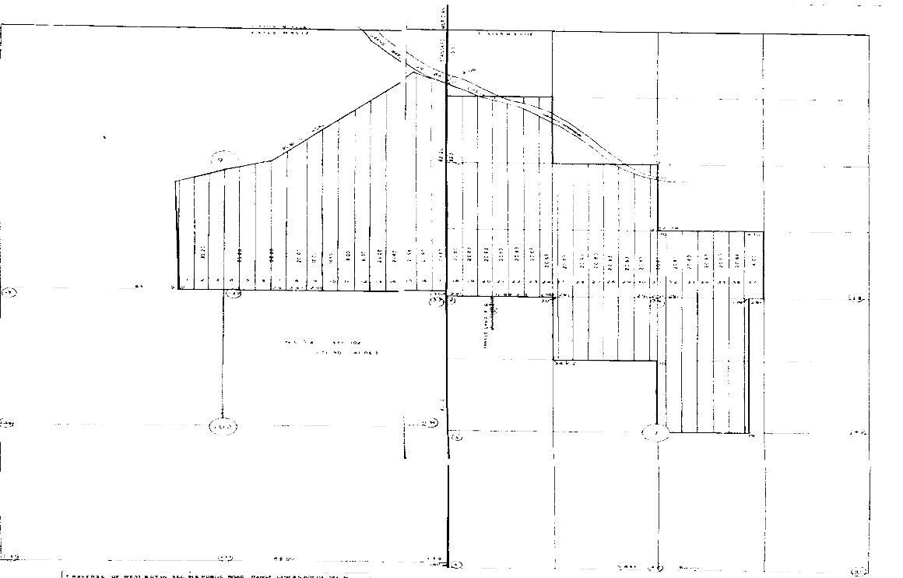
Land Survey of Cleona Plantation

Slide 9
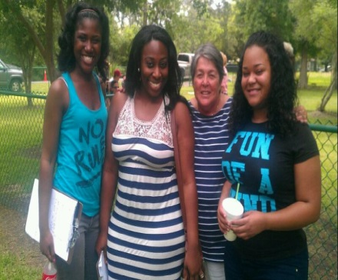
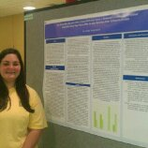
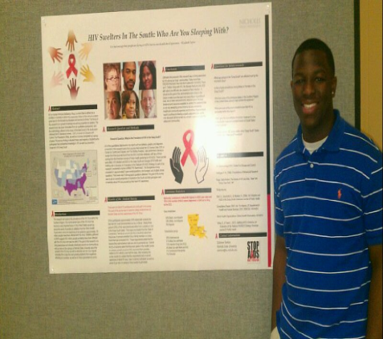
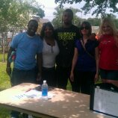
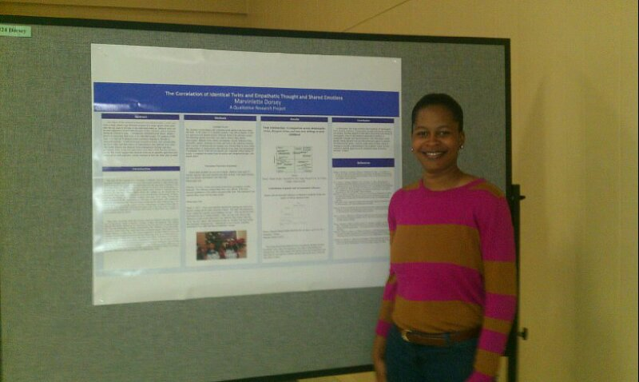
Research
Chauvin Sculpture Gardens
Research Week
Survey construction
Administration
Coding
Community
awareness
April 21, 2013

Slide 10
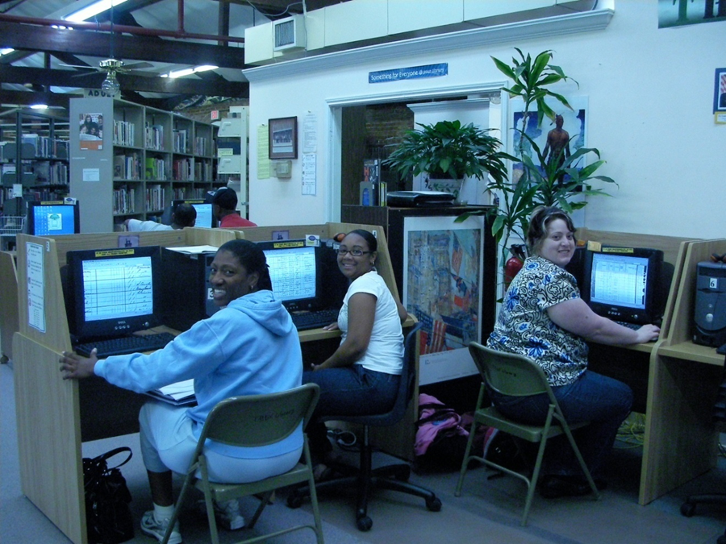
NSU Workshops
Ellender Library Online
Go to the Student Portal
http://www.nicholls.edu/library/student-portal/
Interactive workshops:
Plagiarism, Boolean word search,
How To….
Ellender Computer Lab
Class Workshops
Genealogy & Religious Studies and Mythologies

Slide 11
The African American
Homegoing Celebration
*African American history has its roots in slavery.
*Slavery made death seem like a welcomed departure.
African American funerals became a happy and celebratory affair. Going home to glory.

Slide 12
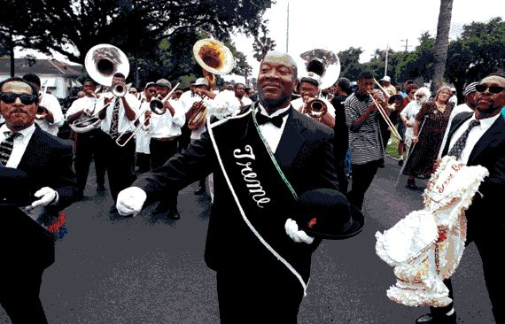
New Orleans, Louisiana
Parades with Extravagant Costumes

Slide 13
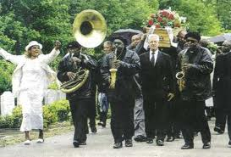
Dancing in the streets!

Slide 14
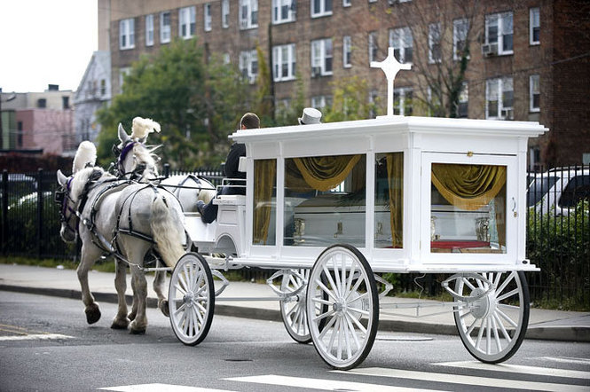
Funeral Procession – A Horse Drawn Carriage
State Superior Court Judge Shirley A. Tolentino

Slide 15
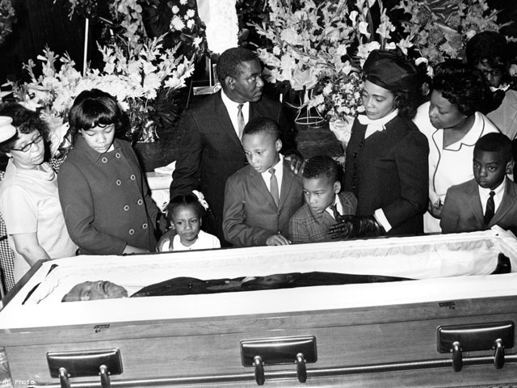
Dr. Martin Luther King, Jr.

Slide 16
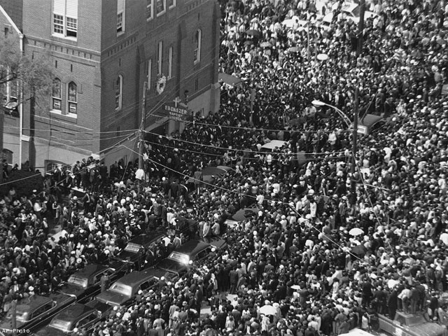

Slide 17
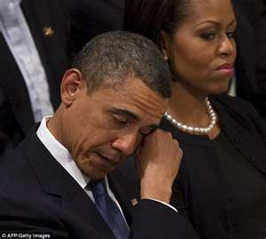
The U.S. president was weeping openly as he watched the service for Dorothy Height in Washington.

