Slide 1
Salmonella Colonization Rates in Green Anoles of Southwest Louisiana
Robert Patten, Jay Comeaux and Kathy Jackson
McNeese State University
Lake Charles, LA

Slide 2
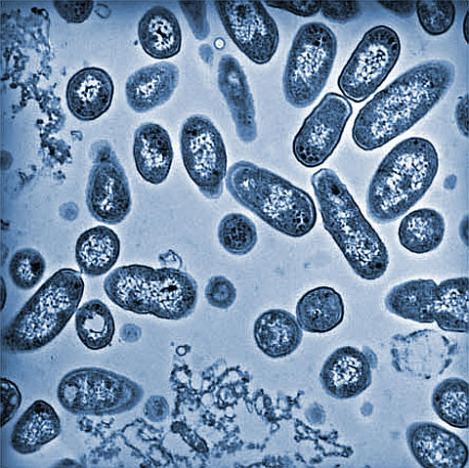
Salmonella
Rod shaped Gram-negative bacterium
Enterobacteriaceae Family: E. coli
and Klebsiella
Salmonella enterica and Salmonella
bongori
6 subspecies of Salmonella enterica
Salmonella enterica serovars
Salmonella Enteritidis and Salmonella Typhimurium
Notes:
Salmonella is a rod shaped gram negative bacterium that belongs to the family Enterobacteriaceae. Other members of this family include E. coli, and Klebsiella among others. Salmonella is divided into 2 species: Salmonella enterica and Salmonella bongori. The Salmonella enterica species is divided into 6 subspecies and has over 2500 serovars which differ in their antigenic specificity. The most important serovars for human infection is Salmonella Enteriditis and Salmonella Typhimurium.

Slide 3
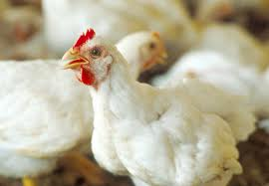
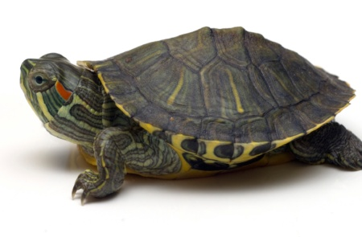
Salmonella Infections
Infections are zoonotic
Sources of Infections:
Contaminated food
Fowl
Reptiles
Excretions from those infected
Diseases: Salmonellosis and Typhoid Fever
Notes:
Salmonella infections are zoonotic meaning the infection can be passed from animals to humans. The most common sources of infections is by ingesting foods especially poultry meat or eggs that have become infected with Salmonella. People have also developed Salmonella infections after exposure to excretions from infected animals. Many animals are know to harbor Salmonella in their digestive tracts including reptiles. Salmonella has been detected in a number of reptiles including turtles, snakes, and lizards. The most common illness associated with Salmonella infections is Salmonellosis, which can cause gastroenteritis including diarrhea, vomiting, and stomach cramps. Salmonella is also the causative agent in Typhoid fever.

Slide 4
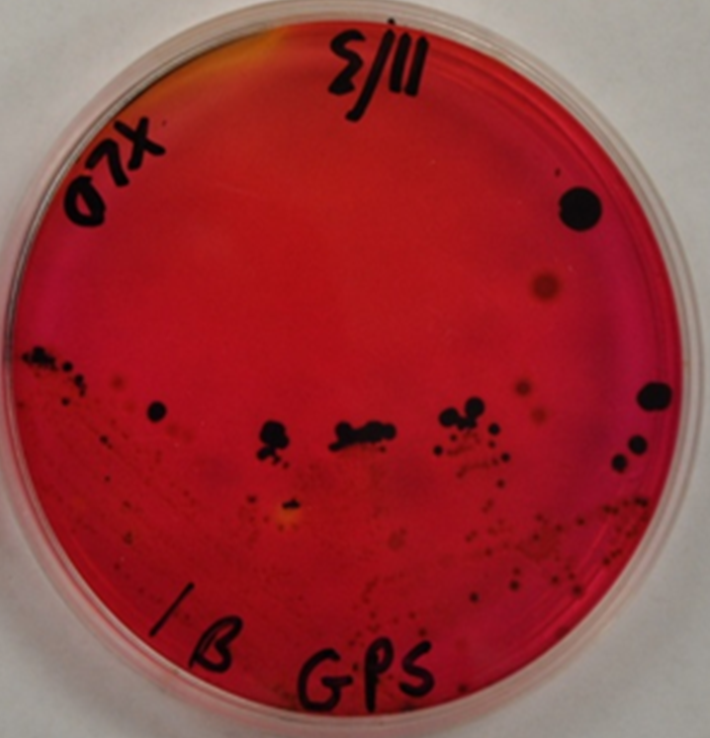
XLD Agar Detection of Salmonella
Shigella- red colony
Salmonella and Edwardsiella – red colony with black center
Notes:
The standard microbiology method for detecting Salmonella is XLD agar. In this assay, most bacteria will appear as a yellow, pink, or red colony, but Salmonella colonies will appear as a red colony with a black center. One complication of this method is that the Edwardsiella bacterium gives the same result. Therefore, in samples that may contain Edwardsiella, other steps must be taken to differentiate these two bacterias. Because of this potential complication, we wanted to use PCR for the detection of Salmonella in biological samples.

Slide 5
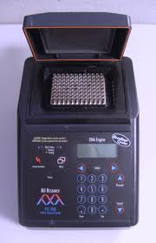
PCR
Notes:
In order to perform PCR, DNA must be isolated from a biological sample. The DNA is then used in a PCR reaction in a thermocycler. Describe how the PCR works with the figure I have drawn out.

Slide 6
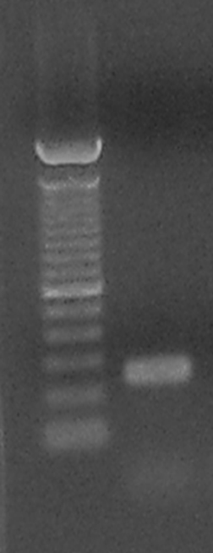
Gel Electrophoresis of PCR Samples
Notes:
The PCR product is then analyzed by gel electrophoresis. At the end of this process, you will get a band on the gel that corresponds to the length of the DNA between the 2 primers. You can add more to make sense.

Slide 7
Identification of Salmonella DNA by PCR
invA primers
Oliveira et al. 2002
Notes:
The first thing we did was a literature search to find published primers that were specific for Salmonella. Acknowledge paper that we got primers from and describe what we did and what it looked like on pure Salmonella DNA.

Slide 8
Specificity of Salmonella invA Primers
Notes:
You can come up with how to describe this slide.

Slide 9
Detection Level of Salmonella DNA
Lane 1= 100ng
Lane 2= 10 ng
Lane 3= 1 ng
Lane 4= 0.1 ng
1 2 3 4
Notes:
You come up with the description for this slide.

Slide 10
Green Anoles (Anolis carolinensis)
Range: Southeastern United States
Reports of pets causing Salmonellosis
Notes:
You can add to what you think should be said about this slide. Their normal range is from North Carolina south to Florida and west to Texas. They are arboreal (residing in trees) within natural habitats. It is the most common lizards in urbarn or suburban areas and can be found on fences or houses. That have been reported cases of children acquiring Salmonella infections from pet green anoles.

Slide 11
Salmonella Rates in Green Anoles
24% of Green Anoles tested positive for Salmonella.
Notes:
Describe this PCR which is a representation of some animals tested. Lane 1 is 100 bp DNA ladder, Lane 2 is Salmonella positive control, other lanes are animal fecal samples. Animals in 3, 4, and 11 are positive while others are negative.

Slide 12
Detection of Salmonella enterica serovars
Soumet et al. 1999
Park et al. 2009
Notes:
Now that we knew which animals were positive, we wanted to see if the Salmonella that the green anoles were harboring was Salmonella Enteritidis or Salmonella Tyhpimurium. We did literature search for primers and ordered them. Describe more.

Slide 13
Specificity of Salmonella serovar Detection
Salmonella enterica serovar | ATCC # | Enteritidis primers | Typhimurium primers
Enteritidis | 13076 | Pos | Neg
Paratyphi B | 8759 | Neg | Neg
Typhimurium | 14028 | Neg | Pos
Typhimurium | 13311 | Neg | Pos
Tranoroa | 10252 | Neg | Neg
Newport | 6962 | Neg | Neg
Notes:
You can create description.

Slide 14
Detection of Salmonella serovars in Green Anoles
Notes:
You can create description.

Slide 15
Conclusions
Salmonella invA, Salmonella Enteritidis and Salmonella Typhimurium primers are specific.
Detection level is 1ng which equals 200,000 cells.
Of the 50 green anoles tested, 12 tested positive (24%) for Salmonella using the invA primers.
Of the 12 positive animals, only one animal tested positive (8%) for Salmonella Enteritidis.

Slide 16
Aknowledgements
McNeese State University Department of Biology and Health Sciences
Notes:
Add as you want.

