Slide 1
SUZUKI COUPLING OF N-ALKOXYIMIDOYL HALIDES
Bijay Bhattarai
Faculty Advisor
Debra D. Dolliver
Kevin Shaughnessy
University of Louisiana System Academic Summit 2013
04/13/2013

Slide 2
Oxime
Oxime Ether

Slide 3
Conventional method for the synthesis of diaryl oxime ether
A. Rosenthal, Can. J. Chem. 1960,38, 2026.

Slide 4
Suzuki Coupling Reaction
Palladium catalyzed cross-coupling between organoboron compounds and
organic halides
Formation of carbon-carbon bonds
N. Miyaura, A. Suzuki, J. Chem. Soc. Chem Commun. 1979, 19, 867

Slide 5
Mechanism of Suzuki coupling reaction
Oxidative Addition
Reductive Elimination
Transmetalation
S.Kotha, K. Lahiri, D. Kashinath, Tetrahedron. 2002, 58, 9637.

Slide 6
Our Research Group
Imidoyl Halide

Slide 7
STEP 1: Hydroxamate Synthesis
Preparation of Starting Material
Path 1
Path 2
Fisher, L.E.; Caroon, J.M.; Stabler, S.R.; Lundberg, S.; Muchowski, J.M. J. Org. Chem., 1993, 58, 3643-3647.

Slide 8
STEP 2: Tosylate Synthesis

Slide 9
STEP 3: Halide Synthesis

Slide 10
Reaction Optimization
Ligands
PPh₃
dppf
PH(t-Bu)₃BF₄
SPhos
No ligand
Bases
K₂CO₃
Cs₂CO₃
KOH
Solvent
MeOH
THF
THF/H₂O
Concentration of Reaction

Slide 11
Reaction Optimization
Ligands
PPh₃
dppf
PH(t-Bu)₃BF₄
SPhos
No ligand
Bases
K₂CO₃
Cs₂CO₃
KOH
Solvent
MeOH
THF
THF/H₂O
Concentration of Reaction

Slide 12
Reaction Optimization
Ligands
PPh₃
dppf
PH(t-Bu)₃BF₄
SPhos
No ligand
Bases
K₂CO₃
Cs₂CO₃
KOH
Solvent
MeOH
THF
THF/H₂O
Concentration of Reaction

Slide 13
Suzuki cross coupling reaction of N-alkoxybenzimidoyl halide with trifluoroborate salt or boronic acid
Compound | Ar | R' | R | Y | Isolated Yield
1Z | Ph | p-OCH₃Ph | CH₃ | BF₃K | 88%
 | Ph | p-OCH₃Ph | CH₃ | B(OH)₂ | 100%
2Z | Ph | p-ClPh | CH₃ | BF₃K | 75%
 | Ph | p-ClPh | CH₃ | B(OH)₂ | 81%
3Z | Ph | o-CH₃Ph | CH₃ | BF₃K | 84%
4Z | Ph | p-CH₃Ph | CH₃ | BF₃K | 99%
 | Ph | p-CH₃Ph | CH₃ | B(OH)₂ | 93%
5Z | Ph | p-NO₂Ph | CH₃ | BF₃K | 72%
6Z | Ph | m-NO₂Ph | CH₃ | BF₃K | 70%
7Z | Ph | mesityl | CH₃ | BF₃K | 0%
8Z | Ph | p-CH₃Ph | i-Pr | BF₃K | 98%
9Z | Ph | Ph | CH₃ | BF₃K | 94%
10Z | Ph | PhCH=CH | CH₃ | B(OH)₂ | 89%
11Z | Ph | p-vinylPh | CH₃ | B(OH)₂ | 82%
12Z | Ph | p-piperidine | CH₃ | B(OH)₂ | 0%
Compound | Ar | R' | R | Y | Isolated Yield
1E | p-OCH₃Ph | Ph | CH₃ | BF₃K | 79%
2E | p-ClPh | Ph | CH₃ | BF₃K | 93%
4E | p-CH₃Ph | Ph | CH₃ | BF₃K | 85%
5E | p-NO₂Ph | Ph | CH₃ | B(OH)₂ | 97%
6E | m-NO₂Ph | Ph | CH₃ | B(OH)₂ | 96%
8E | p-CH₃Ph | Ph | i-Pr | BF₃K | 99%
 | p-OCH₃Ph | p-CH₃ | CH₃ | BF₃K | 83%
 | p-CH₃Ph | p-CH₃ | CH₃ | BF₃K | 86%
Dolliver, D.D. et al. J. Org. Chem., 2013

Slide 14
Imidoyl Halide | Boronic R group RB(OH)₂ or RBF₃K | Product | %Yield (yield in parenthesis had trifluoroborate salt as boron reactant)
 |  |  | 43

Slide 15
 |  |  | 93(99)
 |  |  | 85 (85)
 |  |  | 79
 |  |  | 100(88)

Slide 16
 |  |  | 100(88)
 |  |  | 81(75)
 |  |  | 97
 |  |  | 73

Slide 17
 |  |  | 96
 |  |  | 70
 |  |  | (99)
 |  |  | (98)

Slide 18
 |  |  | (84)
 |  |  | 0
 |  |  | 89
 |  |  | 82

Slide 19
 |  |  | 0

Slide 20
How do you prove that you synthesized single geometric isomer?
Retention Time in GC
NMR-
¹³CNMR
Proton NMR
X-ray crystallography

Slide 21
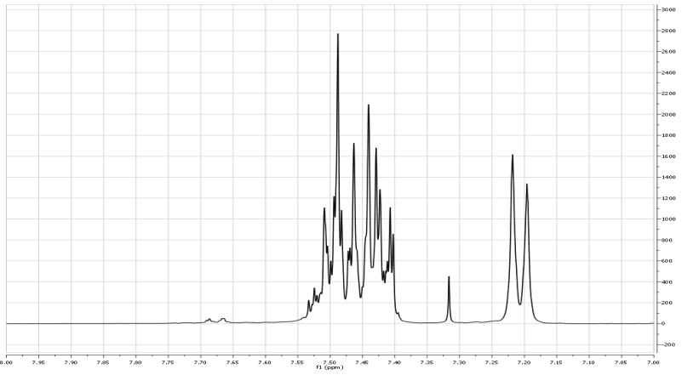
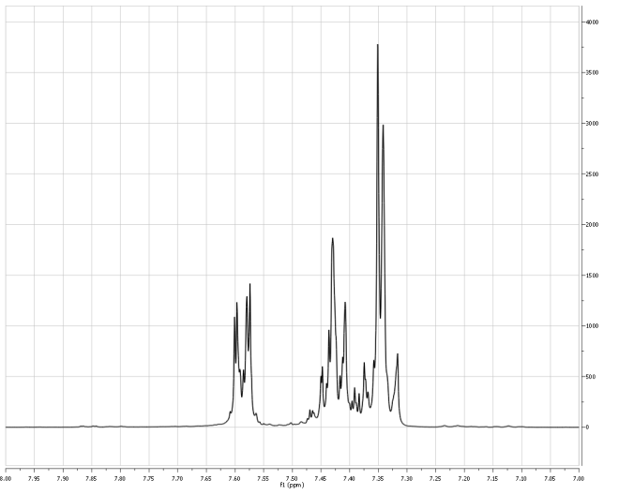
H-NMR
E-isomer
Z-isomer

Slide 22
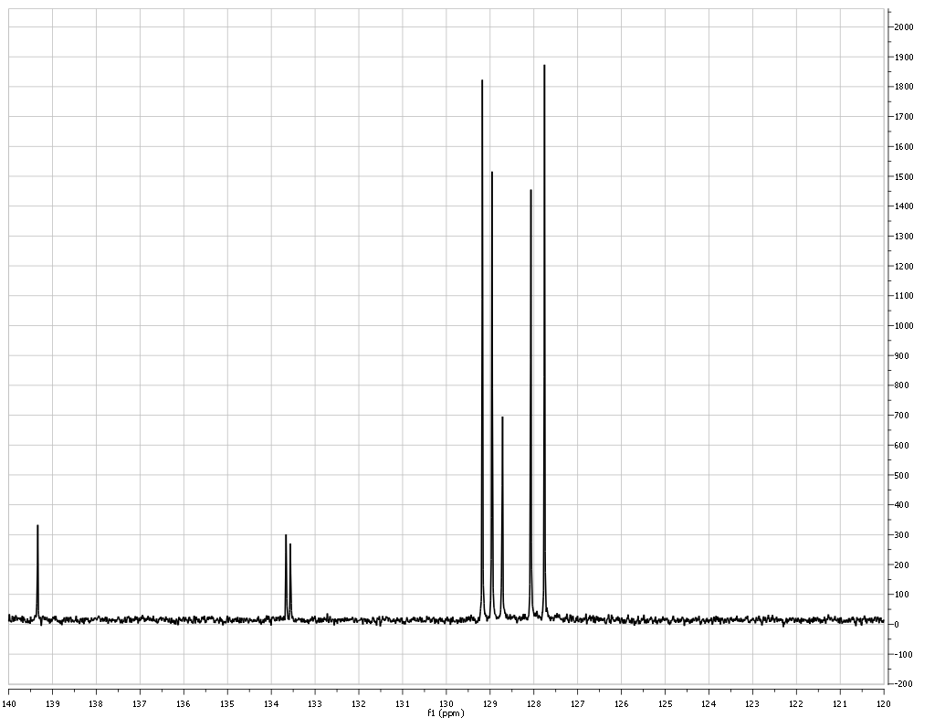
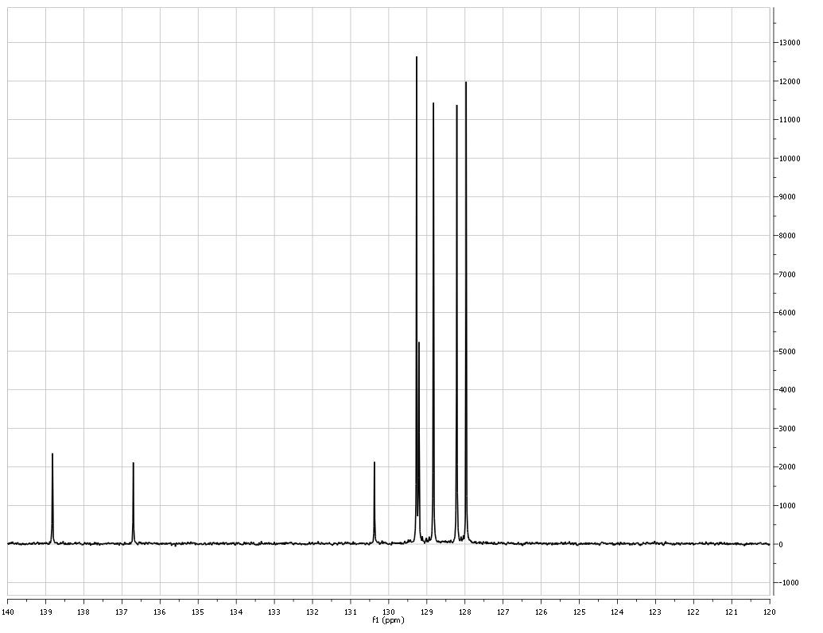
C- NMR
E-isomer
Z-isomer

Slide 23
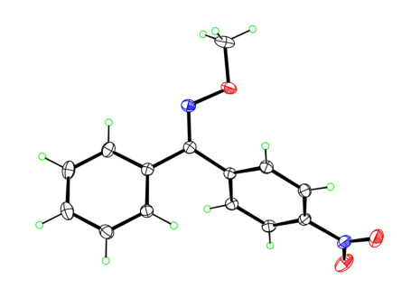
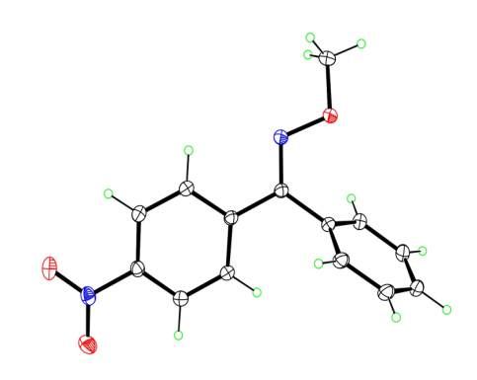
Further Characterization:
Entry | N-alkoxyimidoyl halide reactant | Boronic acid reactant | X-ray crystal structure of product
1
2
Dolliver et al. In progress

Slide 24
Conclusion:
We developed a new synthetic route of oxime ether from benzimidoyl iodide and boronic acid or trifluoroborate salt.
1% Palladium Catalyst- Low catalytic loading
Characterized single geometric isomers by HNMR and CNMR
Single geometric isomers of crystalline compounds were confirmed by X-ray crystallography

Slide 25
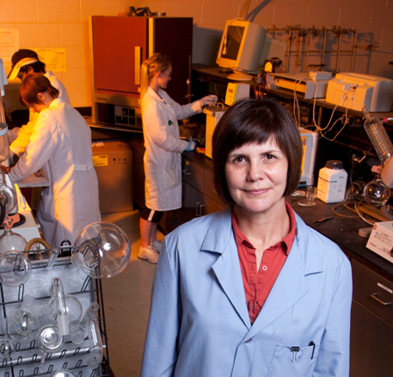
Acknowledgements
Dr. Debra Dolliver
Dr. Kevin Shaughnessy- Univ. of Alabama
Dr. Steven Raders- Univ. of Alabama
Dolliver’s Research Group
Shaughnessy’s Research Group- Univ. of Alabama
Dr. Artie S. McKim- Gaylord Chemical Company
Dr. Frank Fronczek- LSU
NSF-REU – Univ. of Alabama
LSU
ACS-PRF UR grant
NSF-RUI grant

