Slide 1
The Impact of Social Networking on Dependency, Sleep, and Communication in College Students
Cory S. Artis, Amelia M. Bertrand, & Caitlin M. LaCour
Supervisors: Dr. Susan Thorson-Barnett, Mrs. Neeru Deep, & Dr. Mary Edith Stacy
April 13, 2013

Slide 2
Student Academic Research Team (S.T.A.R.T.)
Student Academics Research Team (S.T.A.R.T.) Three undergraduate students of Northwestern State University of Louisiana agreed to further their education and become part of a team to construct the undergraduate research. The research was to investigate the impact of social networking on college students. These undergraduate students are
Amelia M. Bertrand
Cory S. Artis
Caitlin M. LaCour

Slide 3
Abstract
Impact of social networking sites on college students
Dependency
Sleep
Communication
335 enrolled in NSU psychology courses
Surveys:
Bergen Facebook Addiction Scale (BFAS) by Andreassen, et al., (2012)
Sleep Patterns
Communication
Social networking does not appear to have a negative impact on college students sleep pattern and communication style; however 1% of the sample met the criteria of Facebook addiction.

Slide 4
Literature Review

Slide 5
Literature Review: Dependency
According to Facebook’s key fact (2013), as of December 2012 there have been reports of more than nearly a billion monthly active users.
EDUCASE Center for Applied Research (ECAR) collected data that revealed that 90% of students use social networking and of that percentage, 97% reported the use of Facebook (Smith & Caruso, 2010).

Slide 6
Literature Review: Dependency…
Young (2009) recognized that Internet addicts were dependent upon certain aspects of the internet: excessive gaming, online sexual-preoccupation, and text/e-mailing.
Thompson and Lougheed (2012) study results showed that on average participants reported spending nearly 217.2 minutes per day on the internet.

Slide 7
Literature Review: Sleep
Centers for Disease Control and Prevention (CDCP): a 2009 survey reported the average amount of sleep in adults decreased in the past two decades (Wells & Vaughn, 2012).
The average amount of sleep an adult receives 6.9 hours per night.

Slide 8
Literature Review: Sleep…
Excessive use of electronic technologies potentially interrupt initial sleep and wakefulness (Andreassen, et al., 2012).

Slide 9
Literature Review: Communication
Raacke and Bonds-Raacke (2011) found text messaging has gone up in recent years as a form of communication and that people use texting over calling for a variety of reasons.

Slide 10
Literature Review: Communication…
Pierce (2009) found that females were more inclined to use social networking in the form of texting and online sites to communicate than males.
She also found that females had more social anxiety than males.
Pierce’s (2009) study also found that females were more comfortable using social networking than speaking to people face-to-face.

Slide 11
Hypothesis:
Dependence:
The study proposed to investigate if there is a significant difference in gender of college students with regards to Facebook dependency.
Sleep:
Freshman are more likely to have their sleep interrupted due to social network use.
Communication:
The study proposed to investigate if the rise of social networking created a barrier in communication in regards to males and females.

Slide 12
Methods

Slide 13
Participants:
Total 344 college students enrolled in psychology courses at NSU participated.
Only 335 surveys and questionnaires were used in research due to incompletion of survey and questionnaires.
335 Surveys & Questionnaires:
Ages: 18 years old and over
Gender:
- Male: 127
- Female: 208
Classification:
- Freshman: 147
- Sophomore: 74
- Junior: 67
- Senior: 47

Slide 14
Materials: Dependency
Pencil and Paper Survey:
Bergen Facebook Addiction Scale (2012) Dr. Cecilie Schou Andreassen, Torbjorn Torsheim, Gier Scoot Brunborg, and Stale Pallesen; Bergen, Norway
18 Items
6 Criteria:
BFAS 1 Salience
BFAS 5 Mood Modification
BFAS 7 Tolerance
BFAS 11 Relapse
BFAS 13 Withdrawal
BFAS 16 Conflict
5 Point Scale (1: very rarely to 5: very often)

Slide 15
Materials: Sleep & Communication
Pencil and Paper Surveys:
Sleeping Patterns
16 Items
Examples: “I wake-up to the sounds of chat room requests”, “I wake-up at night browsing through social network(s) after previously stopping.”
5 Point Scale (1:never to 5: all the time)
Communication
38 Items
Examples: “I knowingly avoid calling someone because I simply don’t converse well over the phone.”
5 Point Scale (1:never to 5: all the time)

Slide 16
Procedures:
Research was explained.
Participants were eligible when meeting criteria:
Undergraduate of NSU
enrolled in a psychology course
18 years of age or older
sign written consent for participation
completed the three surveys
Conducted in classrooms at Bienvenu Hall, NSU.
Surveys were collected at end of Fall 2012 semester and early Spring 2013 semester.
After completion, debriefing form was given to participant.

Slide 17
Results

Slide 18
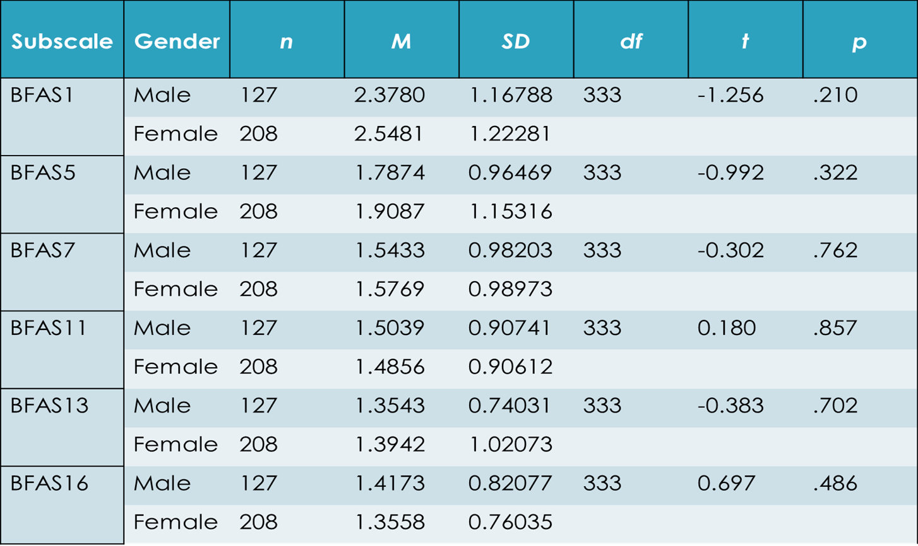
Results: Dependency/Independent T-Test

Slide 19
Results: Percentage of Sleep Hours
Total Population: 335
No Response: 2
0-6 Hours: 179
8-7 Hours: 144
9-More Hours: 10

Slide 20
Results: Sleep/ ANOVA
Item |  | Sum of Squares | df | Mean Square | F | Sig.
SP1*: “I sleep next to any device that can access social network(s).”
SP1* | Between Groups Within Groups Total | 18.929 708.814 727.743 | 3 331 334 | 6.310 2.141 | 2.946 | .033
SP16: “I wake-up every morning feeling groggy or tired.”
SP16 | Between Groups Within Groups Total | 6.141 443.394 449.534 | 3 331 334 | 2.047 1.340 | 1.528 | .207
SP1 * Freshman group (Mean=3.9320, SD=1.38317) and Junior group (Mean=3.3134, SD=1.57835)
SP16 Freshman group (Mean=2.7959, SD=1.19897) and Senior group (Mean=2.4478, SD=0.98909)

Slide 21
Results: Communication/Independent T-Test
Item | Gender | n | M | SD | df | t | p
C1* | Male | 127 | 3.1181 | 1.09555 | 333 | -2.817 | .005
 | Female | 208 | 3.4808 | 1.17116
C3* | Male | 127 | 2.4016 | 1.19030 | 333 | -3.220 | .001
 | Female | 208 | 2.8606 | 1.30949
C28* | Male | 127 | 1.7874 | 1.09566 | 333 | 2.963 | .003
 | Female | 208 | 1.4808 | .79224
C21 | Male | 127 | 2.3780 | 1.19476 | 333 | -.014 | .989
 | Female | 208 | 2.3798 | 1.22572
C23 | Male | 127 | 2.0551 | 1.14301 | 333 | -1.872 | .062
 | Female | 208 | 2.2981 | 1.15787
C25 | Male | 127 | 2.2520 | 1.17493 | 333 | -1.648 | .100
 | Female | 208 | 2.4808 | 1.26629

Slide 22
Discussion:
There were no significant differences found in males and females when comparing if they were addicted to Facebook (Andreassen, et al., 2012). One percent of the sample met the criteria of Facebook addiction.
The only significant difference found was Freshmen were more likely to have sleep impacted by sleeping next to electronic technologies (accessible to social networks). There was no data to separate Freshmen from Juniors feeling groggy or tired in the morning.
Five questions based on gender presented a significant difference; social networking appears to be helping communication, as opposed to hindering it.

Slide 23
Discussion: Weakness in Research
The Bergen Facebook Addiction Scale (BFAS) conforms only to Facebook dependency.
The Sleeping Patterns questionnaire does not utilize all possible causes for lack of sleep, such as environment, biological, etc.
The Communication questionnaire applies a general concept of social networking and should be adjusted to non-verbal (texting and e-mailing) and verbal (face-to-face and phone calling).

Slide 24
Reference:
Andreasesen, C. S.; Torsheim, T.; Brunborg, G. S.; Pallesen, S. (2012). Development of a facbook addiction scale. Psychological Reports, 110(2),503.
Junco, R. (2012). The relationship between frequency of Facebook use, participation in Facebook activities, and student engagement. Computers & Education, 58(1), 162. doi:10.1016/j.compedu.2011.08.004
Key facts: statistics. (2013). Facebook. Retrieved from http://newsroom.fb.com/Key-Facts Accessed 17 February 2013.
Pierce, T. (2009). Social anxiety and technology: face-to-face communication versus technological communication among teenagers. Computers in Behavior, 25(6), 1367.
Raacke, J., & Bonds-Raacek, J. (2011). An investigation of SMS communication use by college students. Individual Differences Research, 9(4), 213.
Thompson, S. H. & Lougheed, E. (2012). Frazzled by Facebook? An exploratory study of gender difference in social network communication among undergraduate men and women. College Student Journal. (2012), 46(1), 91.
Wells, M. E., RPSGT, R., EEG T., R.NCS.T., MS; & Vaughn, B. V., M.D. (2012). Poor sleep challenging the health of a nation. Neurodiagn J., 52, 239.
Young, K. S. (2009). Internet addiction: diagnosis and treatment consideration. Journal of Contemporary Psychotherapy, 39, 242.

Slide 25
Questions?

Slide 26
Contact Information:
Susan Thorson-Barnett, Ph.D., LAC, NCP
Head Department of Psychology
barnetts@nsula.edu
(318) 357-5435
Neeru Deep, M.A., M.Ed.
Instructor Psychology
deepn@nsula.edu
(318) 357-6701
Stacy Mary Edith, Ph.D.
Instructor Psychology
maryedith@nsula.edu
(318) 357-4355
Cory S. Artis
cartis001@student.nsula.edu
(337) 320-0223
Amelia M. Bertrand
abertran001@student.nsula.edu
(337) 581-7608
Caitlin M. LaCour
clacour006@student.nsula.edu
(318) 446-0950

Slide 27
Thank you

