Slide 1
The Architecture of William Faulkner’s
Absalom, Absalom:
A Study on the Decay of the Sutpen Household and the Novel’s Narrative Structure
Maria-Josee Mendez
Dr. Wendy Whelan-Stewart
Department of English and Foreign Languages
McNeese State University
Lake Charles, Louisiana

Slide 2
Outline
Short introduction to Faulkner
Foundation/Construction of the House
Reconstruction of the South
Structure of Language
The Narrators
Textual Evidence
  Romanticization of the South
  Process of Construction of Language

Slide 3
William faulkner
“The past is never dead, [it’s] not even past”

Slide 4
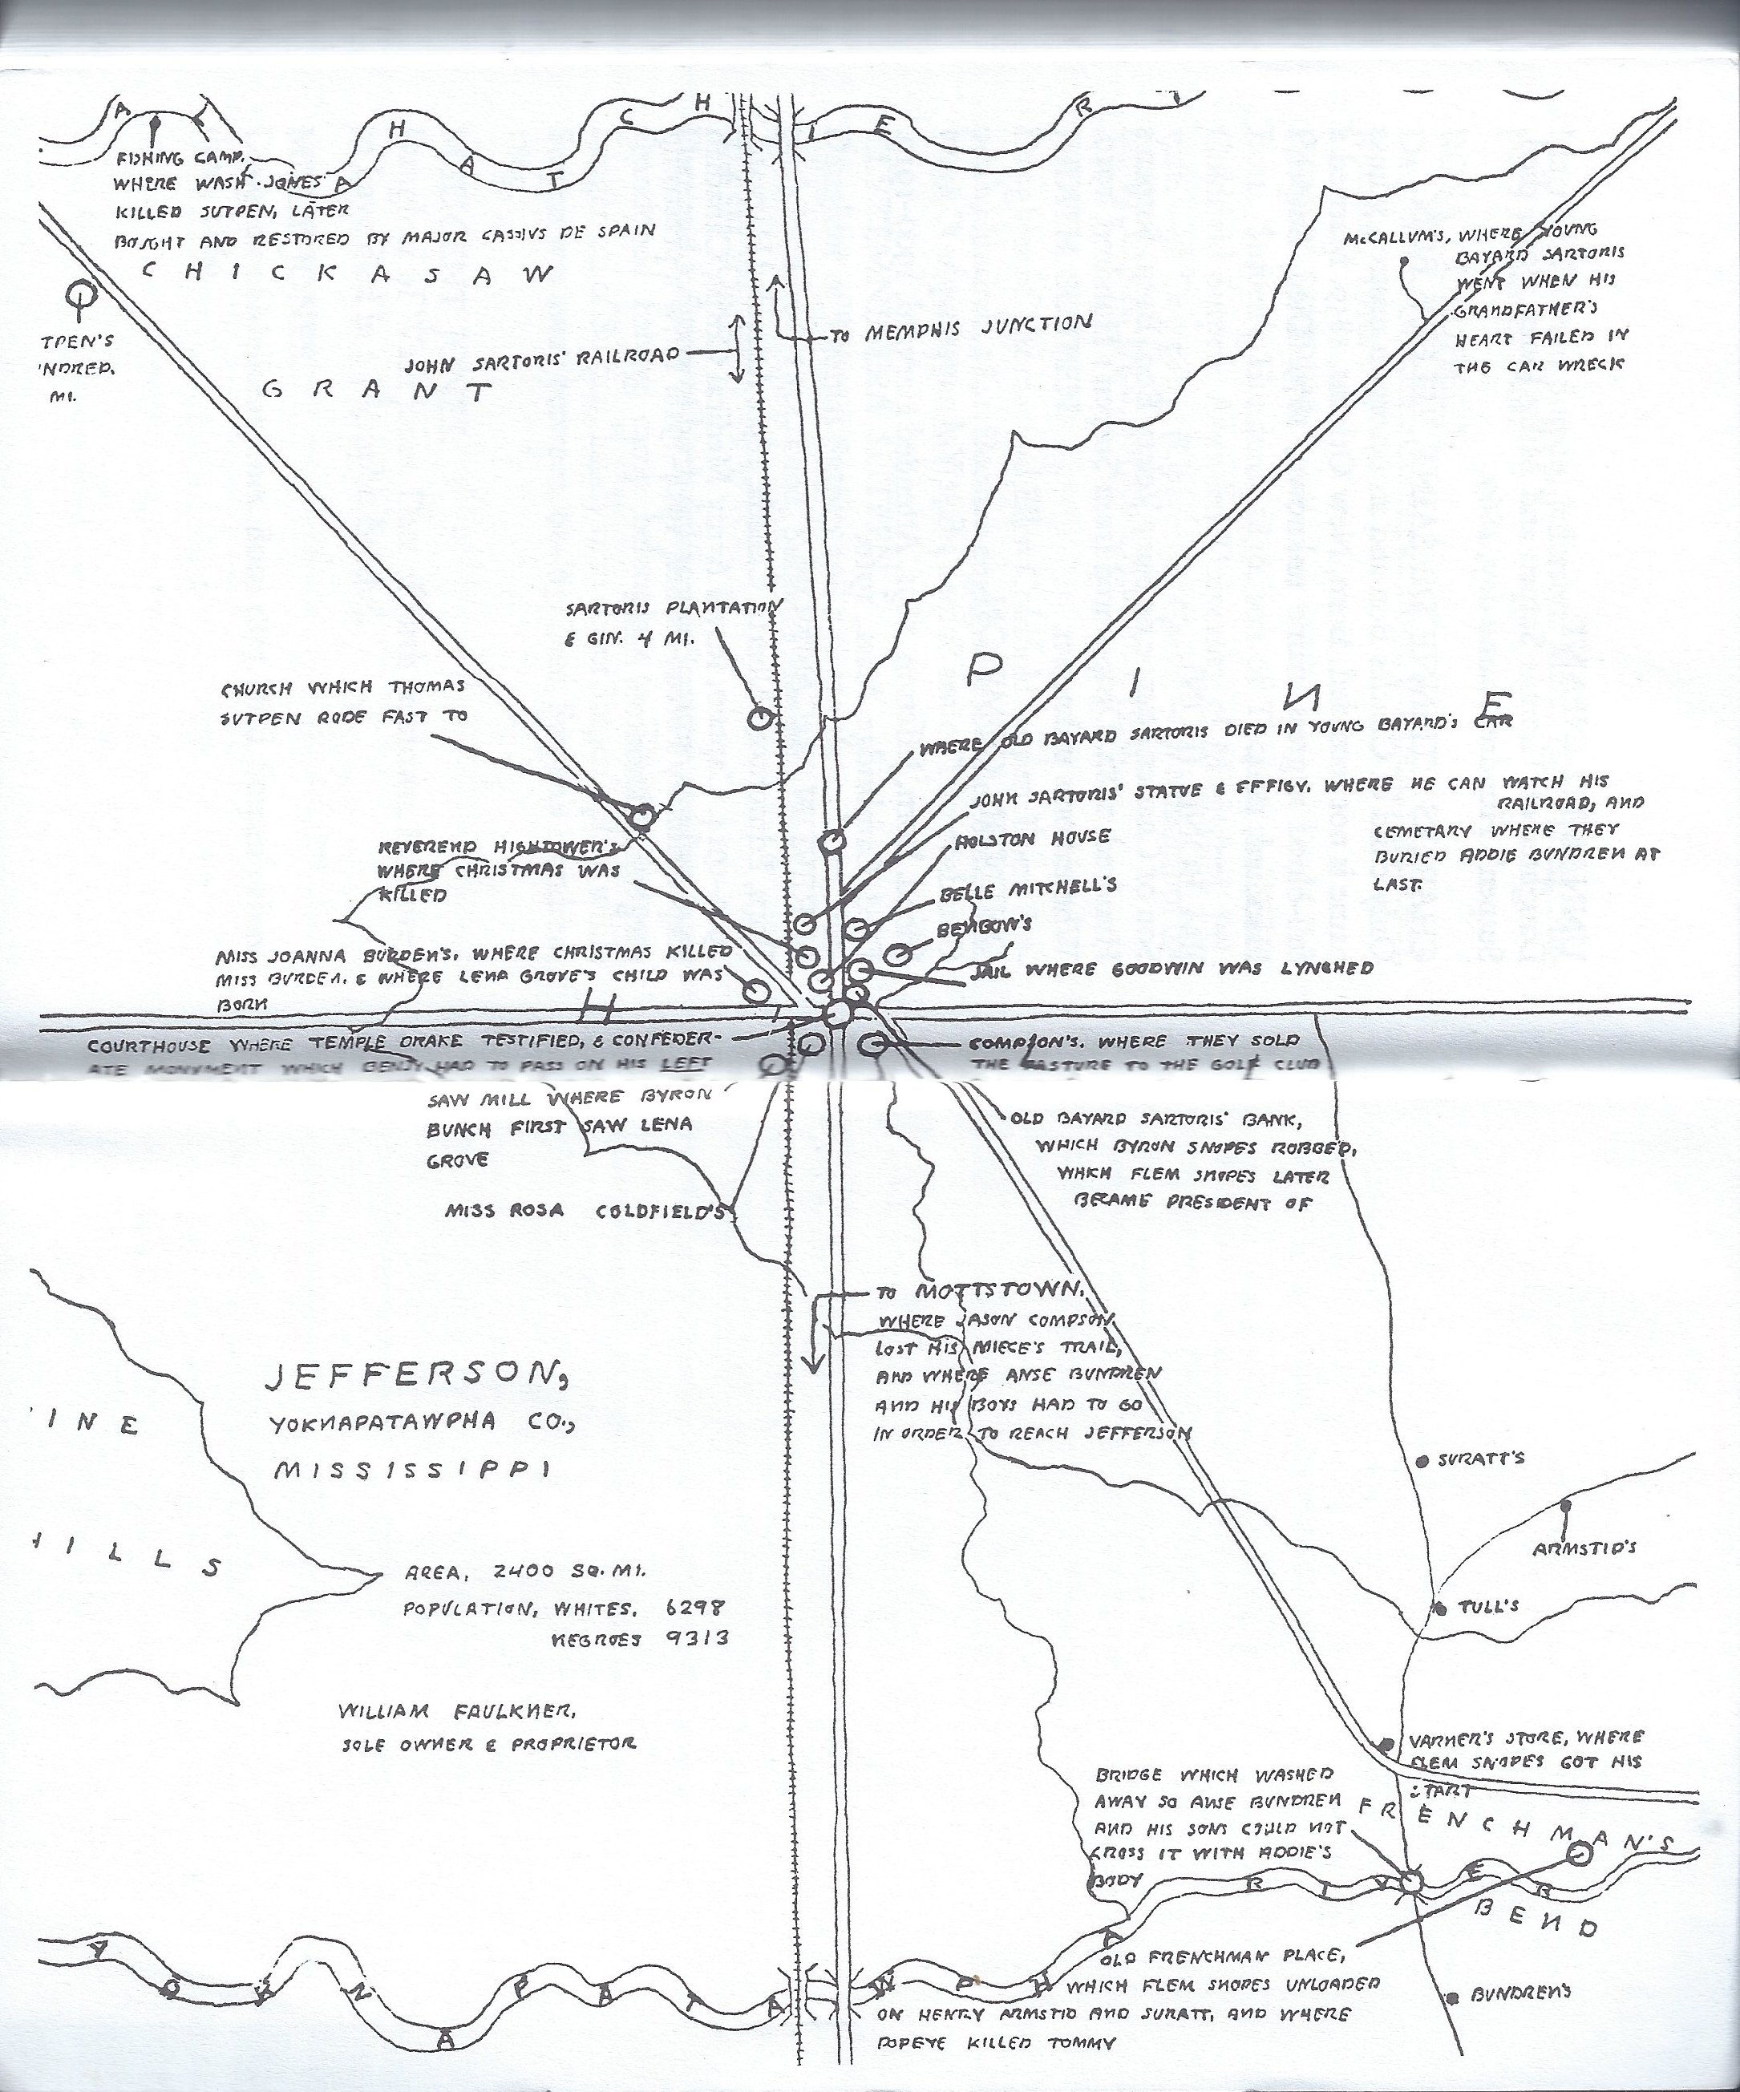
Map of Faulkner’s fictional Yoknapatawpha County, taken from Absalom, Absalom!

Slide 5
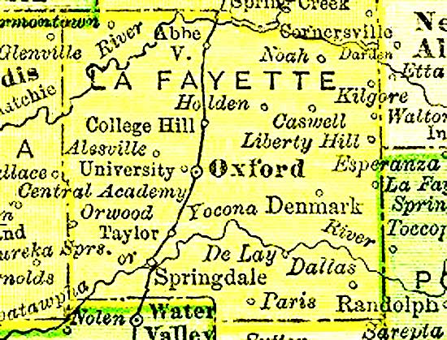
Map of Lafayette County
The model for Faulkner’s Yoknapatawpha County

Slide 6
Foundation and Construction of the House
Thomas Sutpen’s design:
  Microcosm of the entire South
  To establish both a plantation and a dynasty
  Goals for socioeconomic growth in Southern plantation aristocracy

Slide 7
Foundation and Construction of the House
Antebellum aristocracy of the South
  Historically established in one generation through the patriarch’s brutality (Backman 598)
  Thomas Sutpen uses violence to achieve his objectives
  Adherence to declining social order of the South
    Impedes growth/development of Sutpen Household
    Eventually leads to decay, ultimate descent into ruin

Slide 8
Reconstruction of the South
Hierarchy of antebellum Deep South decomposes after Civil War
  Represented by the reduction and collapse of Sutpen Household
  Present-day images associated with the Civil War embrace little or none of the reality (corruption)
  Preference for romanticized constructions

Slide 9
Structure of Language in the Narrative
Syntactically consistent style
Four narrators
Two nearly equal halves
Language emulates creative process; suggests inadequacy (incompleteness) of the written or spoken word

Slide 10
Structure of Language in the Narrative
“disjointed chronological frameworks”
each of the four narrators fragments the story
four different narratives emerge—not one

Slide 11
The Narrators
I. Miss Rosa Coldfield (sister-in-law and one-time fiancée of Thomas Sutpen)
II. Mr. Compson (son of Sutpen’s first friend in the county)
III. Quentin Compson (son of Mr. Compson)
IV. Shreve McCannon (Quentin’s Canadian roommate at Harvard)

Slide 12
Artistic Reconstruction of the Narrative
Miss Rosa Coldfield and Quentin Compson
  1st and 3rd narrators, respectively
  Transmit stories of Southern past from oral tradition to literary form
  “So maybe you will enter the literary profession as so many Southern gentlemen and gentlewomen too are doing now and maybe some day you will remember this and write about it” [Miss Coldfield to Quentin]

Slide 13
Artistic Reconstruction of the Narrative
This practice of creation seeks to ask and answer the questions the creator him- or herself considers important, thus constructing a new artistic reality

Slide 14
Romanticization of the South through the Narrative
“—Have you noticed how so often when we try to reconstruct the causes which lead up to the actions of men and women, how with a sort of astonishment we find ourselves now and then reduced to the belief, the only possible belief, that they stemmed from some of the old virtues? the thief who steals not for greed but for love, the murderer who kills not out of lust but pity?” [Mr. Compson to Quentin]

Slide 15
The Romantic
The Corrupt
“when beside a shuttered and unsleeping candle she embalmed the War and its heritage of suffering and injustice and sorrow on the backsides of the pages within an old account book”[Miss Rosa Coldfield]
“a soil manured with black blood from two hundred years of oppression and exploitation” [Quentin to Shreve]

Slide 16
Constructive Process
“Am I going to have to hear it all again he thought I am going to have to hear it all over again I am already hearing it all over again I am listening to it all over again I shall have to never listen to anything else but this again forever” [Quentin]

Slide 17
Constructive Process
“I will tell you what he did and let you be the judge. (Or try to tell you, because there are some things for which three words are three too many, and three thousand words that many words too less, and this is one of them. It can be told; I could take that many sentences…or take three thousand sentences and leave you only that Why? Why? and Why? that I have asked and listened to for almost fifty years.)” [Miss Rosa to Quentin]

Slide 18
To Conclude
Is the construct of the mythological, romantic South invalid if it is the reality of its descendants?

Slide 19
Questions?

Slide 20
Acknowledgments
Dr. Wendy Whelan-Stewart
Dr. Scott Goins
McNeese State University

Slide 21
Contact Information
Maria-Josee Mendez
msu-mmendez@student.mcneese.edu

