Slide 1
Characterizing Pit-Mound Microtopography In Bottomland Hardwood Forests
Amit Rajkarnikar, Matthew Herron, Joydeep Bhattacharjee
Plant Ecology Laboratory
Department of Biology
University of Louisiana at Monroe
Monroe, LA 71203 USA

Slide 2
Abstract
Bottomland Hardwood Forests (BHFs) are one of the richest ecosystems due to the unique floral diversity
Uprooting events alter the light gradient
Changes in the micro-topography of the site by the formation of pits and mounds
A stratified sampling was performed on BHF to locate pit-mound features to characterize relationships that contributes to the stand heterogeneity, which in turn is known to enhance wildlife habitat

Slide 3
Overview
Introduction
Importance of Pit-Mounds
Aims & Objectives
Site Description
Methods
Preliminary Data Analysis
Implications

Slide 4
Overview
Introduction
Importance of Pit-Mounds
Aims & Objectives
Site Description
Methods
Preliminary Data Analysis
Implications

Slide 5
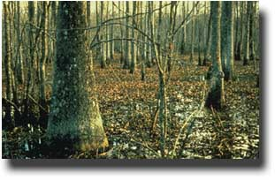
Introduction
Bottomland hardwood forests (BHF) occur along most of the major rivers and streams in the southeastern United States
Commonly found wherever streams or rivers at least occasionally cause flooding beyond their channel confines (EPA).
Hydrology of the site allows growth of plant species such as Gum (Nyssa sp.) and Oak (Quercus sp.) and Bald Cypress (Taxodium distichum).

Slide 6
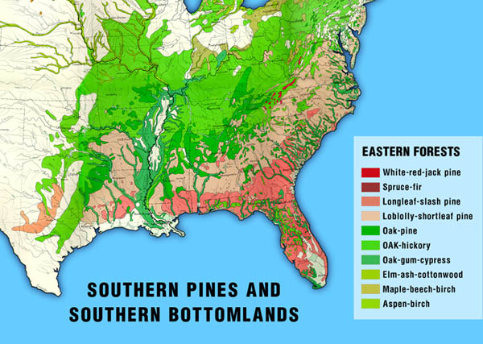
Introduction
www2.for.nau.edu

Slide 7
Introduction
The BHF of Northeast Louisiana fall under the Mississippi Alluvial Plain
The importance of the geomorphology of this region is the influence of glaciation in the past
The water from the glacial melt deposited sediments and formed diverse topography such as ridges, levees, swamps, and sloughs
The differences in the topography of the plain due to elevation can result in differences between the site productivity and plant biodiversity (Hodges)

Slide 8
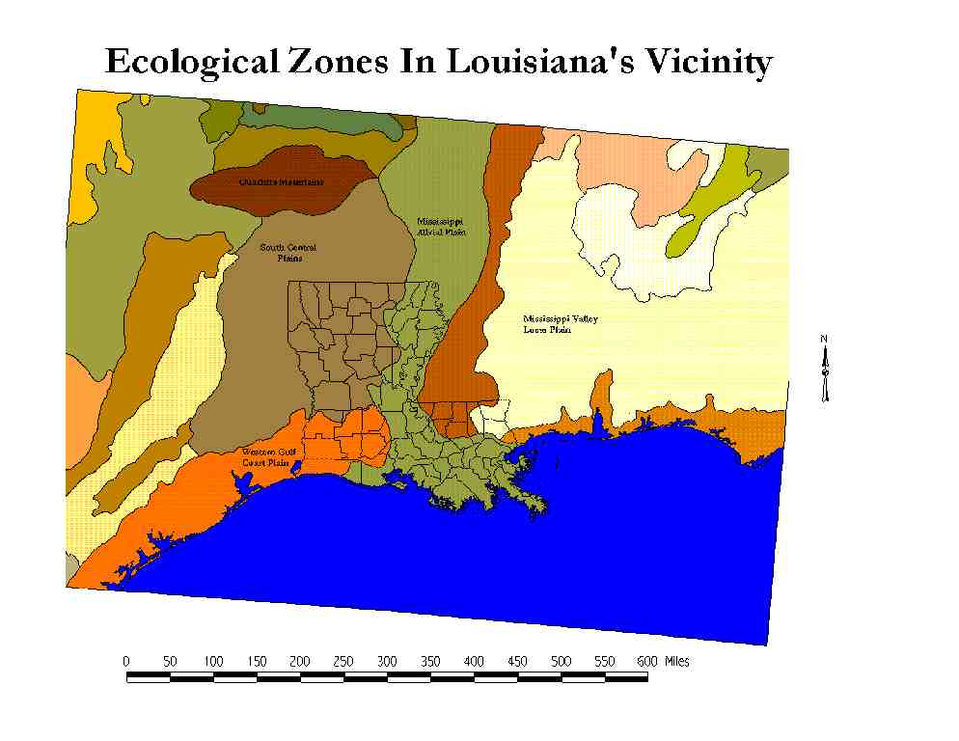
Introduction
Ecological Zones in Louisiana & vicinity
proceedings.esri.com

Slide 9
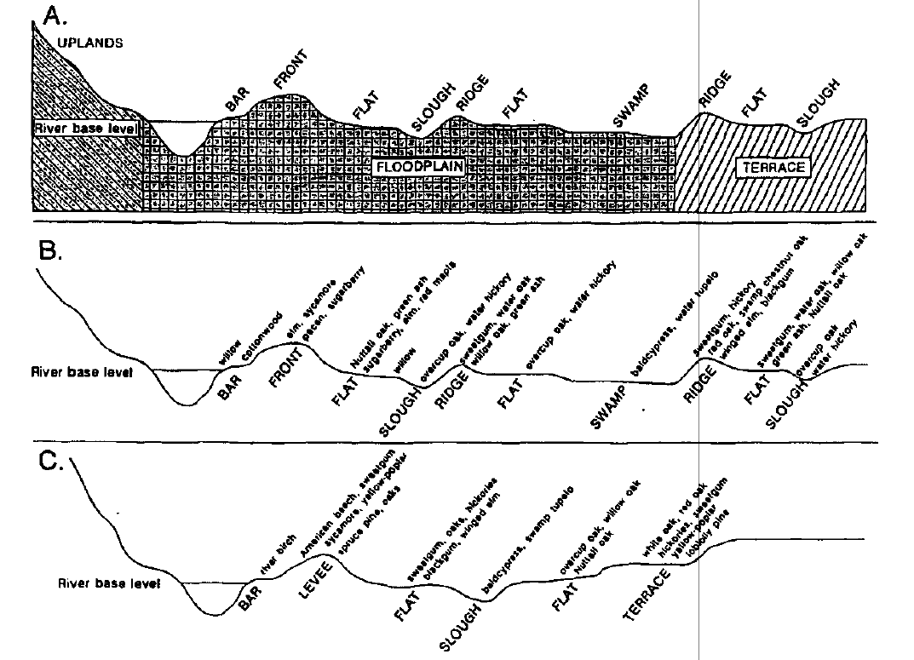
Introduction
(Hodges)

Slide 10
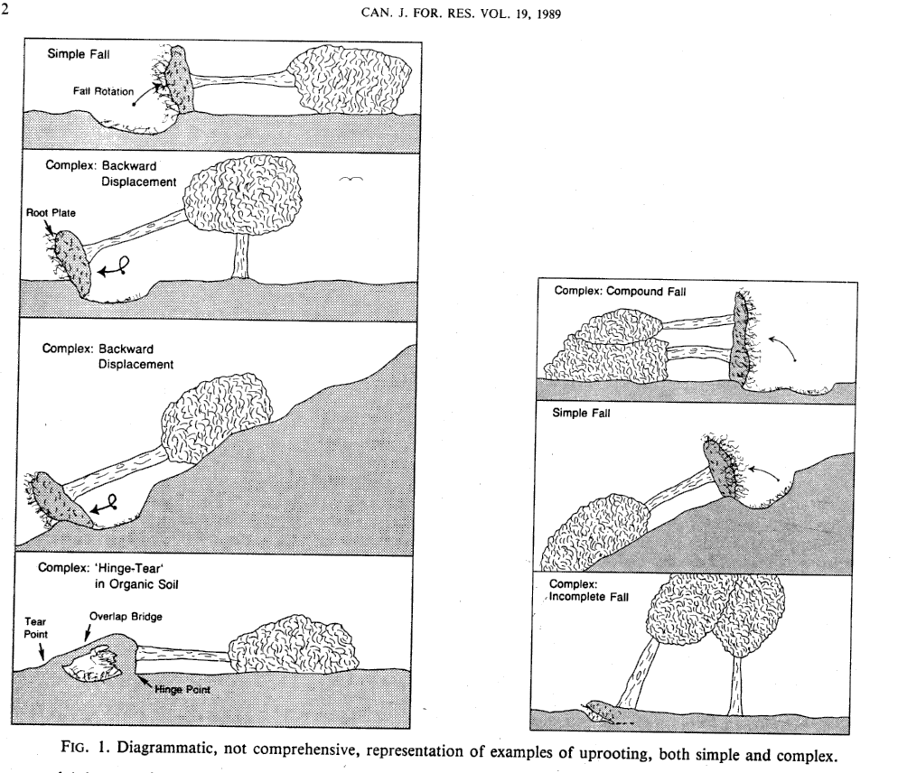
Introduction
Trees fall in the BHF due to disturbances such as strong winds or old growth

Slide 11
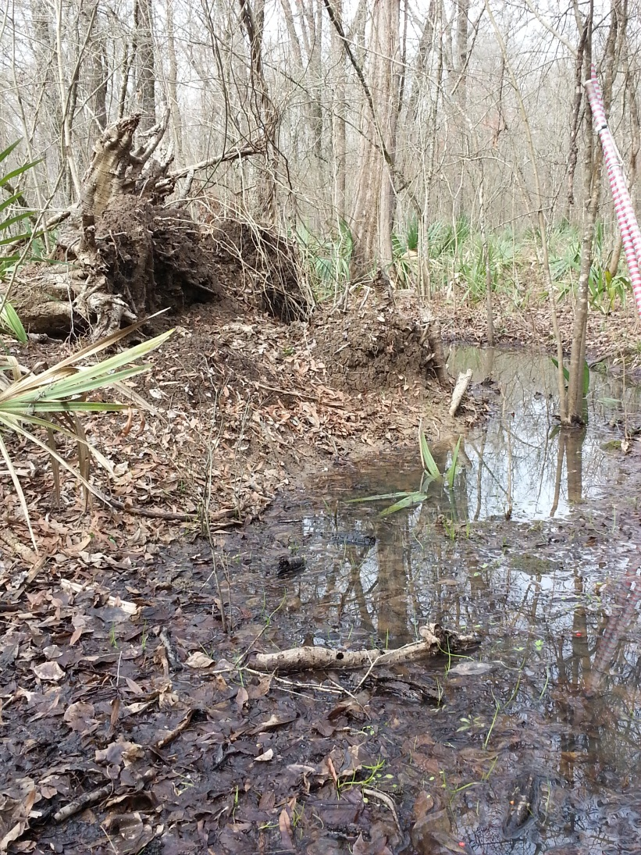
Introduction
The uprooting of the tree (fully or partially), forms a depression or a pit
The loosening of the soil causes formation of a mound

Slide 12
Overview
Introduction
Importance of Pit-Mounds
Aims & Objectives
Site Description
Methods
Preliminary Data Analysis
Implications

Slide 13
Importance of Pit-Mounds
Change in ‘topography’: Pit-mound
Successive changes in topography = changes in vegetation
Plant Diversity
Mounds may be the only refuge for less flood tolerant species in a flood-prone forest

Slide 14
Importance of Pit-Mounds
Gap dynamics
Positive Feedback Loop
Alteration of Light Gradient
Tree fall events
Pit-Mound features

Slide 15
Overview
Introduction
Importance of Pit-Mounds
Aims & Objectives
Site Description
Methods
Preliminary Data Analysis
Implications

Slide 16
Aims and Objectives
Quantify gap densities, gap sizes
Pit-mound characteristics in BHF
Impacts of canopy opening as a result of PMT formation

Slide 17
Overview
Introduction
Importance of Pit-Mounds
Aims & Objectives
Site Description
Methods
Preliminary Data Analysis
Implications

Slide 18
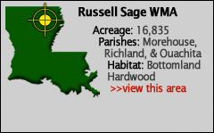
Site Description
Russell Sage Wildlife Management Area located in Morehouse, Ouachita and Richland Parishes
It includes 21,948 acres of land
Elevations range from 58 feet to 63 feet amsl
Located within the Bayou Lafourche flood plain
Flat and poorly drained

Slide 19
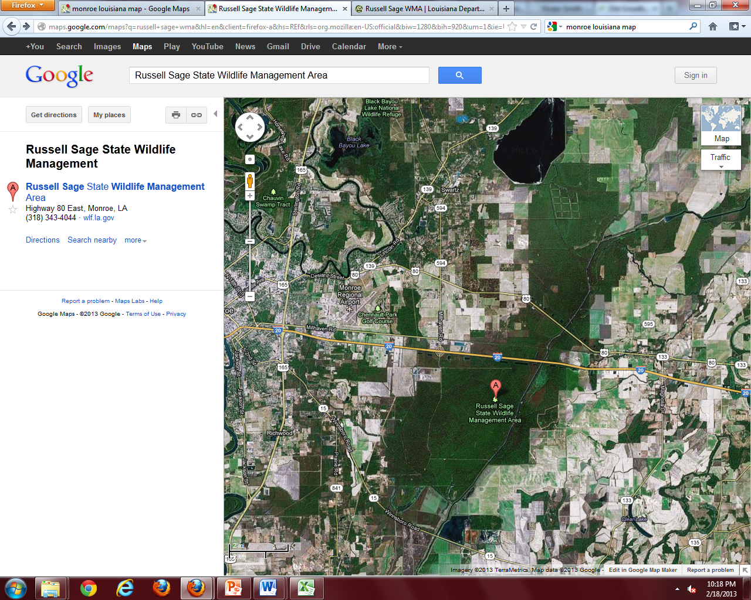
Site Description

Slide 20
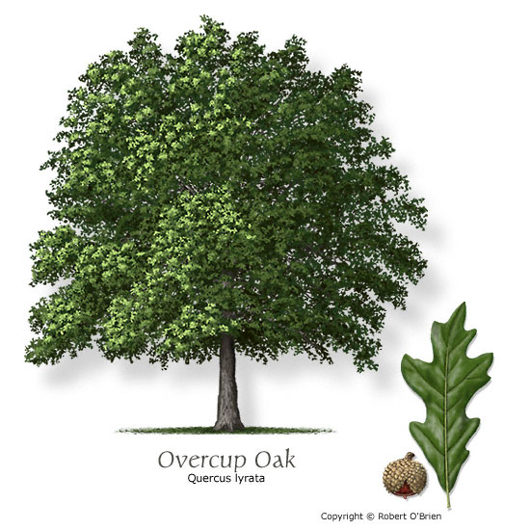
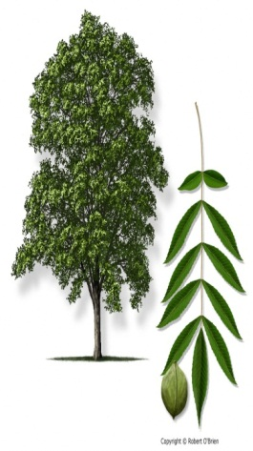
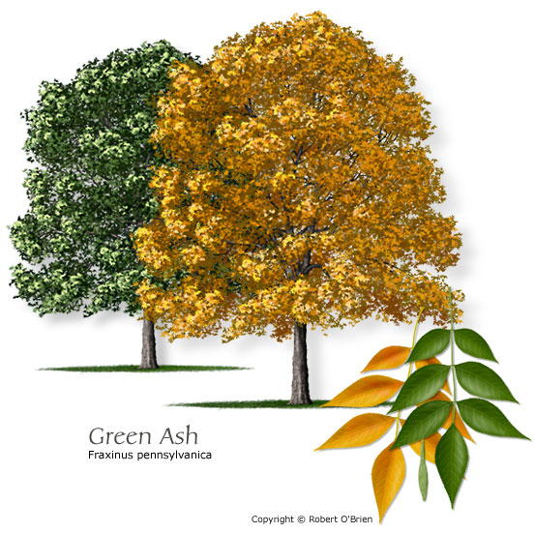
Vegetation
Site Description
Dominant trees include – Overcup oak, bitter pecan (water hickory) and green ash
Associated species include - Nuttall oak, hackberry, bald cypress, winged elm, honey locust, red maple, tupelo gum, and American elm
Ground vegetation include – Poison Ivy, sedges rushes, ground nuts
Overcup Oak
Water Hickory
Green Ash
Quercus lyrata
Carya aquatica
Fraxinus pennsylvanica

Slide 21
Overview
Introduction
Importance of Pit-Mounds
Aims & Objectives
Site Description
Methods
Preliminary Data Analysis
Implications

Slide 22
Methods
Guidelines and Sample Protocol for Sampling Forest Gaps (Runkle, J 1992)
Stratified sampling of the site
dividing the area into 12 transects – even coverage
500-m long, 10-m wide and 100-m apart
East to West
belt transect ➔ increase probability of detecting smaller gaps
transects established a priori using satellite imagery

Slide 23
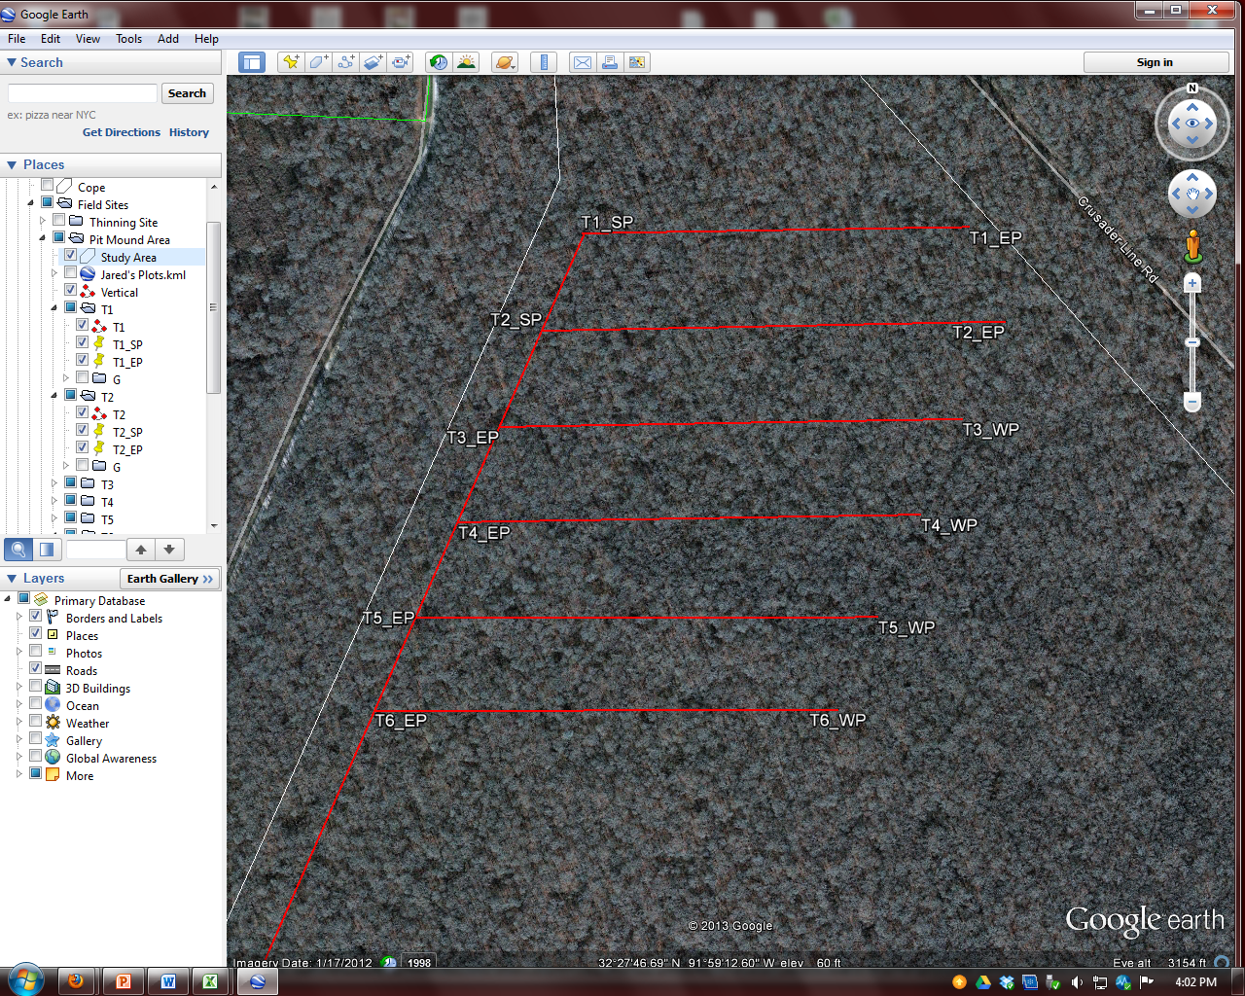
Methods
Google Earth

Slide 24
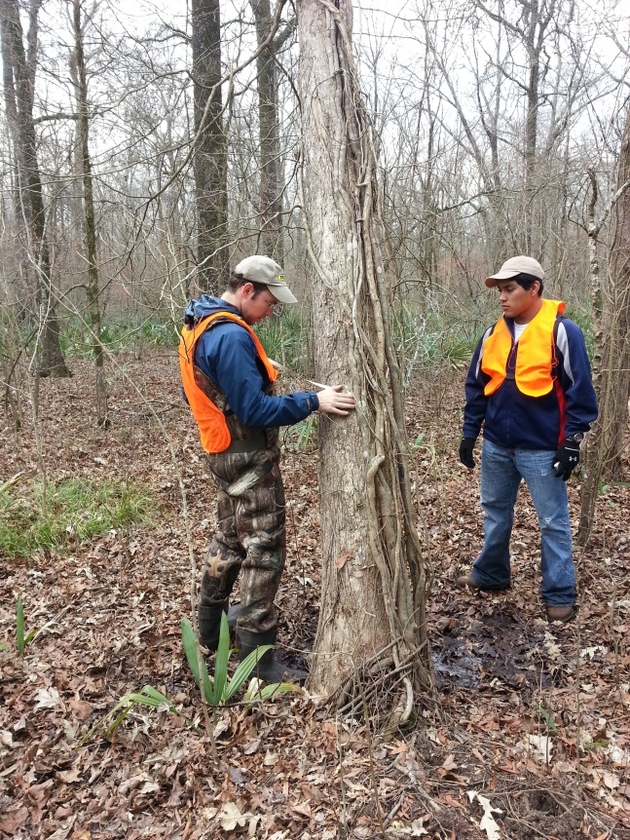
Methods
At a PM site within the transect, the following data were collected
Diameter at breast height (d.b.h) of the tree
Height of the tree (length if fallen)
Direction of fallen trees in E°N
Major and minor axis of the mound
Major and minor axis of the pit
Elevation of the mound
Elevation of the pit
To characterize the pit-mound topography

Slide 25
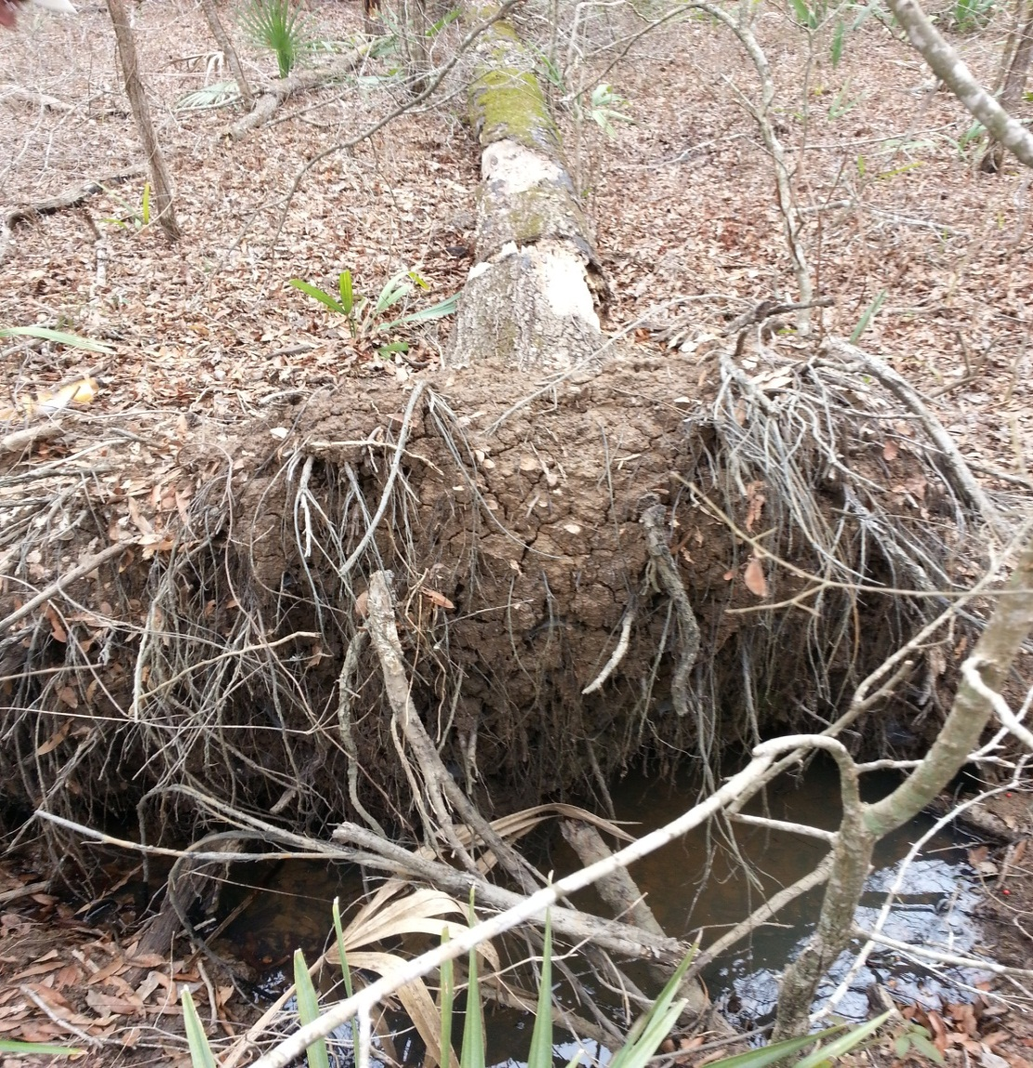
Methods
A
B
Height of the tree
D.b.h. of the tree
The major axis of mound
The minor axis of mound
The major axis of pit
The minor axis of pit
C
D
E
F

Slide 26
Methods
Elevation points of the pit and mound were measured using a clinometer and two poles of equal length
An observer measures the change in elevation by determining the percent slope at a fixed distance
Elevation point was observed at a distance of 5 meters
The direction of fall was measured using a 360° compass
Elevation point = $\frac{Distance}{\% slope}$

Slide 27
Overview
Introduction
Importance of Pit-Mounds
Aims & Objectives
Site Description
Methods
Preliminary Data Analysis
Implications

Slide 28
Preliminary Data Analysis

Slide 29
Preliminary Data Analysis
Regression between Height of Mound and Depth of Pit
F_{value} = 12.76 DOF = 1,9
P = 0.006 R² = 0.59

Slide 30
Preliminary Data Analysis
Regression between Height of Tree (w/snags) vs. Depth of Pit
F_{value} = 5.48 DOF = 1,9
P = 0.04 R² = 0.38

Slide 31
Preliminary Data Analysis
Regression between Ht. of Tree (w/o snags) vs. Depth of Pit
F_{value} = 20.84 DOF = 1,6
P = 0.0064 R² = 0.78
Notes:
Regression between Depth of Pit vs Ht. of Tree (w/o snag)
F_{value} = 20.84
DOF = 1,9
P = 0.006
R² = 0.78

Slide 32
Preliminary Data Analysis

Slide 33
Overview
Introduction
Importance of Pit-Mounds
Aims & Objectives
Site Description
Methods
Preliminary Data Analysis
Implications

Slide 34
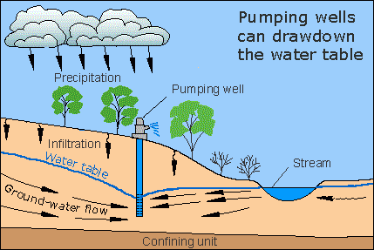
Implications
Animal Diversity
Mammals – burrows and borrowed burrows
Reptiles – use old burrows, hibernate/find shelter in fallen logs,
Amphibians – pools are used as breeding grounds
Birds – find shelter in woody debris of fallen trees
Insects – important pollinators (bees, wasps) burrow in exposed dry soil
Water quality-quantity
ga.water.usgs.gov

Slide 35
Implications
Explore
Distribution of direction of fall
Relationship between d.b.h and pit depth
Relationship between water table and pit-mound frequency
Relationship between mound height and age class
D.b.h and bare soil
Relationship between vegetation and several other variables

Slide 36
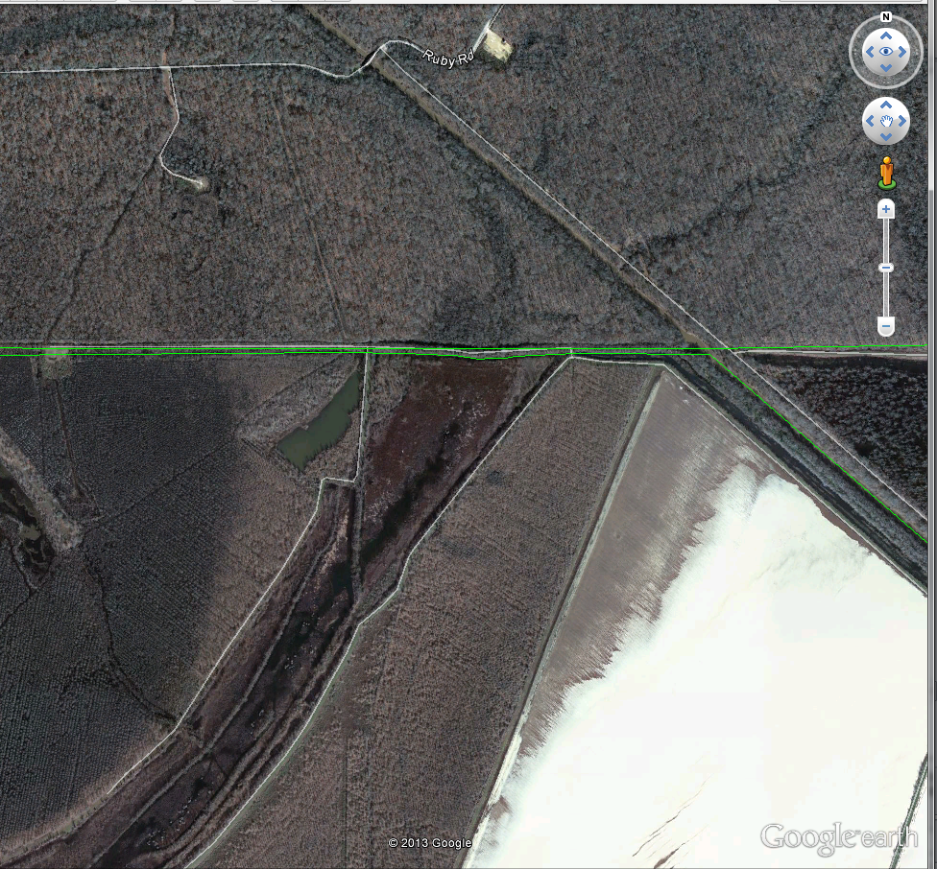
Implications

Slide 37
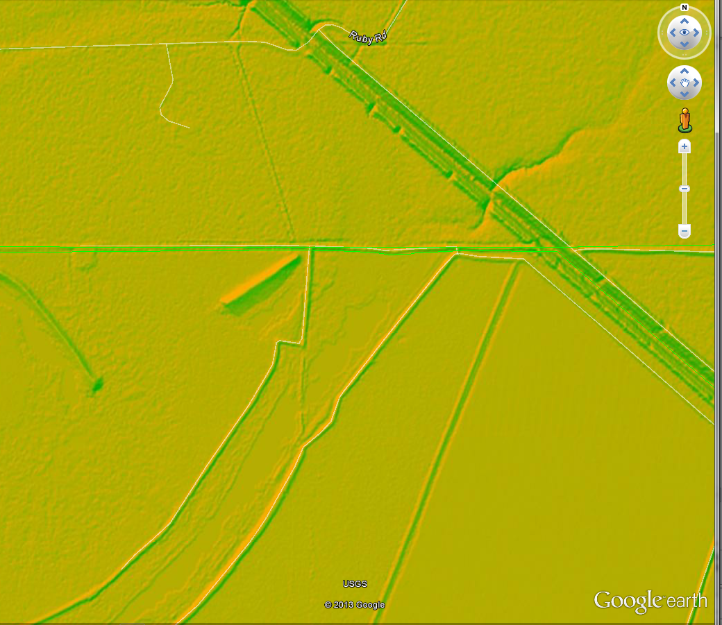
Implications
Notes:
Elevation Datas

Slide 38
References
Hodges, John. "Development and ecology of bottomland hardwood sites." Forest Ecology and Management. (1997). Print. <https://Hodges - 1997 - Development and ecology of bottomland hardwood sites.pdf?auth=co&loc=en_US&id=39485&part=2>.
Runkle, James. Guidelines and Sample Protocol for Sampling Forest Gaps. 1992. Print. <https://Runkle - 1992 - Guidelines and Sample Protocol for Sampling Forest Gaps.pdf?auth=co&loc=en_US&id=39181&part=3>.
United States. Environmental Protection Agency. Bottomland Hardwoods. <http://water.epa.gov/type/wetlands/bottomland.cfm>.
United States, Louisiana. Department of Wildlife and Fisheries. Russell Sage WMA. Web. <http://www.wlf.louisiana.gov/wma/2777>.

Slide 39
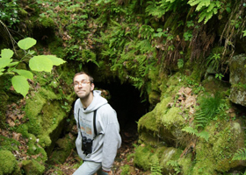
Acknowledgements
Dr. Joydeep Bhattacharjee
Matthew Herron

Slide 40
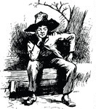
Q&A

