Slide 1
From Dolly to Loli?
Female Empowerment and the Lolita Fashion Subculture
By Randi Ditta

Slide 2
What is Lolita?
Japanese Street Fashion
Popularity spreading worldwide
Appearance is:
Doll-like
Youthful
Lacy/frilly

Slide 4
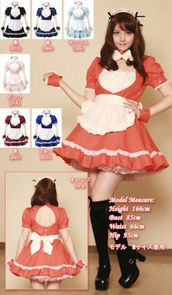
Misconceptions
Implications of age-play
Immaturity
Submissiveness
Costume

Slide 5
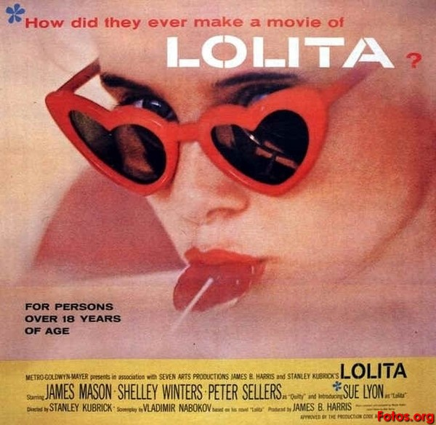
Nabokov’s Lolita
Story of a pedophile
Girl-child objectified, silenced
Critics/films built reputation of scandal
The Lolita Complex:
Out-dated idea of adult-child relations
Inspired naming of lolicon

Slide 6
Nabokov’s Lolita (cont’d)
No stylistic connection
Members deny association
Western connotation
Implications convenient
Reclaiming

Slide 7
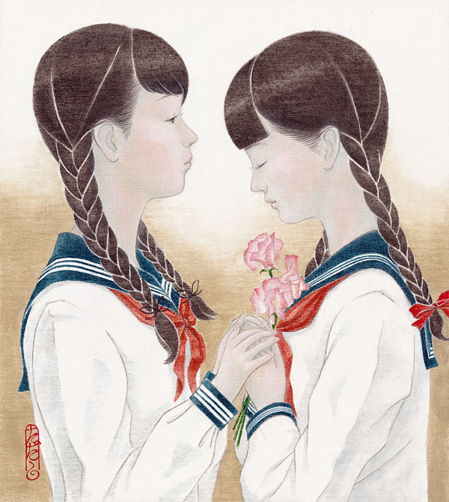
History
Meiji and Taishō Era Japan (1914-1926)
Compulsory education:
Separated sexes/ages
Shōjo youth sentimentality

Slide 8
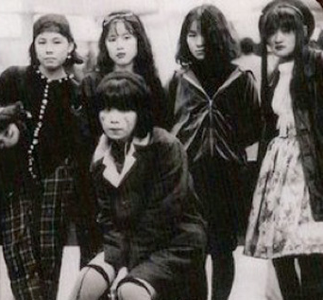
Evolution
Tribes and Subcultures:
Rebellion against tradition
Western emphasis
Medatsu
Punk influences

Slide 9
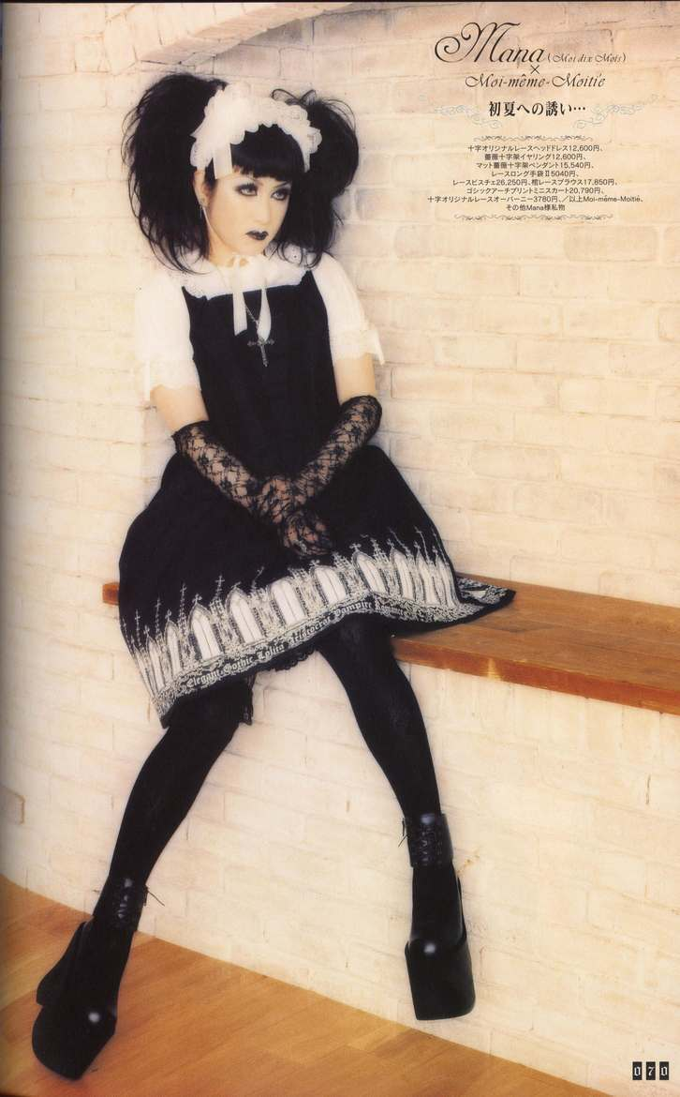
Mana
Cross-dressing glam rocker
“Elegant Gothic Lolita”
Guidelines:
Not costume
Victorian/Gothic/Rococo
Conspicuous, not offensive

Slide 10
Doll Culture
Japanese Doll culture:
Hina Matsuri:
Celebration of girls
Shintō spirits of children
Survival of childhood

Slide 11
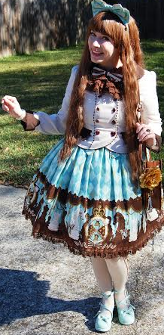
Reactionary Fashion
Reaction to:
sexualized women’s fashion
sexualization of youth
Defense of ladyhood

Slide 12
Reactionary Fashion
Results:
Lolita values: modesty, elegance, manners
Wearers feel: confident, magical, beautiful
Constructive, marketable hobbies

Slide 13
Is Lolita Feminist?
Lolita today:
Primarily aesthetic
Changes with globalization
In the West:
Community activity
Boycotts favoring small business
Raising awareness of scams and hate crime

Slide 14
Is Lolita Feminist?
Political involvement not inherent
Worn for self:
Not as protest
Not for social change
Not feminism now:
Potential for future

Slide 15
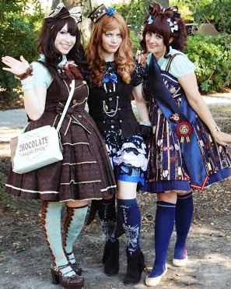
Conclusions
No clear relation to novel
Symbolic connotation in the West
Girl power ideology, not yet feminism
Visual, personal opposition to patriarchy
Western culture adds feminist tendencies

Slide 16
Credits
Sources:
Thesis: From Dolly to Loli?: Investigating the Origins, Implications, and Globalization of the Lolita Fashion Subculture
Independent study: Survey and interview of Lolita fashion community members in person and online regarding the origins of and common misconceptions associated with Lolita fashion
Image sources:
Jake Riojas and Alaina Davis of the Revolt Media Team
Fotos.org
Stephen and Renee Martin
Gothic & Lolita Bible
Bodyline (Brand). (2014). Costume535 [Digital image]. Retrieved Feb. 19, 2014, from: http://www.bodyline.co.jp/bodyline/showAll.asp?type=left&subType1=new&subType2=5
Brockway, Robert (Journalist). (2010). Sukeban Gang [Digital image]. Retrieved Feb. 19, 2014, from: http://www.cracked.com/blog/5-strange-real-life-gangs-that-put-the-warriors-to-shame/
Hoffpauer, Vivienne (Artist). (2007). Anatomy of a Lolita [Digital image]. Retrieved Feb. 19, 2014, from: http://vivcore.livejournal.com/69839.html
Nesnad (Photographer). (2011). Hina Matsuri Dolls [Digital image]. Retrieved Feb. 20, 2014, from: http://wordgyrl.typepad.com/photos/therealjapan/toyama_winter_05_084.html
Nobuko, Yoshiya (Artist). (2011. )Sweet Pea [Digital image]. Retrieved Feb. 19, 2014, from: http://www.behance.net/gallery/Hana-Monogatari-Tales-of-Flowers/2693443

