Slide 1
The Community Rating System
As a
Hazard Mitigation Tool
French Wetmore, CFM
French & Associates, Ltd.

Slide 2
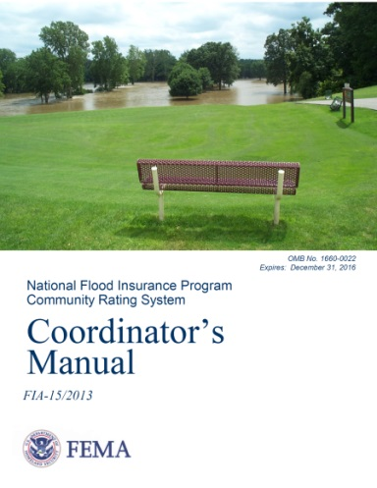
CRS Basics
FEMA program
NFIP program
Voluntary program
Provides reduced flood insurance premiums where there is better floodplain management
(above and beyond the minimum requirements of the NFIP)
Administered by the Insurance Services Office
    ISO/CRS Specialist

Slide 3
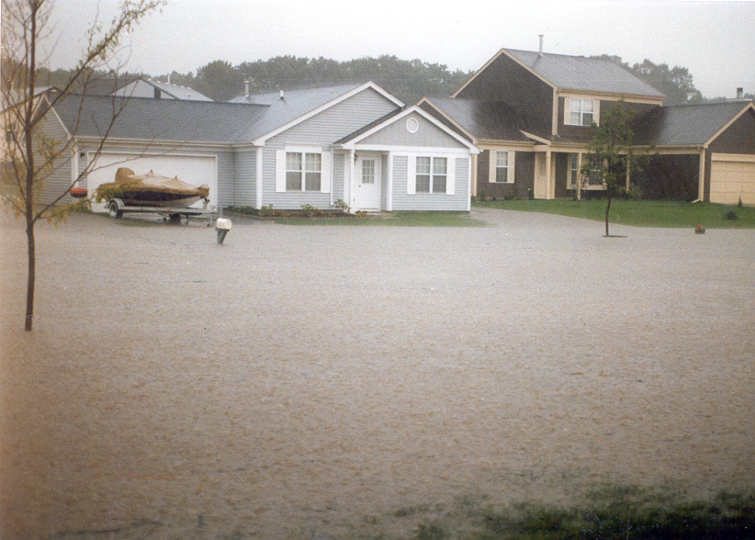
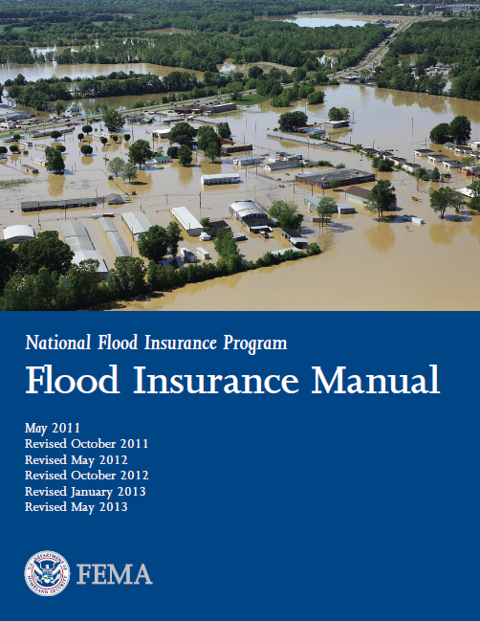
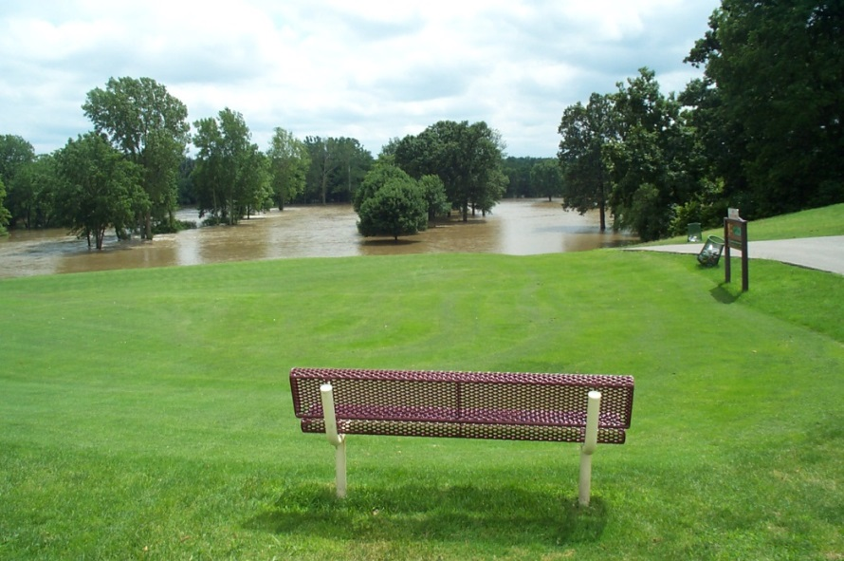
Goals
Reduce and avoid flood damage to insurable property
Strengthen and support the insurance aspects of the NFIP
Foster comprehensive floodplain management

Slide 4
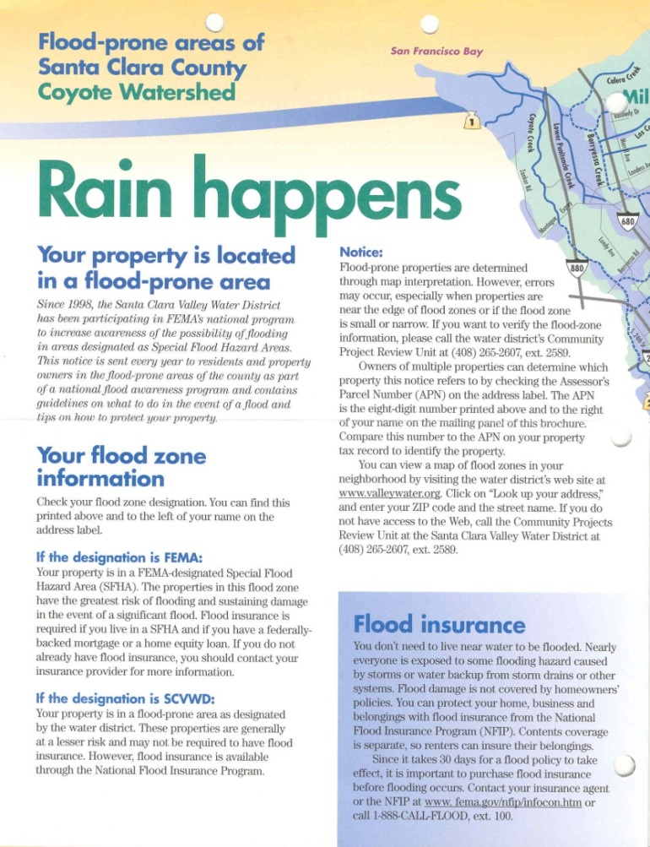
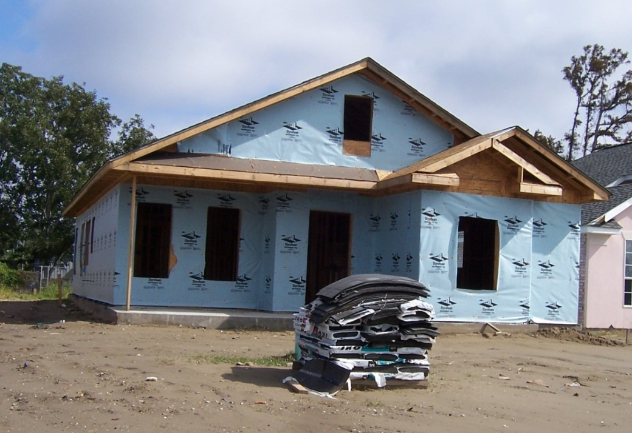
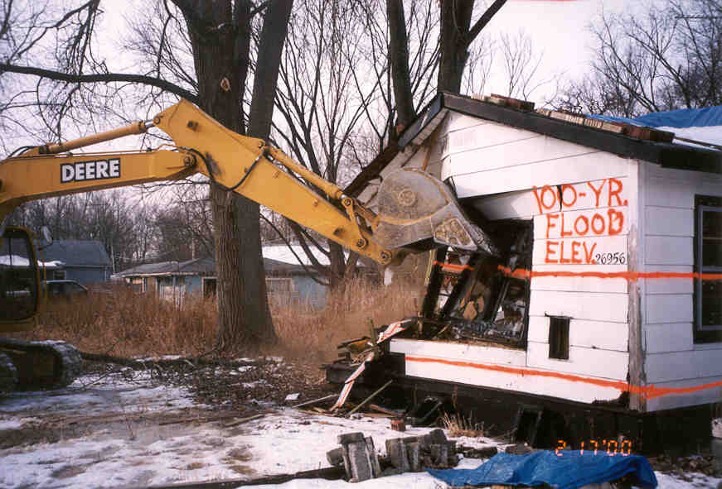
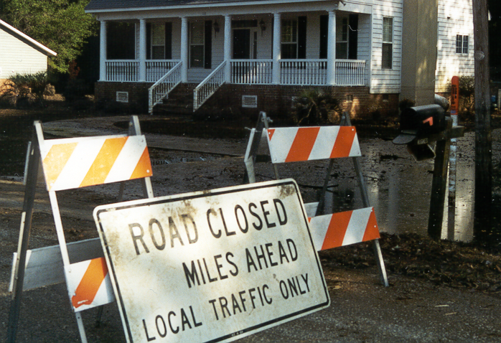
4 Series of Activities
300 Public Information
Mapping and Regulations
Flood Damage Reduction
Warning and Response
19 Activities
94 Elements

Slide 5
    Class Points SFHA Non‑SFHA PRP
1 4,500 45% 10% 0
2 4,000 40% 10% 0
3 3,500 35% 10% 0
4 3,000 30% 10% 0
5 2,500 25% 10% 0
6 2,000 20% 10% 0
7 1,500 15% 5% 0
8 1,000 10% 5% 0
9 500 5% 5% 0
10 < 500 0 0 0

Slide 6
1,313 communities
As of October 1, 2014
9 8 7 6 5 4 3 2 1
Class

Slide 7
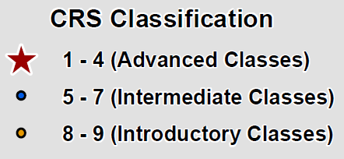
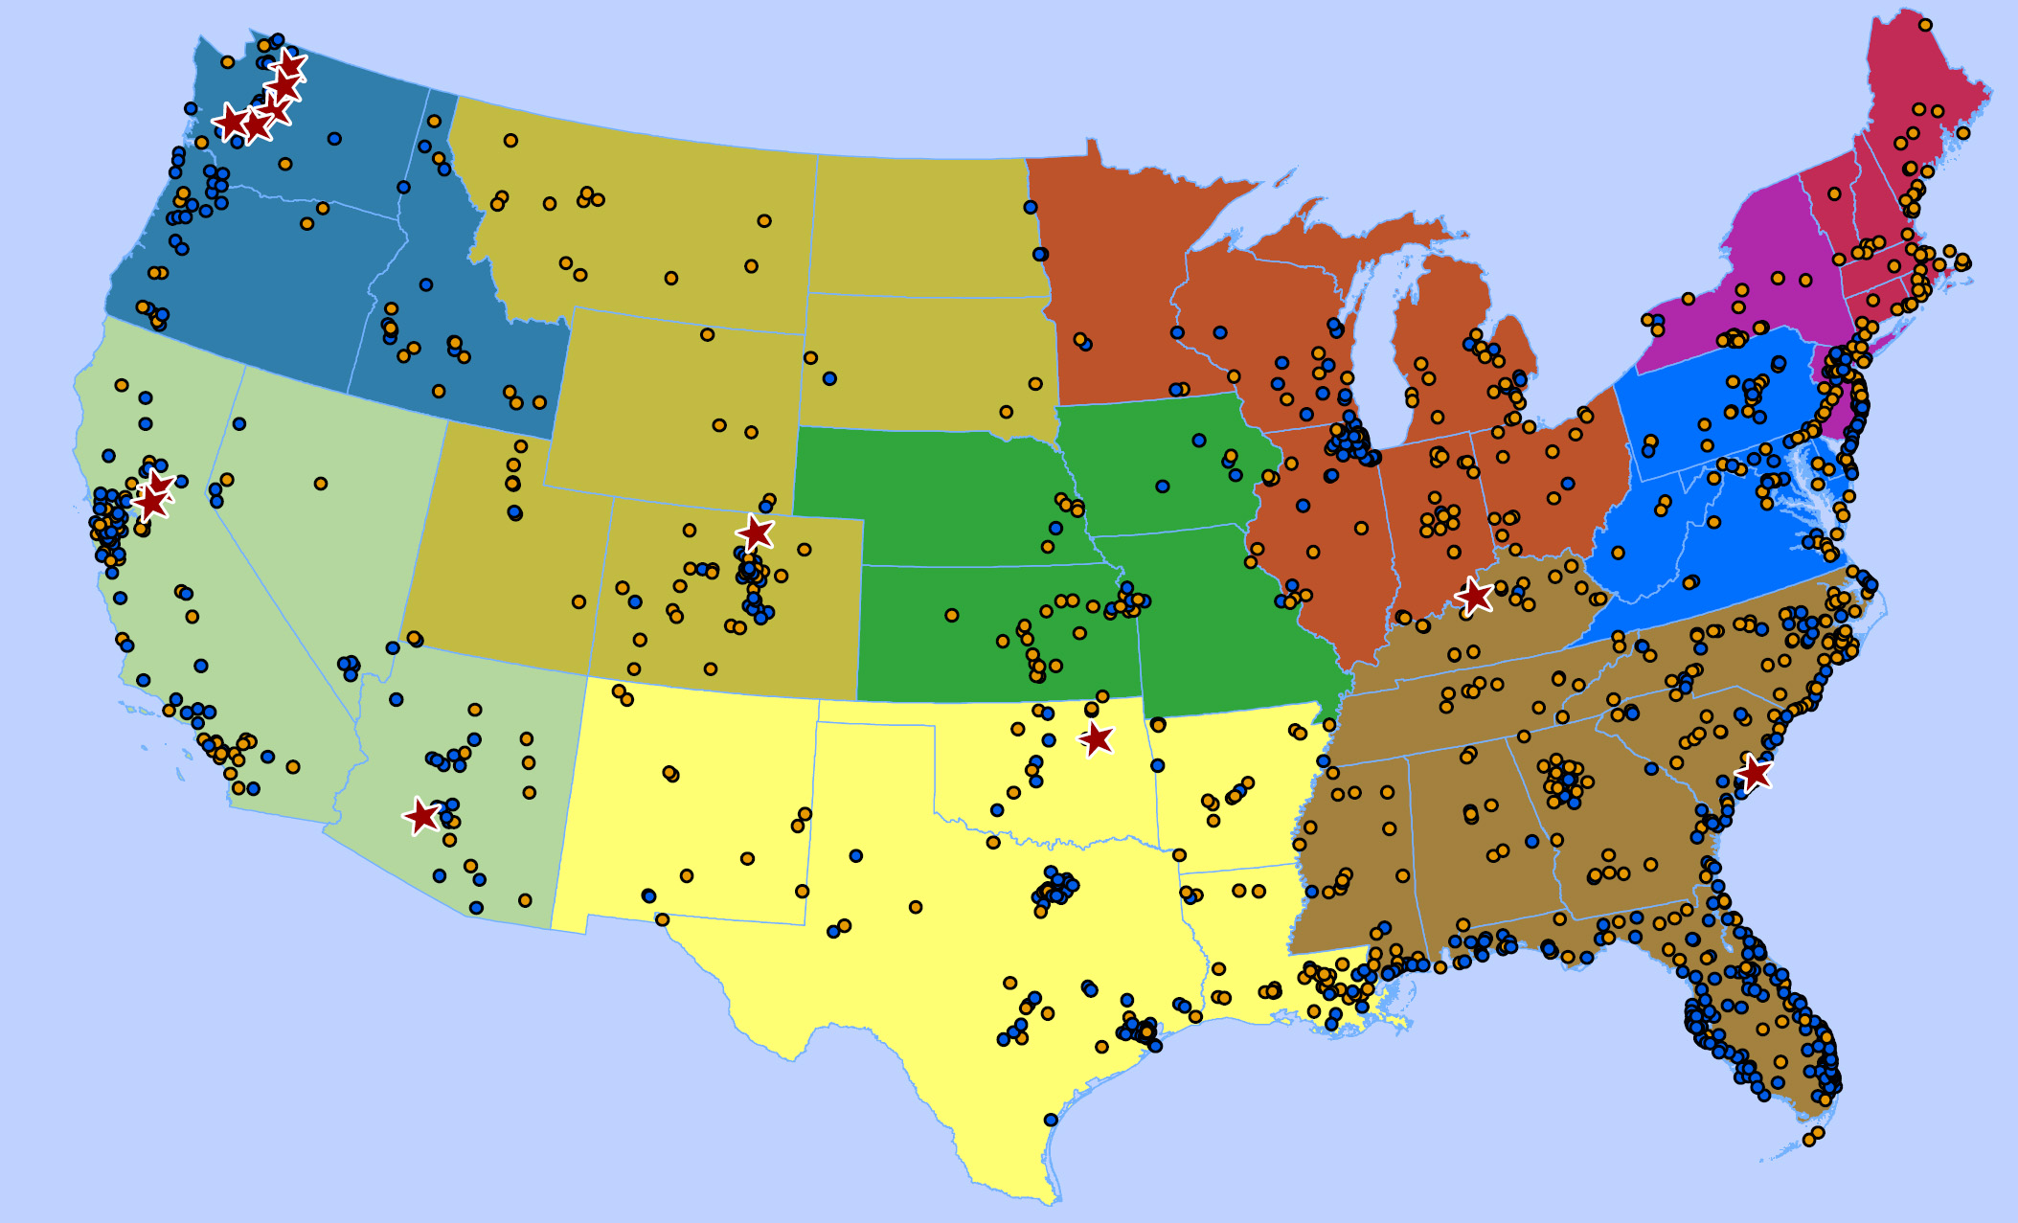
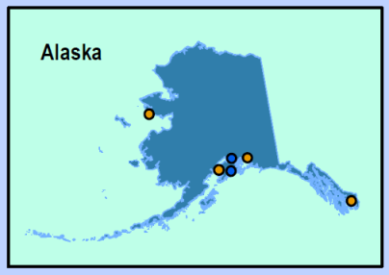

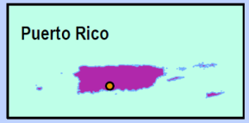

Slide 8
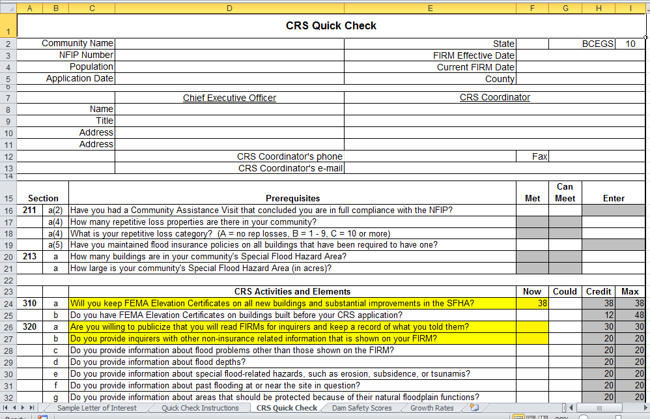
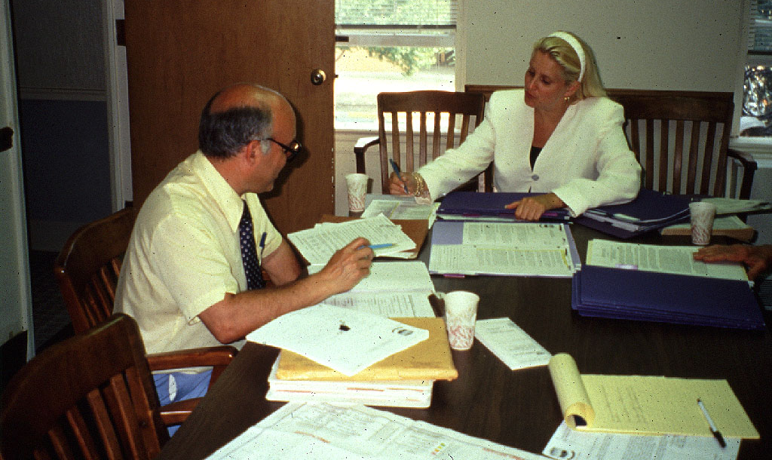
Application
Letter of interest from CEO
CRS Quick Check
FEMA Region OK’s a visit
ISO/CRS Specialist conducts the verification visit
Will need a CAV

Slide 9
Once in
Recertification
Modification
Cycle Verification
    Every 5 years for most
    Every 3 years for some

Slide 10



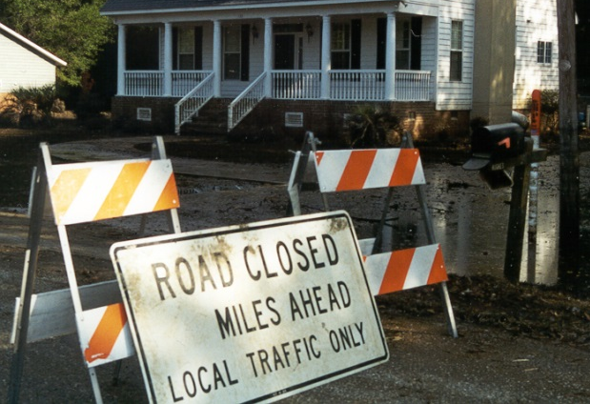
Costs & Benefits
Costs
Designate CRS Coordinator
Implement activities
Maintain records
Recertify each year
Participate in verification visits

Slide 11
Benefits
Money stays in the community

Slide 12
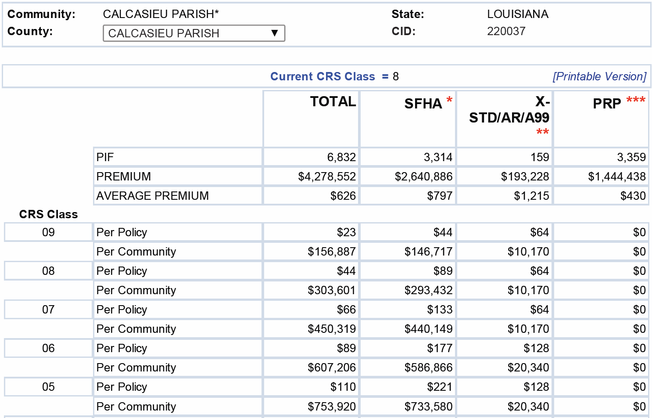

Slide 13
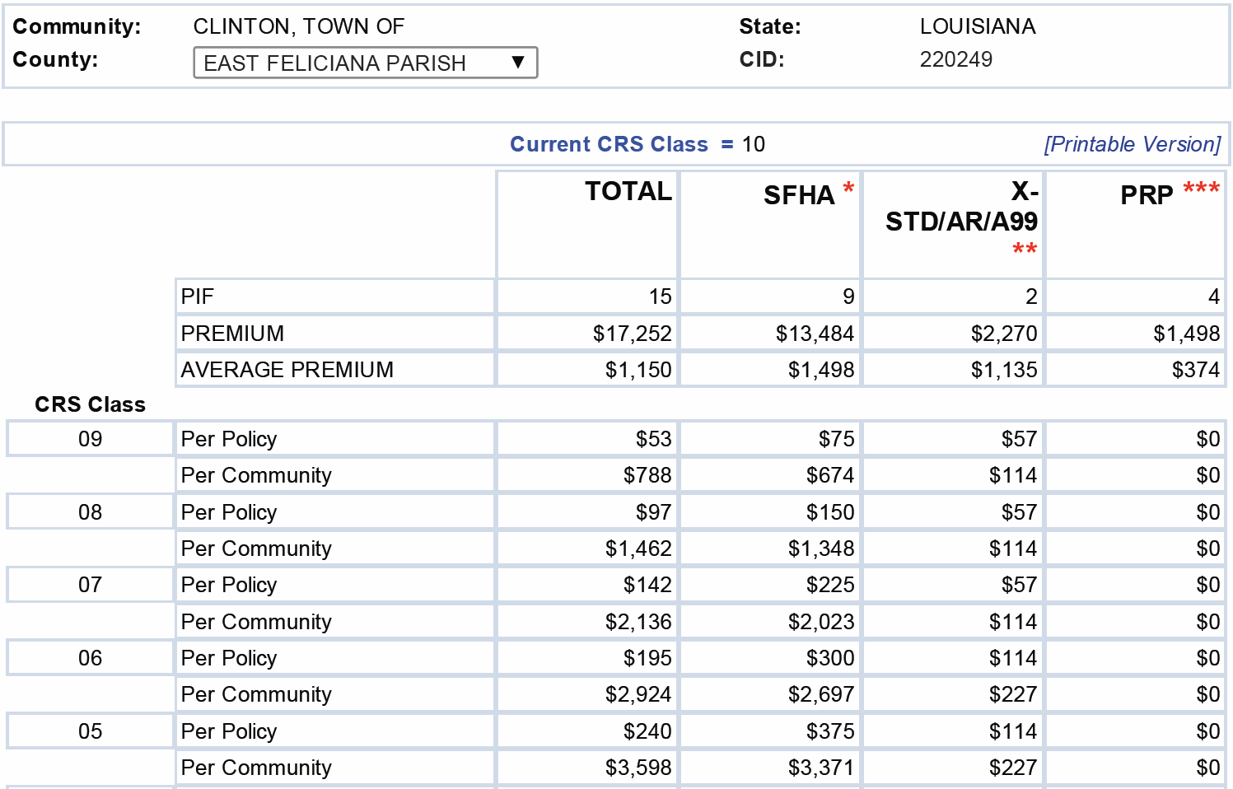

Slide 14
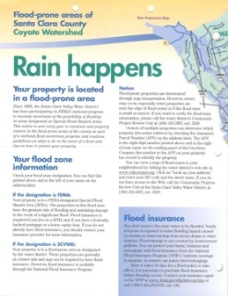

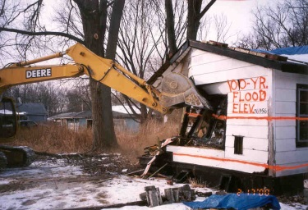
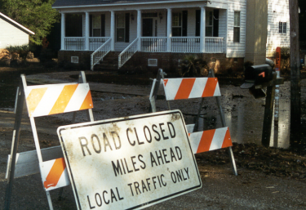
Benefits
Money stays in the community
Insurance savings offset costs
Better and better organized programs
Technical assistance
Public information builds constituency
Incentive to keep implementing
Community pride
$150
CRS
$100
Taxes

Slide 15
CRS Mitigation Credits
300 Series: Public information activities
400 Series: Mapping and regulations
500 Series: Flood damage reduction
600 Series: Warning and response

Slide 16
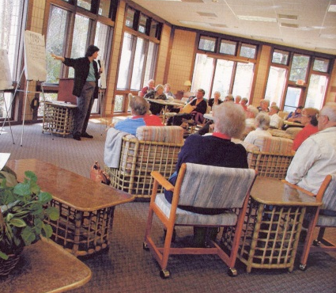
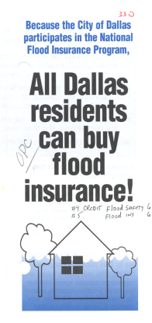

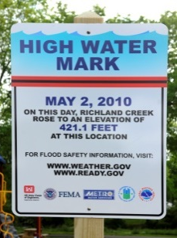

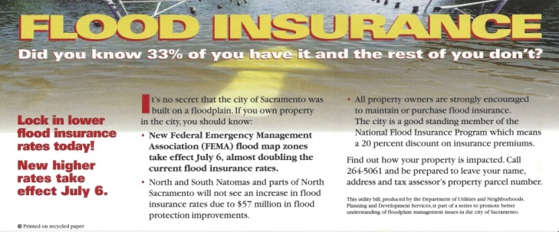
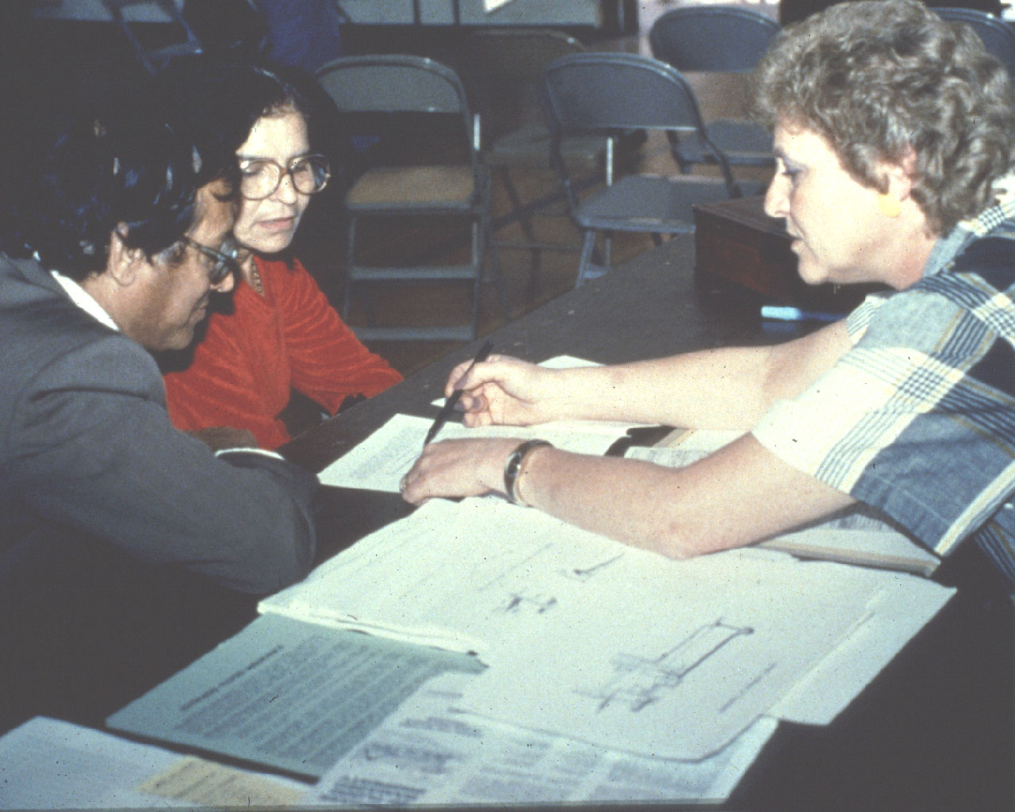
CRS Mitigation Credits
300 Series: Public information activities
330 Outreach Projects
350 Flood Protection Information
360 Flood Protection Assistance
370 Flood Insurance Promotion

Slide 17
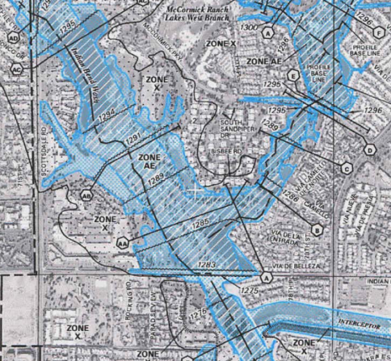
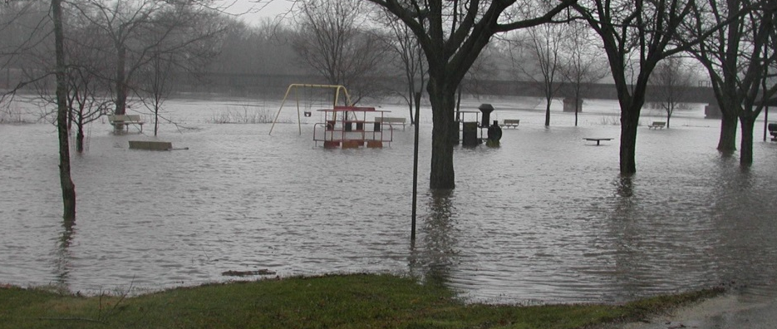
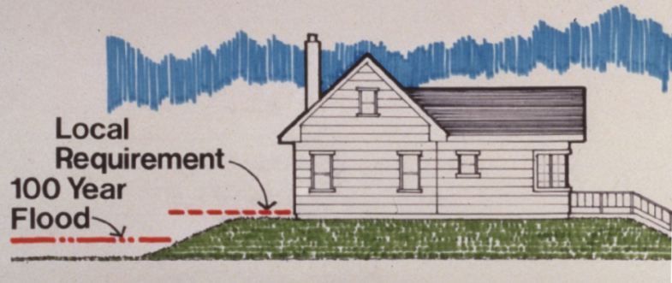
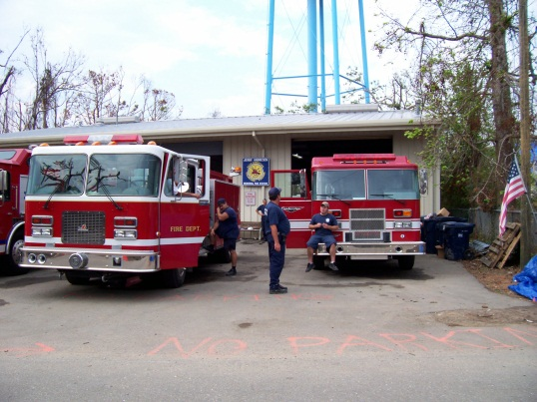
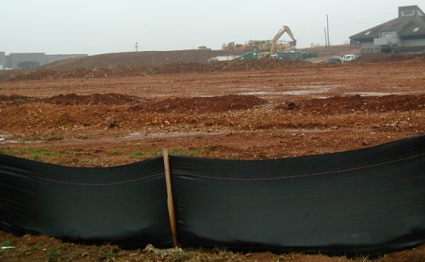
CRS Mitigation Credits
400 Series: Mapping and regulations
410 Floodplain Mapping
420 Open Space Preservation
430 Higher Regulatory Standards
450 Stormwater Management

Slide 18
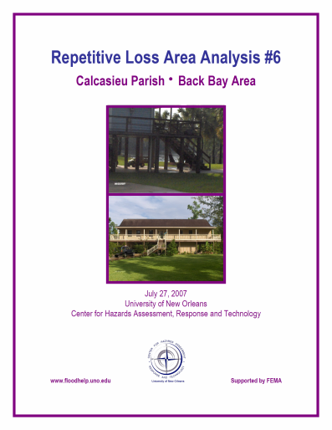
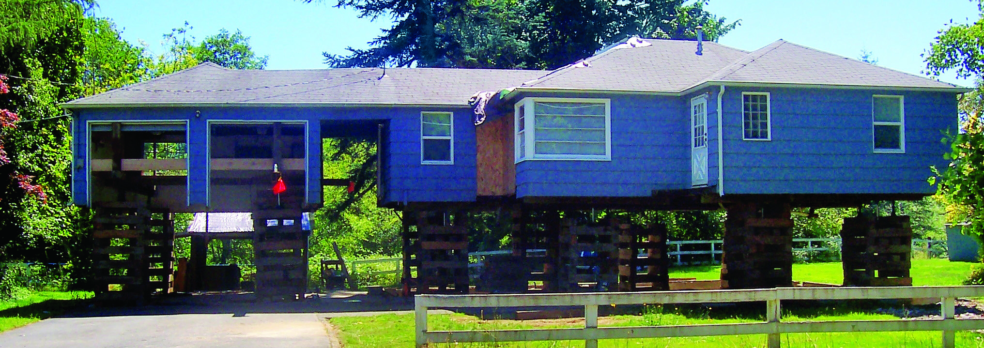
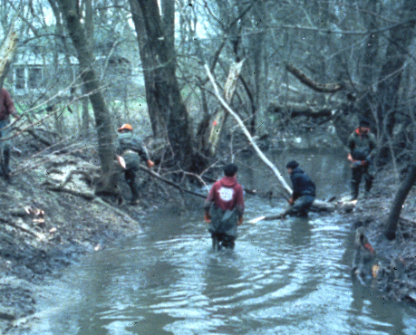

CRS Mitigation Credits
500 Series: Flood damage reduction
510 Flood Management Planning
520 Acquisition and Relocation
530 Flood Protection
540 Drainage System Maintenance

Slide 19
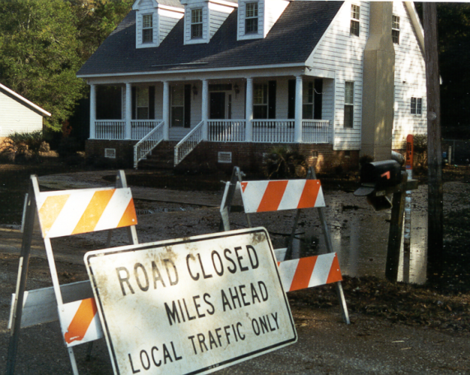

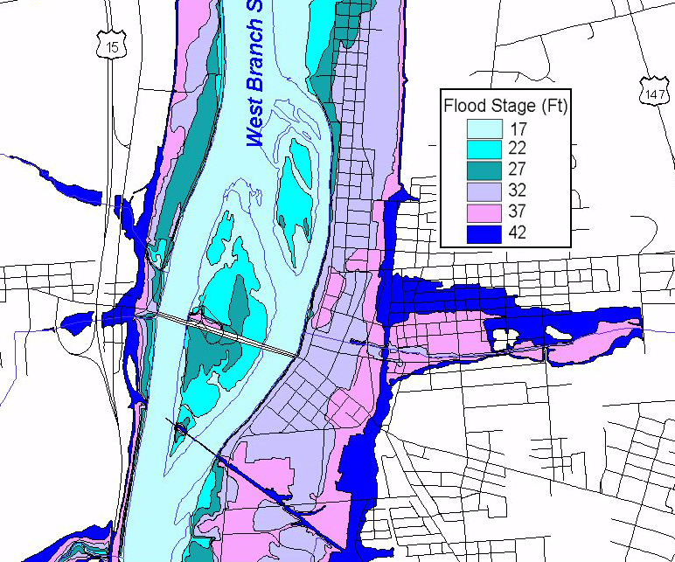
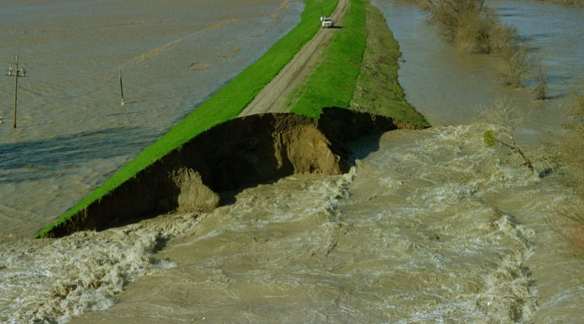
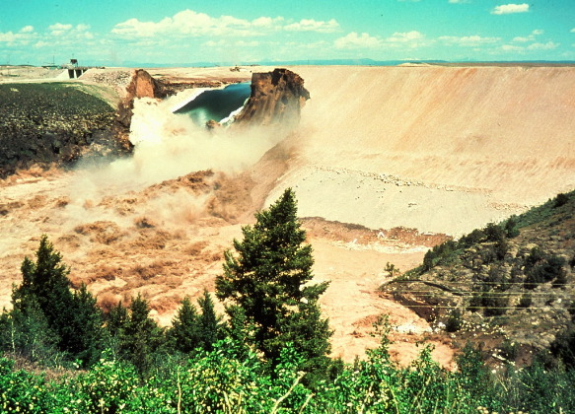
CRS Mitigation Credits
600 Series: Warning and response
610 Flood Warning and Response
620 Levees
630 Dams

Slide 20

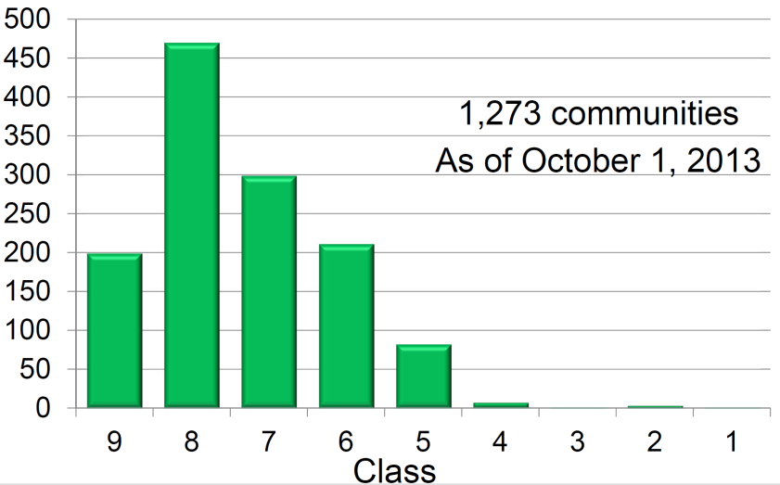
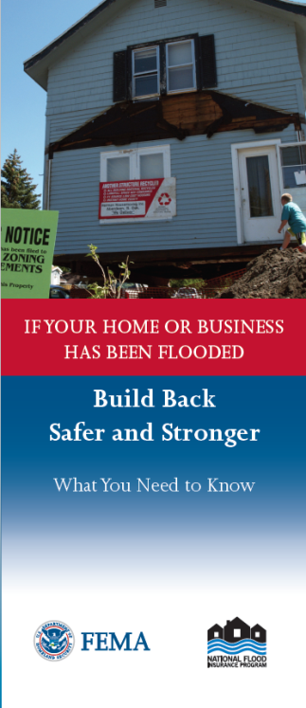
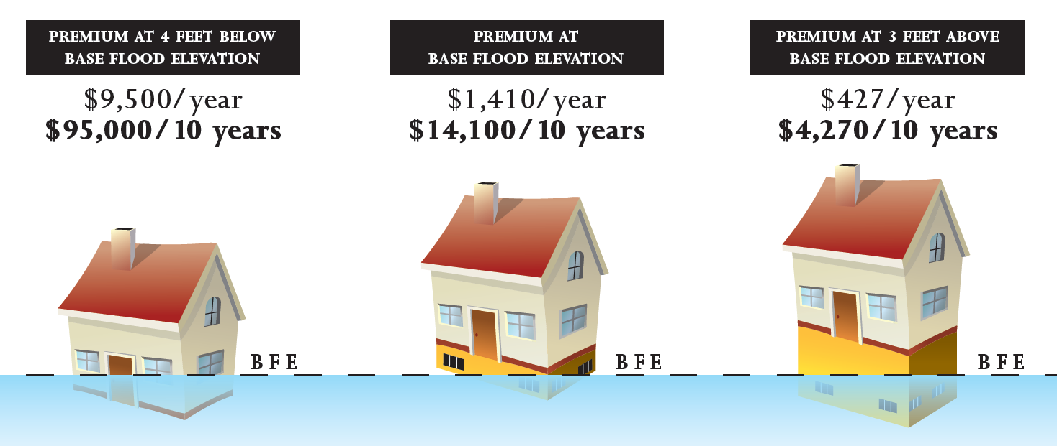
Biggert-Waters Reform Act of 2012
Reduced premiums:
5% - 45%
85%
95%
Notes:
The Biggert-Waters Reform Act of 2012 (BW12) has motivated many communities to look at ways to reduce the cost of flood insurance. We're not going to tell you what the Biggert-Waters Act says, or how it's interpreted these days, but we understand that it’s getting a lot of people interested in CRS.
Maybe your community would be motivated to do so many things, you could be a class one, but there's only one of those in the country right now. (Roseville, California)
Most likely, if you join CRS, you'll start as a class 7-8-9 and see a 5-15% decrease in your premiums.
But remember that flood insurance rates are based on several factors, including what community you’re in, what FIRM zone you're in, and how high your building is.
This particular FEMA brochure has a graphic you've probably seen before. Note that if you're building is actuarially rated, at four feet below the base flood elevation your premium will be really high. Those are the scary stories you are hearing about in the news. That’s what got people worried about Biggert-Waters and what it means.
But, if you elevate the building, for example, to the base flood elevation, you can see an 85% reduction in the premium. If you go three feet above the base flood elevation, it could save as much as 95%.
If you want to reduce premiums…CRS helps. But the most effective way to save residents money is to encourage elevation and relocation of floodprone structures. Mitigation reduces exposure to flooding and that will reduce their insurance premiums.

Slide 21
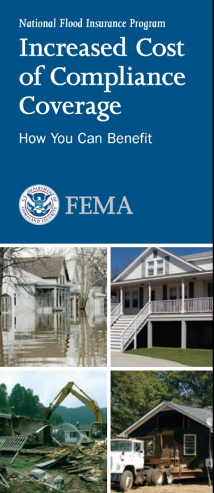
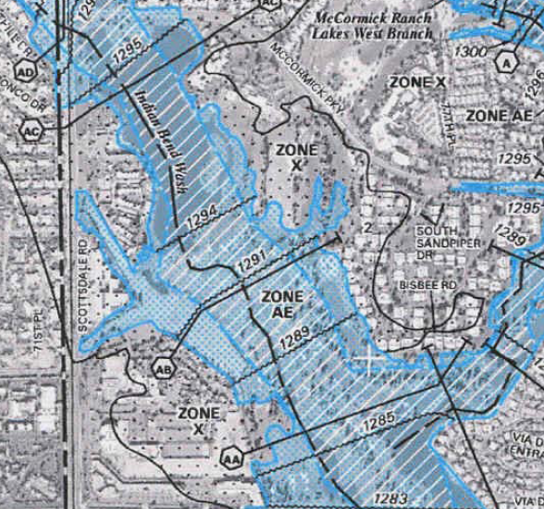
Biggert-Waters Reform Act of 2012
Reduced premiums
Property protection credits:
  Map information (320)
  Insurance information (330)
  Website (350)
  Retrofitting advice (360)
  Answer questions (370)
  Improve hazard maps (410)
  Freeboard (430)
Notes:
CRS has a variety of credits that help support mitigation.
Map information programs that tell people about the flood hazard.
Outreach projects, websites and one-on-one assistance to inform residents about flood insurance and retrofitting measures.
Improving flood maps so the true hazard really is reflected…
and in particular higher regulatory standards. CRS wants you to think about the big picture. Think in terms of not only joining just for reduced premiums, but joining to do things in your community that will reduce flood risks and therefore improve or reduce their premiums.

Slide 22
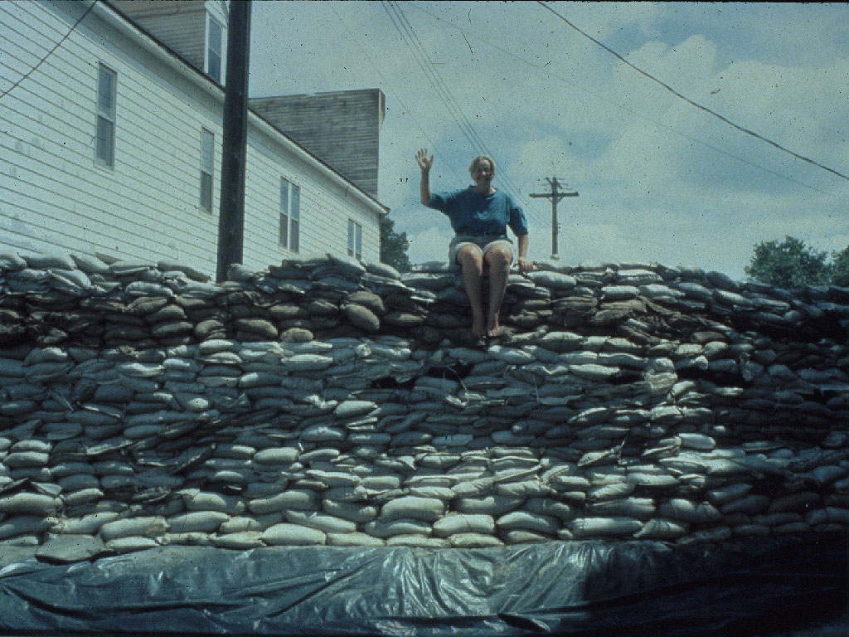
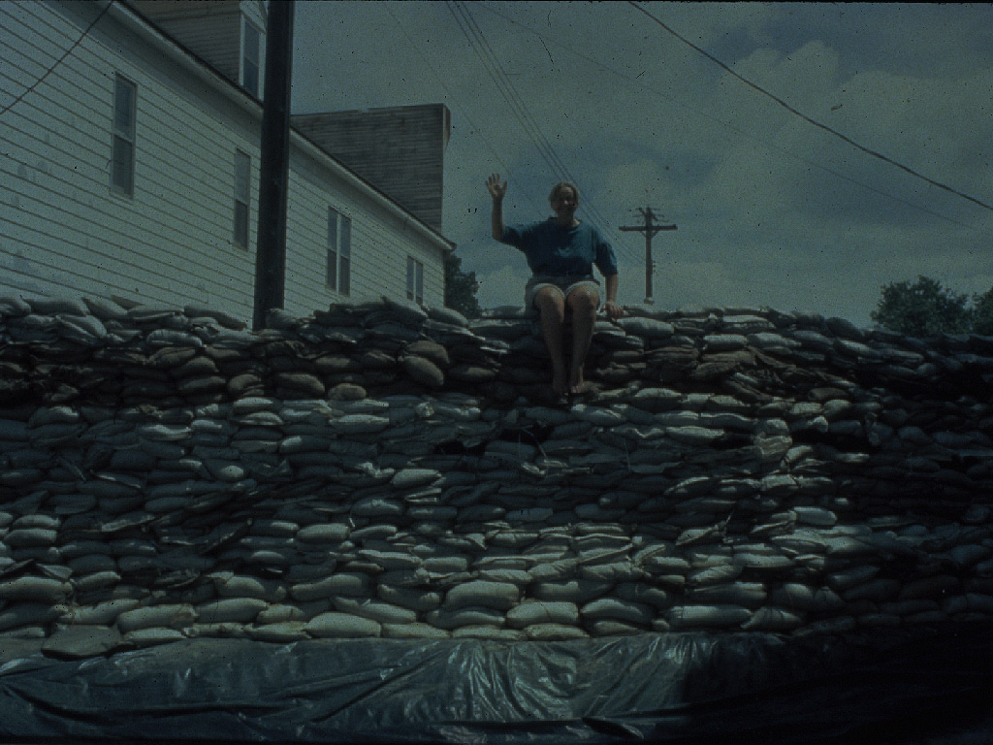
“HELP”
ISO/CRS Specialist
State
FEMA
CRS Websites
Publications
Other CRS communities
CRS users groups

Slide 23


Slide 24

www.CRSResources.org
New

Slide 25
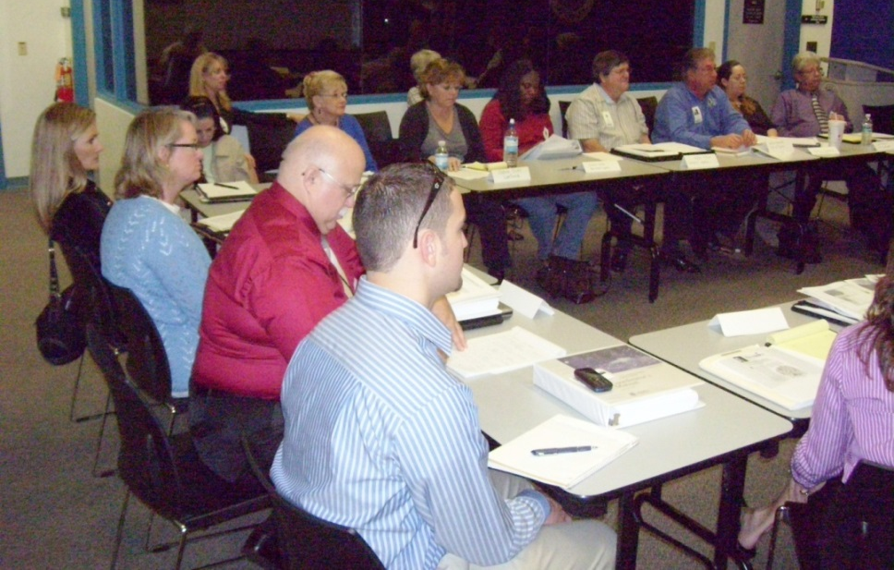
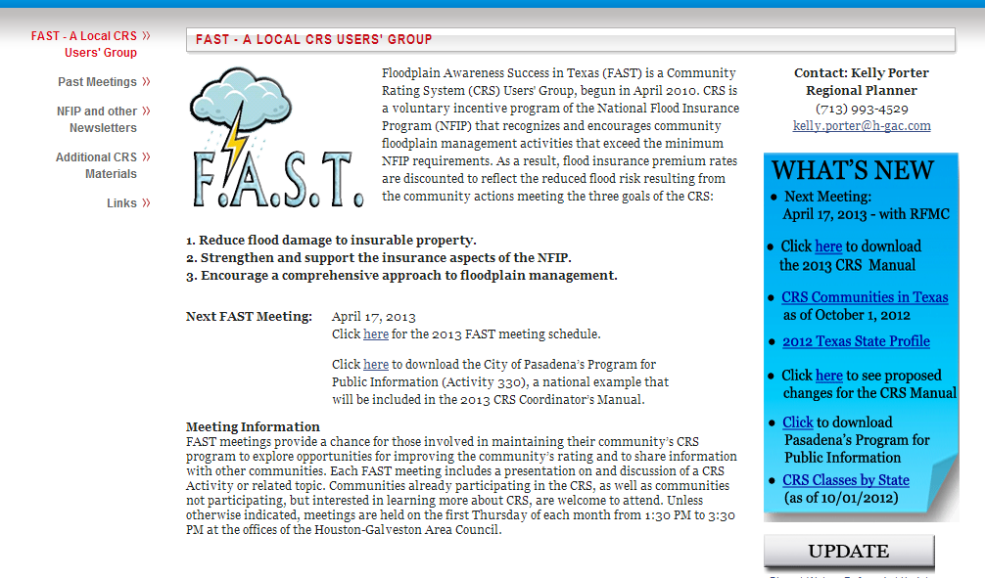
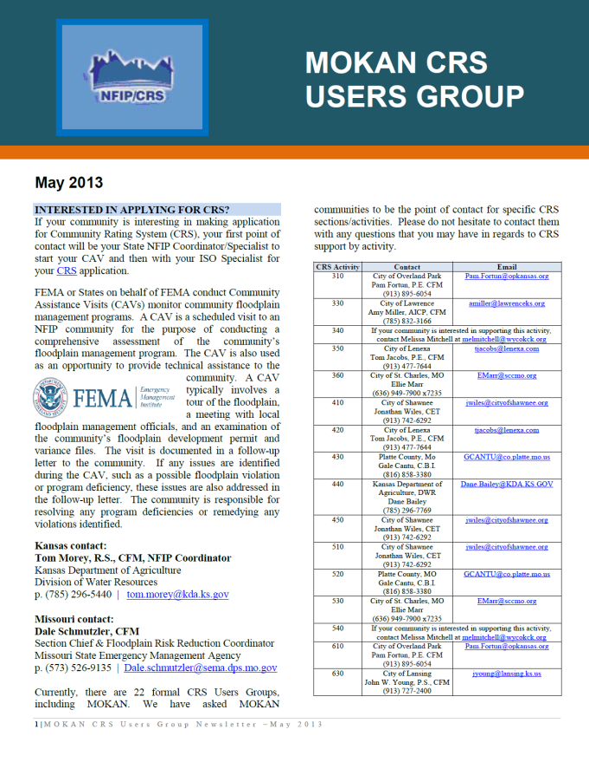
CRS Users Groups
Informal organization
Meet periodically
Talk and share ideas
Share how activities done
Cooperate on joint ventures
Provide feedback on CRS

Slide 26
