Slide 1
STARBUCKS TROOPERS
Stefannie Garcia
Stephanie Morgan
Jeremy Sanders
Taylor Hooper
Natalie Rowe

Slide 2
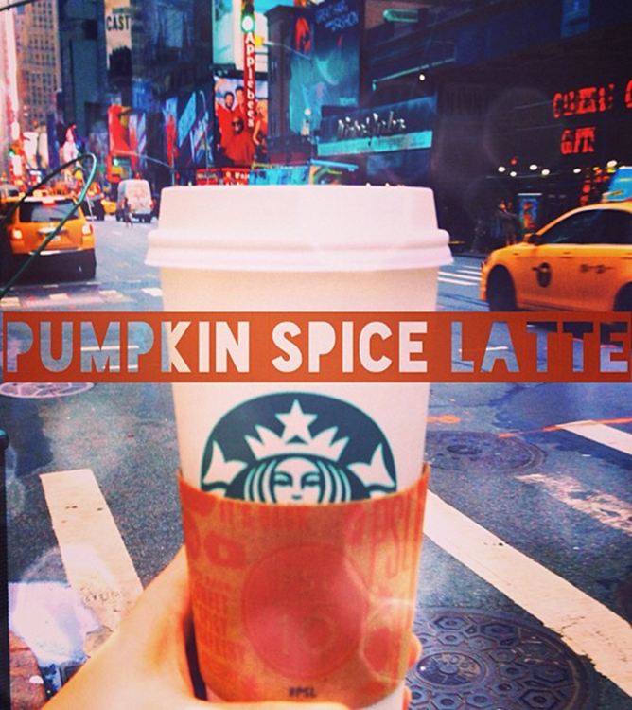
OUTLINE
About Starbucks
Research Purpose
Research Problems
Hypothesis Development
Research Methods
Data Analysis and Interpretation
Results
Limitations and Sampling Errors
Conclusions and Recommendations

Slide 3
ABOUT STARBUCKS
International coffee house giant
Established 1971 in Seattle, Washington
Currently 18,000 stores in 60 different countries
Over 13 stores in Orleans Parish and 10 in St. Tammany Parish
Designated one of the world’s most ethical companies by Ethisphere
Practically everybody knows Starbucks!

Slide 4
GENERAL RESEARCH PURPOSE
Focus on the Pumpkin Spice Latte seasonal drink
Most popular seasonal drink offered in the U.S.
Popular among regular and non-regular customers
Why is it the most popular seasonal drink?
Is it popular because it is a limited time offering?
Who responds to this promotion?

Slide 5
SPECIFIC RESEARCH PURPOSE
To measure and analyze popularity of the Pumpkin Spice Latte among heavy and light Starbucks consumers over regular menu offerings
To see if the “limited edition” offering may have an effect on Starbucks consumers’ purchasing frequency.

Slide 6
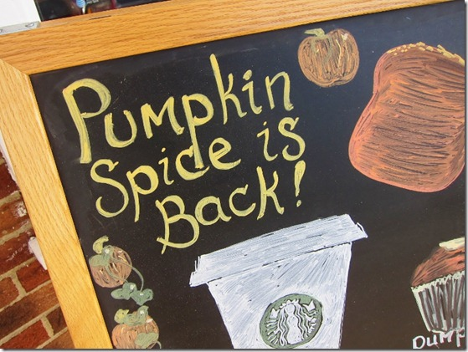
RESEARCH PROBLEMS
MANAGEMENT DECISION PROBLEM:
Will changing the ad campaign to reflect limited time offer have an effect on the Pumpkin Spice Latte?

Slide 7
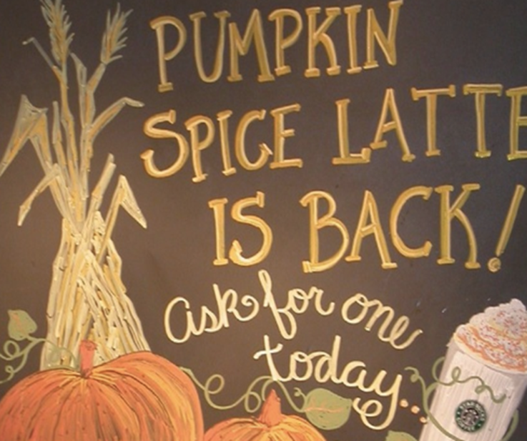
RESEARCH PROBLEMS
MARKETING RESEARCH PROBLEM:
Will putting “limited time offer” on a Pumpkin Spice Latte ad have an effect on consumer evaluations of the Pumpkin Spice Latte?

Slide 8
HYPOTHESIS DEVELOPMENT
H1: There is a significant difference in placing the words “limited time offer” on the Pumpkin Spice Latte over a regular Pumpkin Spice Latte advertisement without the limited time offer.
H2: The impact of addressing the “limited time offer” has an effect on the consumer purchase of the Pumpkin Spice Latte. (Heavy vs. Light users)

Slide 9
THE ADVERTISEMENTS
LIMITEDIME OFFER

Slide 10
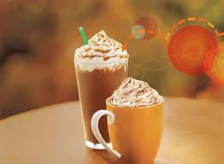
RESEARCH METHODS
100 Respondents
Experimental Design
Ratio, Nominal, & Interval Scale
Mutually Exclusive & Collectively Exhaustive
One-Way & Two-Way ANOVA

Slide 11
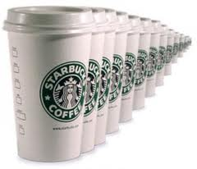
ONE-WAY ANOVA INDEPENDENT VARIABLE
FREQENCY:
How often do you consume Starbucks products per week?
( ) times per week

Slide 12
ONE-WAY ANOVA DEPENDENT VARIABLES
2. How would you rate Starbucks products: Attitude Towards Starbucks
3. The advertisement for the promotional Pumpkin Spice Latte on the previous page is: Attitude Towards The Promotion
5. Based on the given promotion, how likely are you to purchase the Pumpkin Spice Latte in the near future? Purchase Intention
Unlikable 1 2 3 4 5 6 7 Likable
Unlikable 1 2 3 4 5 6 7 Likable
Ineffective 1 2 3 4 5 6 7 Effective
Very Unlikely 1 2 3 4 5 6 7 Very Likely

Slide 13
ONE-WAY ANOVA RESULTS FOR H1
QUESTION 2: Attitude towards Starbucks
QUESTION 3: Attitude towards advertisement
QUESTION 5: Purchase Intention
Based on these results, attitude towards Starbucks and the PSL promotion is significantly affected by the words “limited time offer”. Therefore, only Purchase Intention does not support H1.
ANOVA
 |  | Sum of Squares | df | Mean Square | F | Sig.
Q2 | Between Groups | 7.290 | 1 | 7.290 | 3.655 | .059
 | Within Groups | 195.460 | 98 | 1.994
 | Total | 202.750 | 99
AVERAGE | Between Groups | 10.240 | 1 | 10.240 | 3.441 | .067
 | Within Groups | 291.620 | 98 | 2.976
 | Total | 301.860 | 99
Q5 | Between Groups | .160 | 1 | .160 | .032 | .858
 | Within Groups | 487.280 | 98 | 4.972
 | Total | 487.440 | 99

Slide 14
DATA ANALYSIS FOR TWO-WAY ANOVA
Independent Variables
1.Frequency of Consumers
Light (2 or less times per week) vs. Heavy (3 or more times per week)
2. Condition of Promotion Type
Limited Edition vs. Regular
Dependent Variable
1. Average attitude towards promotion

Slide 15
INTERPRETATION FOR TWO-WAY ANOVA
We found there is a significant relationship between the add type (limited edition vs. regular) and the consumer buying frequency (heavy vs. light). Thus being able to support H2.

Slide 16
PROFILE PLOTS FOR TWO-WAY ANOVA

Slide 17
RESULTS
The Limited Time Offer Promotion was more appealing to Light Users
The Regular Promotion was more appealing to Heavy Users

Slide 18
LIMITATIONS
Wording and placement of questions in survey
Geographical; only administrated questionnaires in Orleans and St. Tammany Parish
Frequency limited to only light and heavy users
Sampling Errors

Slide 19
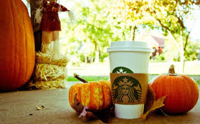
SAMPLING ERRORS
Respondent Errors
Skipping Questions, Non-Responses, Not Engaged in Questionnaire
Human Errors
Misunderstanding Questions
Design Errors
Placement of Questions

Slide 20
CONCLUSION
Based of our One-Way Anova analysis, there was no effect on purchase intention based of the two promotion types.
We found that the words Limited edition on a given Pumpkin Spice Latte promotion have a greater effect on light Starbucks consumers
Other variables, such as gender also played a factor in the Pumpkin Spice Latte promotion
Female vs. Male

Slide 21
RECOMMENDATIONS
“Limited Time Offer” phrase was found to be more effective promoted on light users who are categorized as variety seekers
Due to greater response to the Pumpkin Spice Latte by females, focus on more on promotion efforts to females

Slide 22
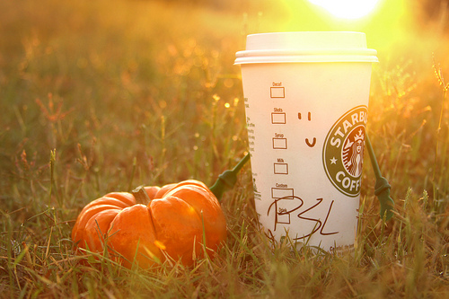
QUESTIONS?
Limited Time Offer!!

