Slide 1
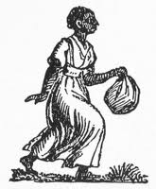
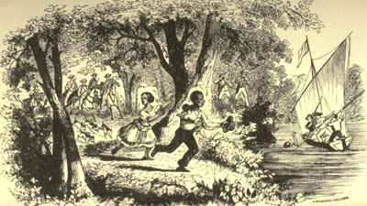
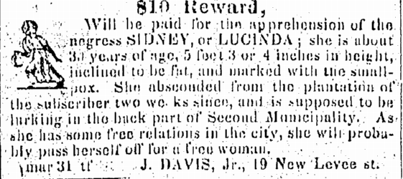
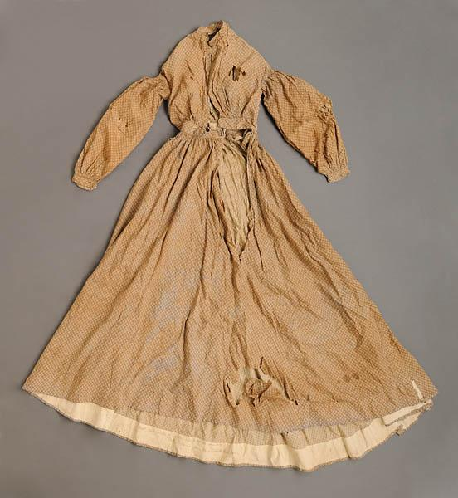
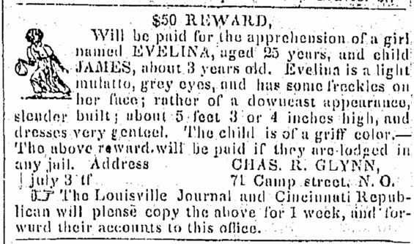
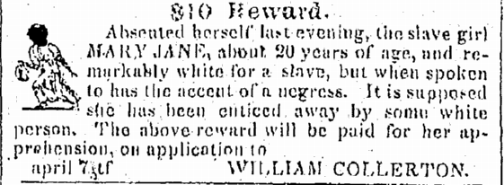
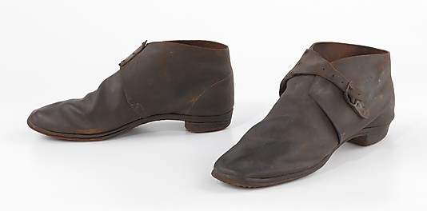
The Runaway Slave Women of New Orleans An Urban Perspective on the Antebellum South by Tara Garbutt
Abstract
While working on a project collecting runaway slave ads, it became apparent that female slaves were less likely to run away than men. So what can we learn from looking at those women who did run? Our team of researchers is working with the New Orleans Times Picayune. These runaway slave ads provide fascinating detail about the fugitives: how they looked, spoke, with whom they traveled, and where they were going. This poster provides insights into female runaways in the city of New Orleans, and compares our early results with those of our cohort in Mississippi, which had largely rural populations.
New Orleans Times-Picayune, 31 March 1839, p. 3.
16 November 1839
Piney Wood Planter (November 16, 1939)
[Libery, Miss.]
Twenty Dollars Reward.
Ran away from the subscriber this morning, (16th Nov.) [sic] a negro woman by the name of NANCY she is about sixteen years old, five feet, one or two inches high, very black, quick spoken. Said negro left me near Mr. Browns, 3miles south of Liberty. Had on a red calico dress and coarse brogan shoes. She will probably try to make her apprehension and delivery to me at Mr. Brown’s, confinement in any jail that I may get her again.
J.R. HUNTER.
New Orleans Times-Picayune 3 July 1839, p. 3
See also Liberty Advocate,21 November 1839 [in November 21, 1839]
Was Committed to the Jail of Amite County, on the 18th instant, by John Walker Esq., a Justice of Peace, in and for said County, a negro girl who says her name is NANCY, and that she belongs to ELIZABETH SMITH and CHAS. SMITH, of the State of Tennessee. Said negro is about sixteen years old-five feet, one or two inches high-very black-quick spoken-had on when committed a red Calico dress and coarse Brogan shoes. The owner of the above described negro is requested to comply with the law, and take her out of Jail.
M. M. WHITNEY, Jailor.
Introduction
Antebellum slavery was a brutal institution. Enslaved people were told to do so much for very little. There were added pressures and expectations for female slaves. They were beaten, raped, and some were described in the slave market as “breeders.” In this light, the thought of female slaves running away might be an obvious one. But, how practical would it have been for a woman in 1839 to run away, possibly by herself or with family? Was there a difference between running away in a rural Mississippi and an urban area like New Orleans? Those are the questions I will be answering in this research project.
New Orleans Times-Picayune 7 April 1839, p.3
American-made brogan, ca. 1860-65. Brooklyn Museum Costume Collection at the Metropolitan Museum of Art
Methods
Using America’s Historical Newspapers, our team reads the New Orleans Times- Picayune year by year and page by page, from 1837-1861. When we find an ad for a runaway, we follow a set rubric for scanning the ad, giving it a file name, transcribing it, and recording the names of the enslaved, the owner, the advertiser, and the address of the owner.
Calico dress made by slave Combo on Robeson Plantation, c. 1860. North Carolina Museum of History.
25 March 1839
Liberty Advocate (April 4, 1839)
$150 Reward.
Ranaway from the plantation of the subscriber on the night of the 22nd of March, a yellow woman named FANNY WOLFOLK. She is low and chunky, a broad face, bow-legged, turns her toes in, broad teeth, wide apart, and has a scar on her right cheek bone. It is supposed that she was enticed off by an Indian Fellow, and will probably try to pass herself for an Indian woman, but her speech and hair will be sufficient to detect her. I will give a reward of $50 for the woman, and $100 for the thief, if he be prosecuted to conviction.
W. S. HAMILTON.
Plantation, West Fel., La.
7 January 1839
Southern Argus (January 8, 1839)
[Columbus, Miss.]
25 Dollars Reward.
Ranaway from the subscriber, living in Carrollton, Mississippi, on the 3d ult., two Negroes, a man and woman-Ben, about 40 years old, six feet high, very black, and some of his teeth bad; SARAH, 23 or 24 years old, a very small woman, thin visage, and some of her teeth bad; no other marks recollected. I will give the above reward for said negroes if taken in the state, or $50 if taken out of the state. Any information concerning them thankfully received.
P. MONEY.
Carrollton.
Conclusion
In conclusion, from the research gathered so far, there were more women that ran away in the urban area (New Orleans). It seems as though the city had more of an opportunity for fugitives to hide in plain sight, perhaps even in close proximity to their owners. The fact that a number of the runaway’s spoke different languages also made it easier for them to get around the city and blend in where they could. There were also large numbers of free people of color in New Orleans, which made blending in easier as well. It was much harder to run away in a rural area because of the great distance between towns, large tracts of cleared land, and a relatively sparse rural population. Rural runaways were trapped by land, but may have been more likely to run away from the state border than the interior part of the state.
Results
There were more runaway advertisements per issue in New Orleans than in rural Mississippi. Also, in New Orleans runaways were often fluent in more than one language, unlike those in Mississippi. The advertisements collected for Mississippi for the year 1839 were spread across multiple newspapers. The slaves in the rural areas typically ran away close to the border of the state. Some of the slaves in the city, on the other hand, were suspected to be in places where they could hide in plain sight. Some of the New Orleans advertisements also stated that fugitives might try to pass for someone of another race. Female runaways in both the city and rural areas often ran away with a male family member. Other advertisements, in both locales, mentioned a relative or a spouse’s location as a possible destination.
Sources
America’s Historical Newspapers,http://infoweb.newsbank.com.ezproxy.uno.edu/
Douglas B.Chamber and Max Grivno, Max, “Mississippi Runaway Slaves: 1800-1860” (2013). Documenting Runaway Slaves . Paper 1. http://aquila.usm.edu/drs/

