Slide 1
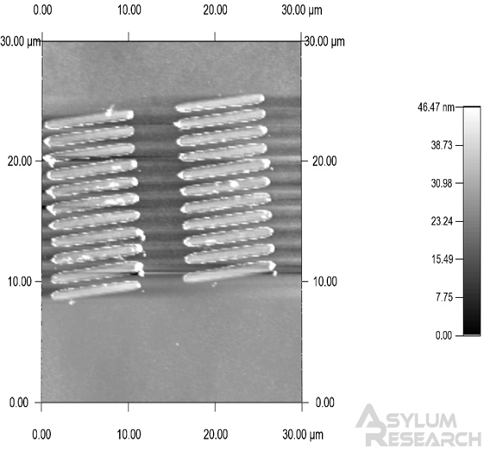
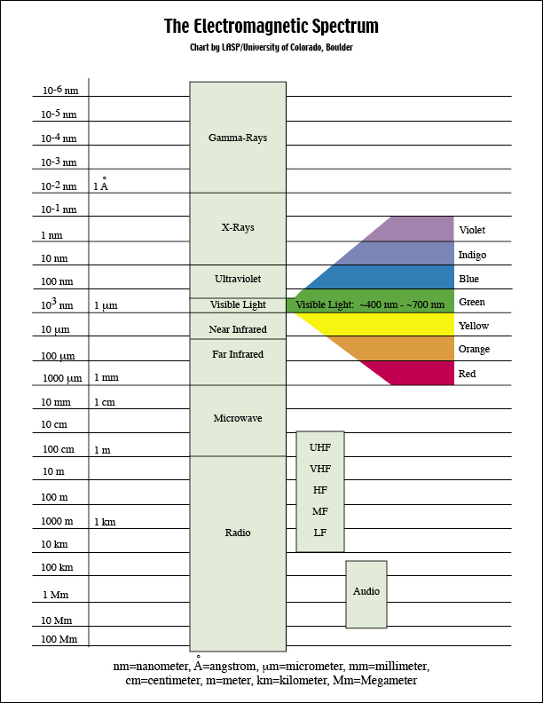
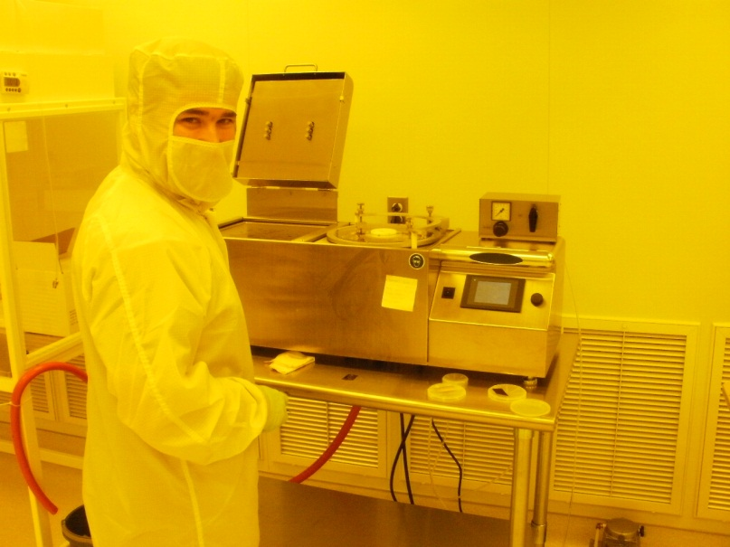
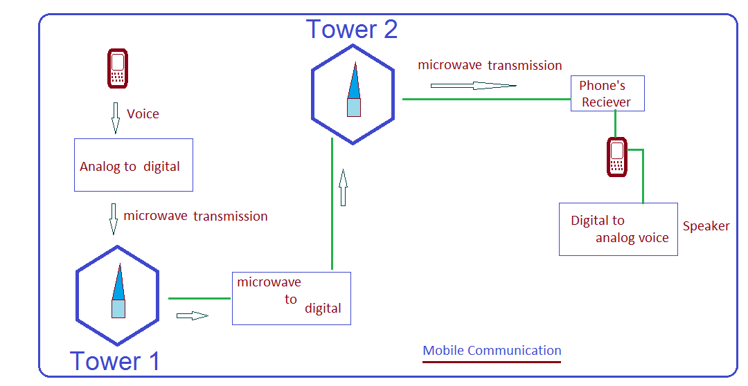
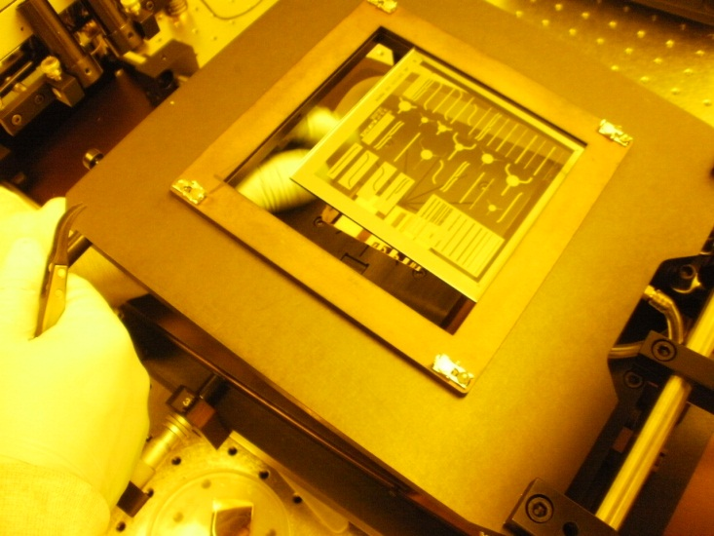
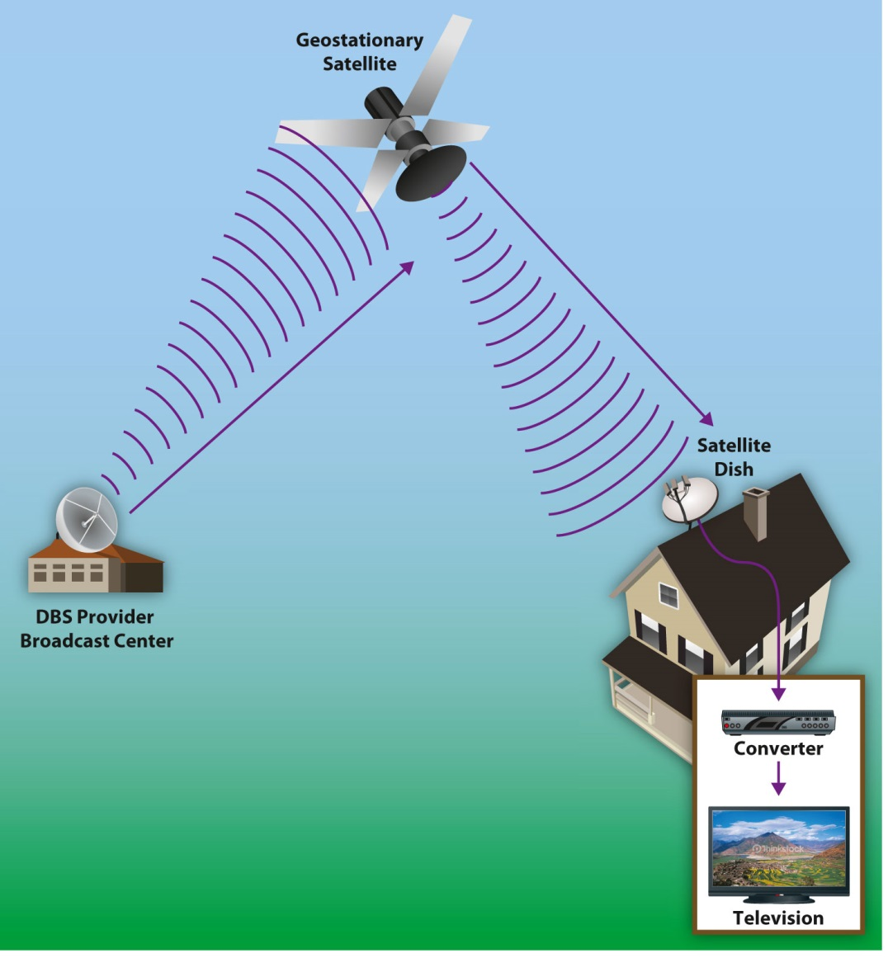
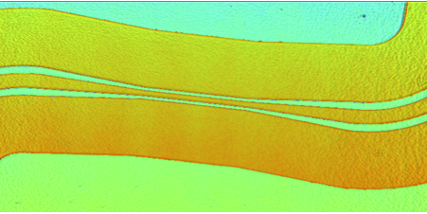
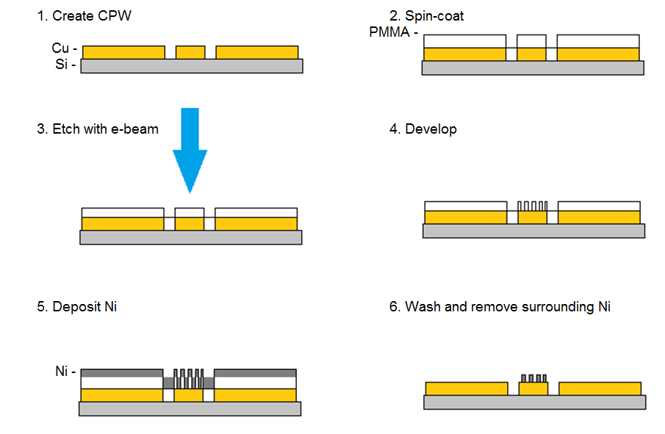
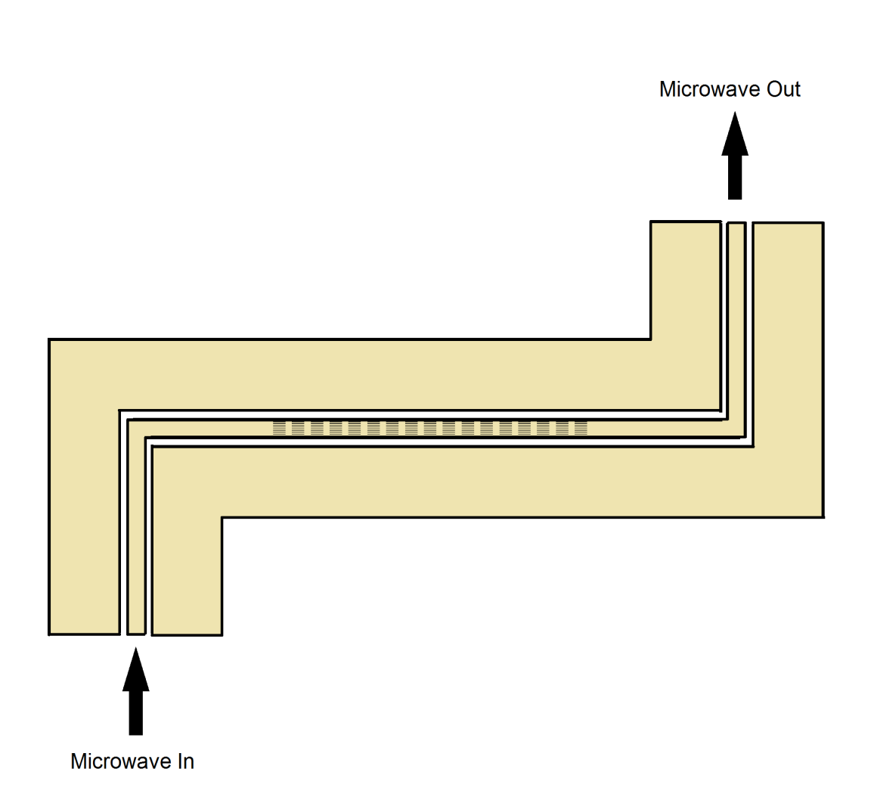
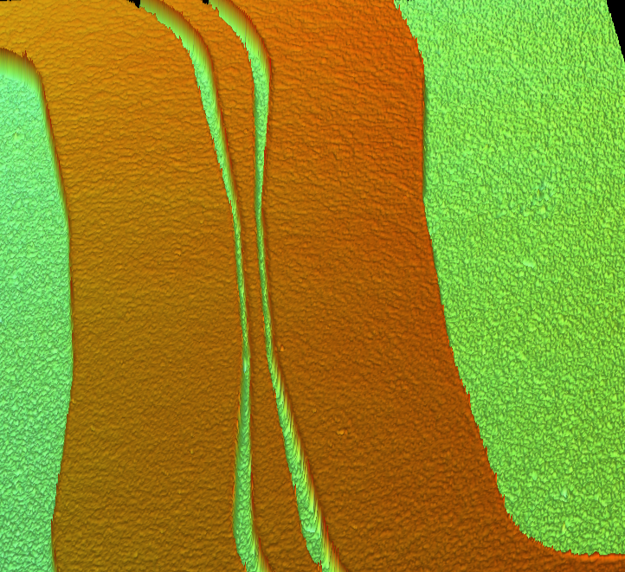
Microwave Properties of Magnetic Nanowire Arrays
D. Adams, S. Khanal, L. Spinu
Advanced Materials Research Institute, University of New Orleans, New Orleans, LA 70148
Abstract
E-Beam Lithography
Microwave technology has various applications in wireless systems such as communication, radar, remote sensing, security, and satellite. Microwave applications continue to grow with the rising developments of microwave integrated circuits and high-frequency devices.
In this study we focus on studying the high frequency properties of various sets of magnetic nanowire arrays of different sizes and orientations. The microwave magnetic field is produced by a Vector Network Analyzer (VNA) in the (1 GHz, 40 GHz) frequency range and transmitted by using coplanar waveguides (CPW). The coplanar waveguides we use for our investigations are 300 µm long with a signal line width of 20 µm. This particular CPW configuration ensures minimum losses due to radiation. Micron-scale coplanar waveguides are fabricated through the photolithography process in AMRI’s clean room. The sets of magnetic nanowires are fabricated by e-beam lithography.
The microwave properties of the samples are investigated by broadband ferromagnetic resonance experiments carried out at room temperature.
Electron beam lithography uses a focused electron beam to etch a pattern into PMMA used as a resist. Material can then be deposited and substrate is washed in a similar way to photolithography.
AFM image of permalloy nanowires planted on Si substrate
In this experiment, nanowires were planted by e-beam onto a Si substrate to optimize parameters first.
Microwave Technology
CPW Design
Microwaves are electromagnetic radiation with wavelengths between one meter and one millimeter and frequencies between 0.3GHz to 300GHz.
Silicon substrate is coated with photoresist and exposed to UV radiation through a mask with the desired pattern.
This must be done in a clean room to minimize dust exposure. Dust particles are larger than the width of the CPW, so it will easily contaminate the experiment.
Photoresist is developed in the clean room until desired pattern appears.
It is important to carefully select the width of the central line as well as the spacing between the central line and ground planes so that impedance can be predicted and accounted for.
Conducting material such as copper can now be deposited. Substrate is bathed in a remover to lift off surrounding copper, leaving only the CPWs.
X-band FMR results for the permalloy nanowires
The next step will be to plant nanowires on the transmission line of a CPW to further study the microwave properties of nanostructured materials.
http://lasp.colorado.edu/cassini/education/Electromagnetic%20Spectrum.htm
http://www.techulator.com/resources/6120-How-does-mobile-communication-work.aspx
Mobile communication involves voice conversion to analog and then to digital form which is sent from one tower to another through microwave signals.
Ground planes
DBS signals are sent at microwave frequency and converted to an output that can be viewed on a television
Profilometer images of CPW patterns
http://2012books.lardbucket.org/books/mass-communication-media-and-culture/s12-04-influence-of-new-technologies.html
10 μm gap between central line and ground plane at center of CPW
Objectives
Incorporate nanowires into microwave devices
Measure microwave properties of the nanowires
Width of central line is 20 μm at center
Transmission line
Sets of permalloy nanowires
Methods and examples of integrating nanowires with microwave devices:
Nanowire configurations with microwave transmission devices
References
Dorin Cimpoesu, Junjia Ding, Laurentiu Stoleriu, Adekunle Adeyeye, Alexandru Stancu, and Leonard Spinu. Appl. Phys. Lett. 102, 232401 (2013);
Acknowledgments
This work was supported by the National Science Foundation, through Grant No. ECCS-1028547 and the LASiGMA program under Award No. EPS-1003897 with additional support from the Louisiana Board of Regents.

